Slide 1

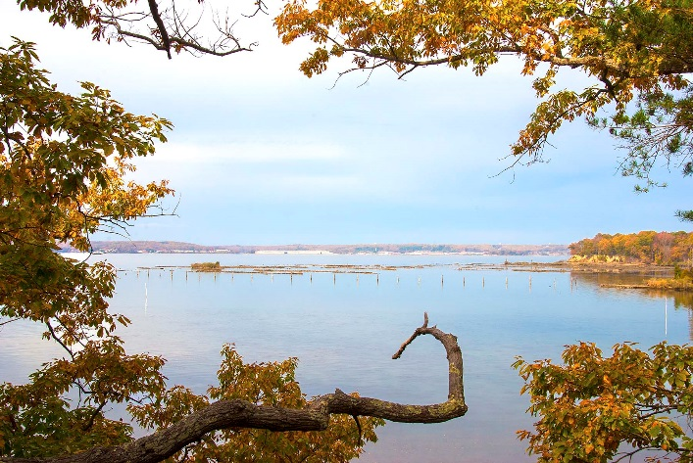

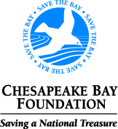

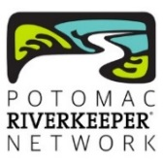
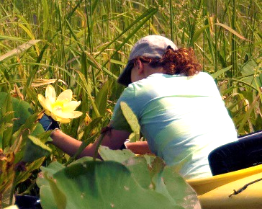
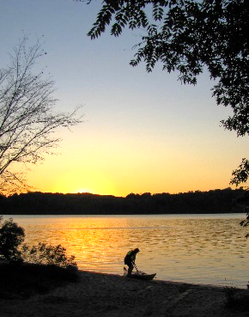
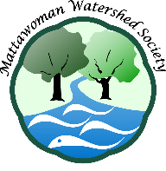
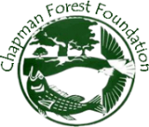

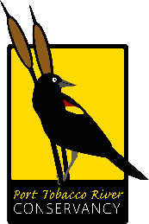
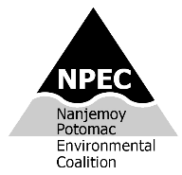

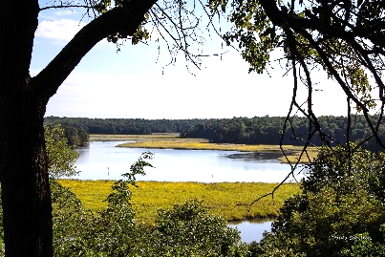

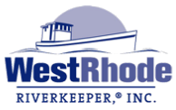


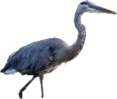
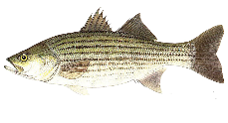


Mallows Bay-Potomac River
National Marine Sanctuary
The system of National Marine Sanctuaries presently comprises 14 systems ranging in size from one to thousands of square miles. The sanctuaries are administered by the National Oceanic and Atmospheric Administration (NOAA) in partnership with local, state, and nonprofit agencies.
Hard work by a dedicated team successfully nominated the Mallows Bay-Potomac River sanctuary, focused around the largest ship-wreck fleet in the western hemisphere. Mallows-Potomac will be the 1st sanctuary in 20 years, the 1st in the Chesapeake Bay, and the 1st in a tidal river.
The nomination has gone through a scoping stage, when the public commented on the proposal. The next step is hearings and public comment on a draft Environmental Impact Statement.
Note: the nomination endorses fishing.
More inclusive boundaries
During scoping, a number of groups and individuals expressed a desire for expanded boundaries to enhance the goals of promoting fishing, recreation, education, research, and tourism. The public will have a chance to comment again once the draft Environmental Impact Statement is released.
Sanctuaries are NOAA Sentinel Sites
“National marine sanctuaries are where monitoring and research take place to enhance our understanding of natural and historical resources and how they are changing… In that sense they are what we call "sentinel sites" and are focal points for both the scientific and resource management communities.”*
Extended boundaries will greatly enhance the sanctuary’s value as a sentinel. It will contain the transition from brackish water to tidal freshwater, a rich ecosystem where, e.g., striped bass produce the 2nd highest number of eggs in the Chesapeake Bay. The sanctuary would be uniquely suited to monitor ecosystem response to shifts in brackish boundaries and marsh flooding expected with sea-level rise. Further, sub-watersheds range from Nanjemoy’s forested “reference” to Mattawoman’s, where warning signs of urbanization are seen as a faltering of its famous anadromous fish nursery.
Mallows Bay-Potomac River
National Marine Sanctuary
The benefits of inclusive boundaries
* http://sanctuaries.noaa.gov/science/sentinel-site-program
Mallows Bay
Mattawoman Creek
Port Tobacco R
Potomac
River Assoc
Nanjemoy Creek
www.mattawomanwatershedsociety.org
Photos: Paula Schiller, Jim Long

Slide 2

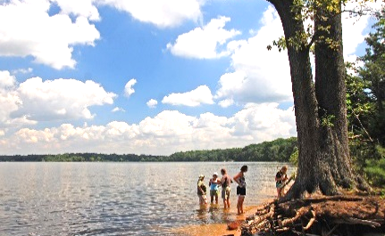
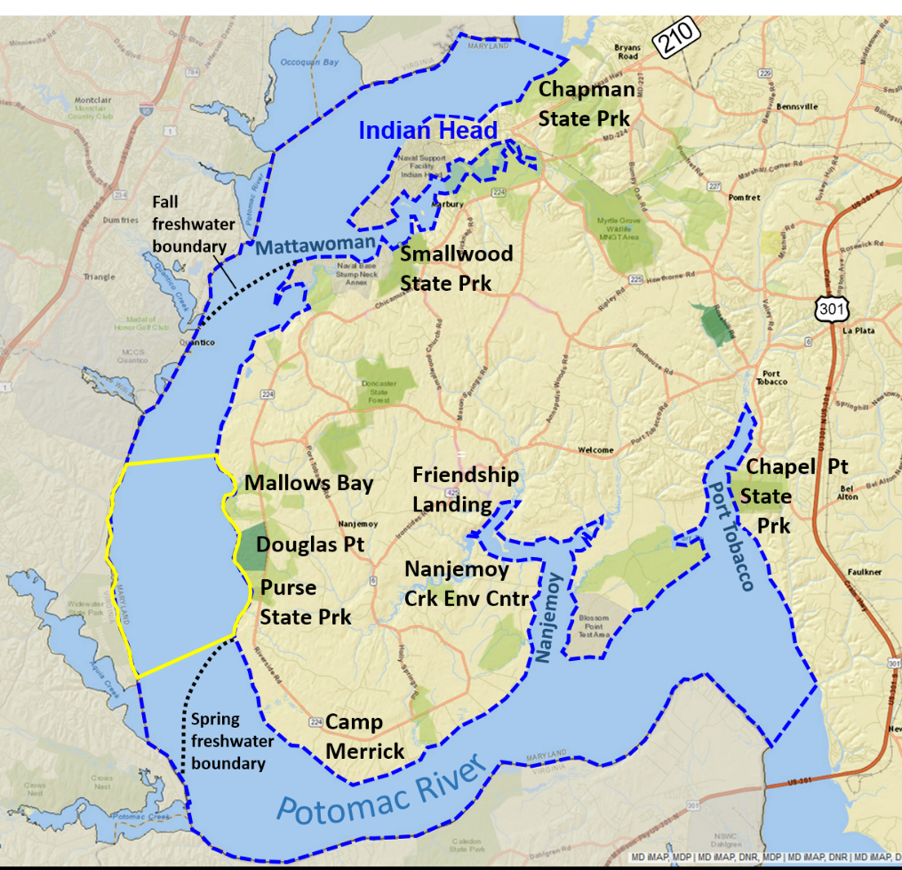
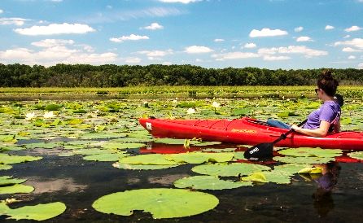
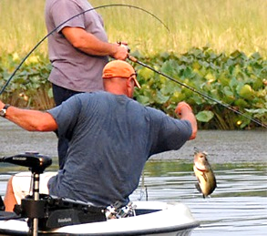
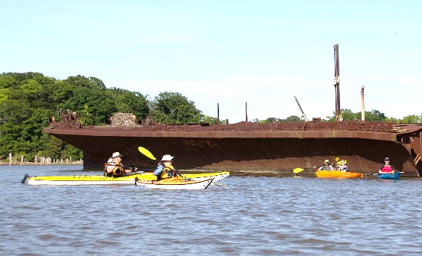
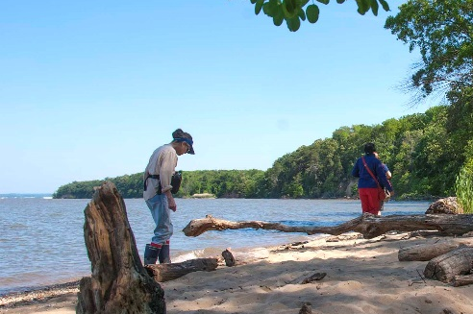
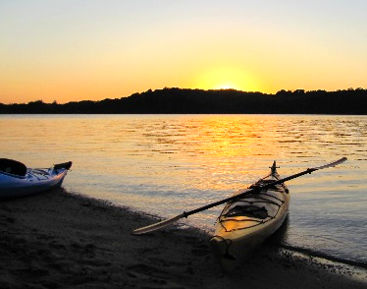
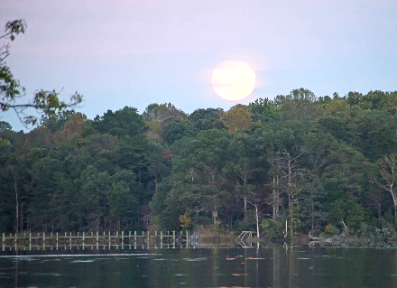
A National Marine Sanctuary on the Nation’s River
“A National Marine Sanctuary contributes to building a stronger, more resilient future for America's communities, ecosystems and economy. It is a place of inspiration. Within its waters and along its shores, you can find vibrant tapestries of marine life and ancient mysteries of our past.” *
The boundaries we’ve heard suggested for the Mallows Bay-Potomac River Sanctuary, below, would increase it from the 2nd to only the 4th smallest of all sanctuaries.
Chapman State Park
Expanded area is perfectly suited for:
Education
-Leverage many ongoing programs
Heritage & nature tourism
-Example: 1st ‘aircraft carrier’ launched spy
balloons from barge off Mattawoman in Civil
War
-Revitalize Indian Head through tourism &
a visitor center to relieve rural Mallows
Bay of crowding pressure
-Trails: John Smith; Potomac Heritage; Star
Spangled Banner; Religious Freedom Byway
-Extensive tidal-freshwater marshes;
‘Breadbasket marshes’ & lotus in Mattawoman
-Ghost fleet of Mallows Bay (of course!)
Research
-Baseline fisheries research in hand, esp. for
Mattawoman & in Potomac seine surveys
-Tidal freshwater globally uncommon, and
where many migratory marine species spawn
-Hotspot for spawning by striped bass & other
migratory-fish
-Sensitive laboratory for predicted saltwater
shifts, sea-level rise
-Nanjemoy a forested reference
-Ideal sentinel site (see back)
Historic
shad fishery
Mattawoman Creek
New proposed boundary
Charles County
Present proposed boundary
Mallows Bay
Purse State Park
Nanjemoy Creek
Port Tobacco River
www.mattawomanwatershedsociety.org
*http://sanctuaries.noaa.gov/about/

