Slide 1
COVID-19 Guidance for Charles County
Maryland Department of Health
Charles County Health Department
14 September 2020

Slide 2
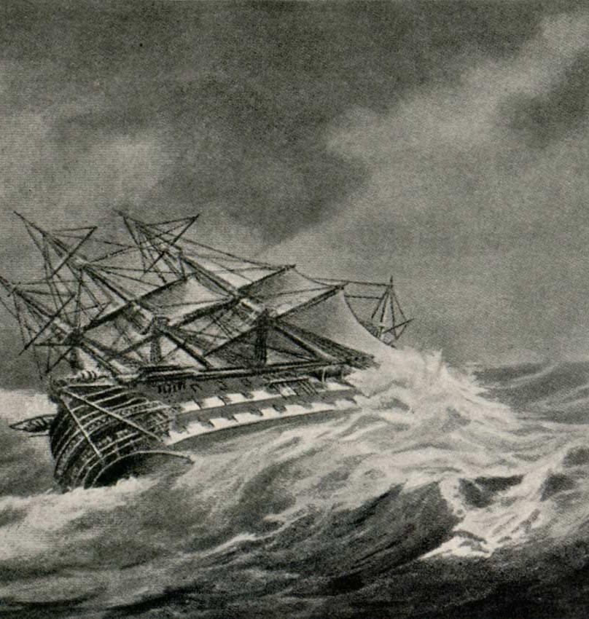
Resilience
“And once the storm is over, you won’t remember how you made it through, how you managed to survive. You won’t even be sure whether the storm is really over. But one thing is certain. When you come out of the storm, you won’t be the same person who walked in. That’s what this storm’s all about.”―Haruki Murakami

Slide 3
Housekeeping
Questions in chat box- answered at the end, please be succinct
Resources links in the appendix
Presentation will be emailed to all registered participants, recording will be posted
Moving to new day and time next week-
Mondays at 5:30 PM

Slide 4
Agenda
COVID-19 Business Guidance
Phase 2 Recovery- What’s Important Now
  Keep Vulnerable people safe
  Data on Covid-19- Global, National, State and Charles County
  Testing
  Contact Tracing
  Vaccines, Medications and the future
Seeking volunteers for Medical Reserve Corps
Closing comments
Questions
Resources- links

Slide 5

The basic and essential plan to safely get through the pandemic
Businesses that will keep their employees and customers safe
Neighbors who will keep their neighbors safe
High risk public will stay out of harm’s way
Hand Hygiene-Face coverings- Social distancing- Screen and Test
Safer at Home

Slide 6
Harm Reduction for
Vulnerable Populations
People over the age of 60
People with significant underlying medical conditions- hypertension, COPD, diabetes, obesity
People with immune compromise (cancer therapy, etc)
Pregnant women
Stay away from high risk environments
Businesses create safe zones and times

Slide 7
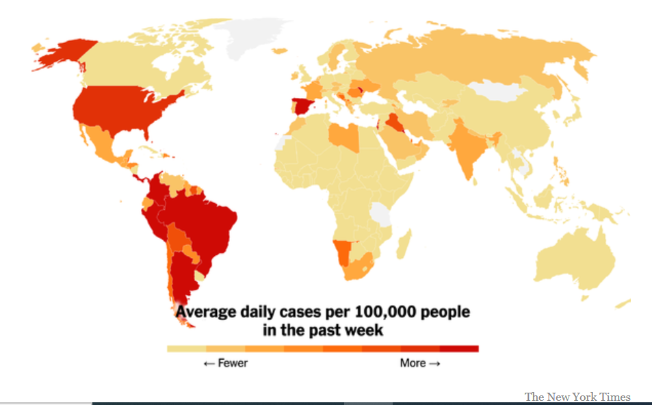


Morbidity and Mortality Update
Cases
Deaths
Source: MDH, CDC, New York Times

Slide 8
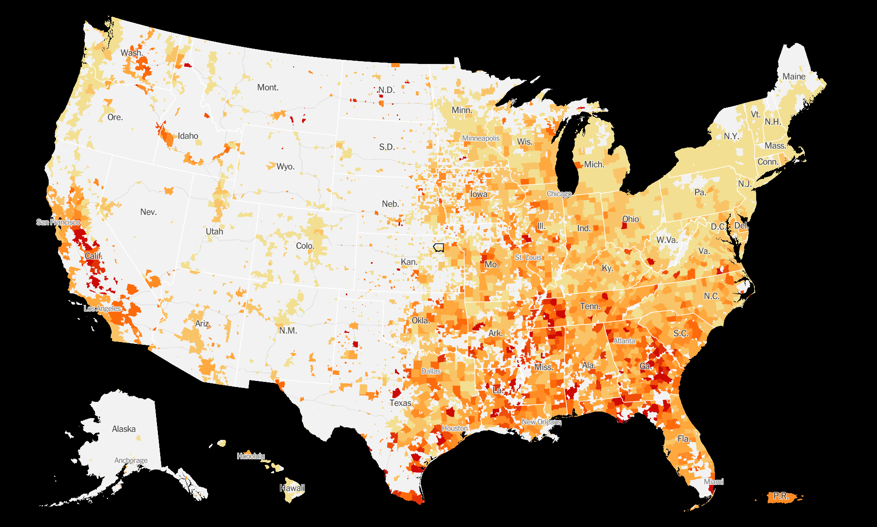
COVID-19 Outbreak US Hotspots
Source: New York Times

Slide 9
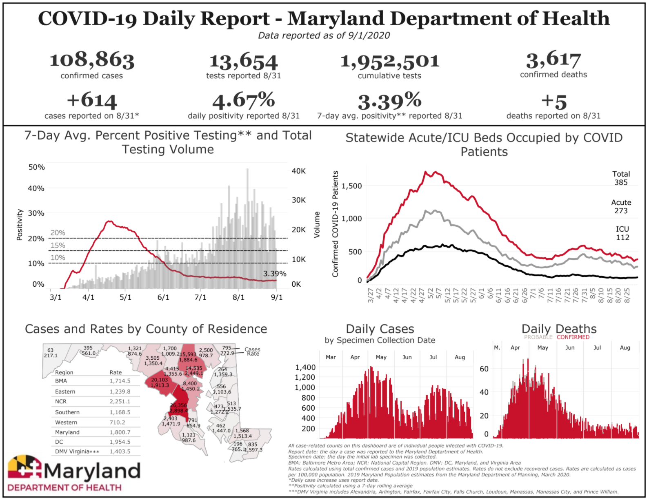

Slide 10
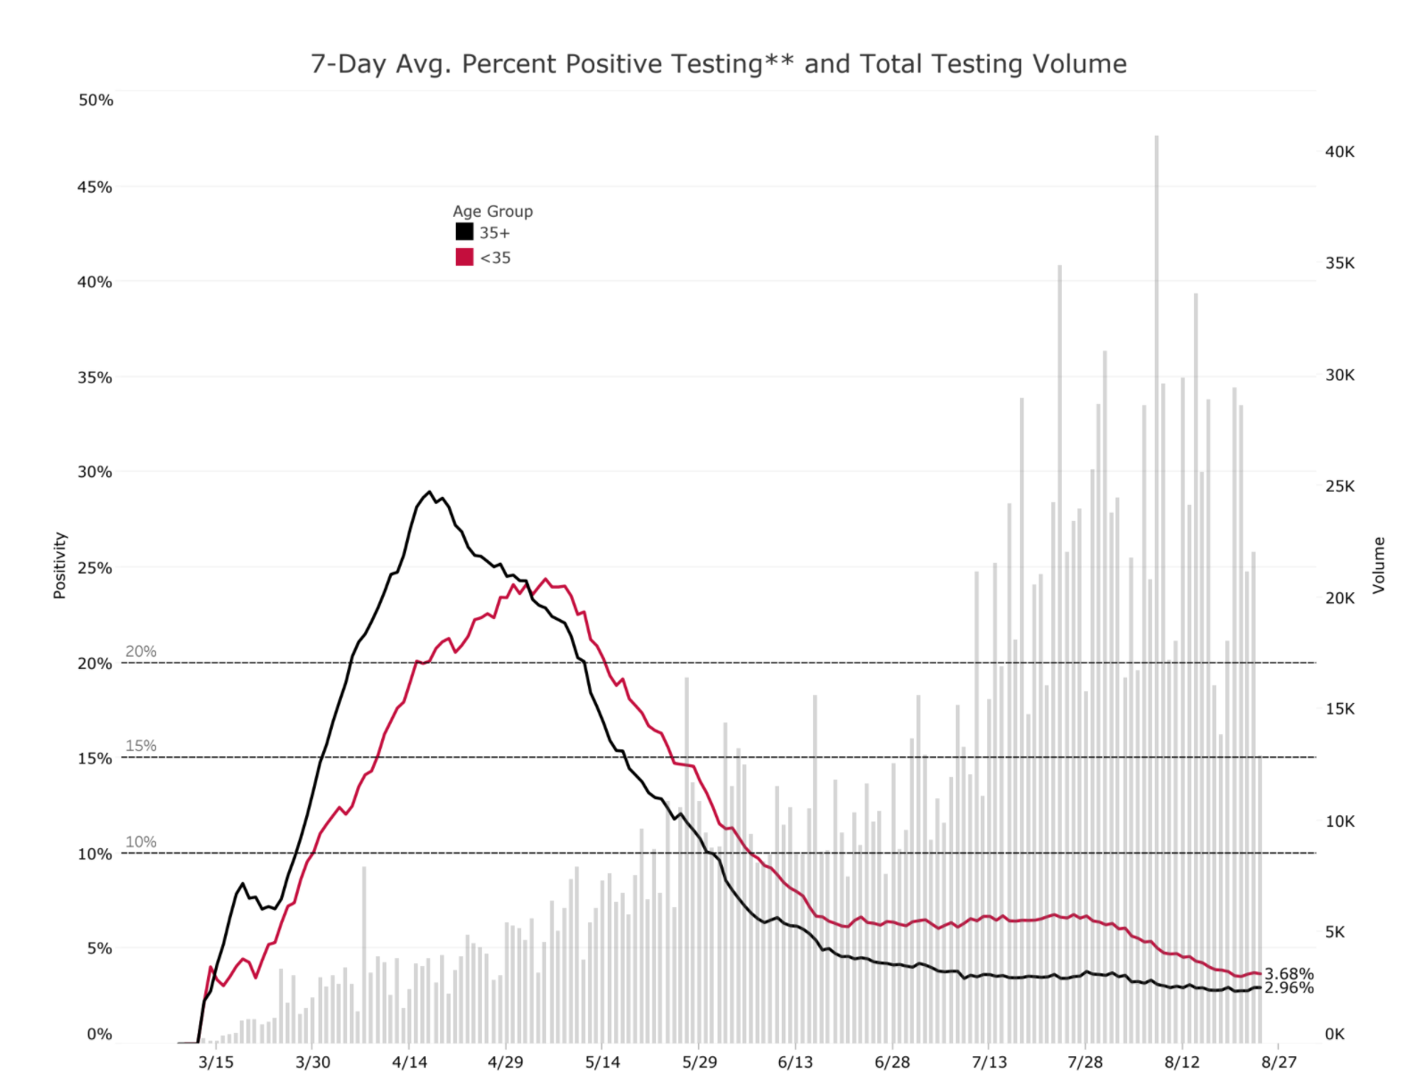
Maryland Daily Positivity Rate
Source: MDH
Updated 8/25

Slide 11
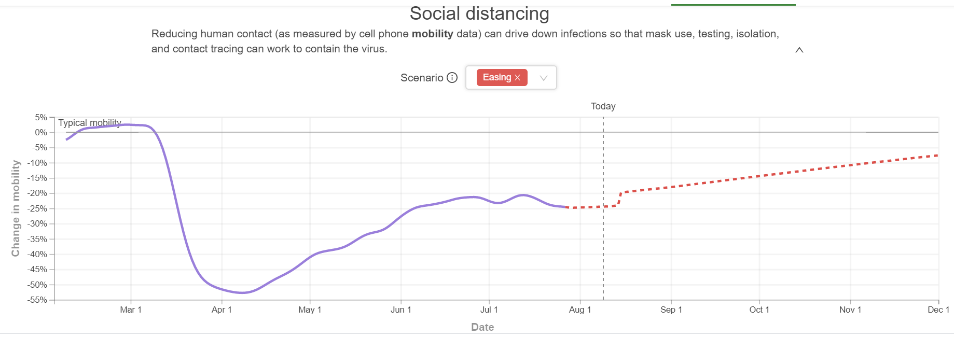
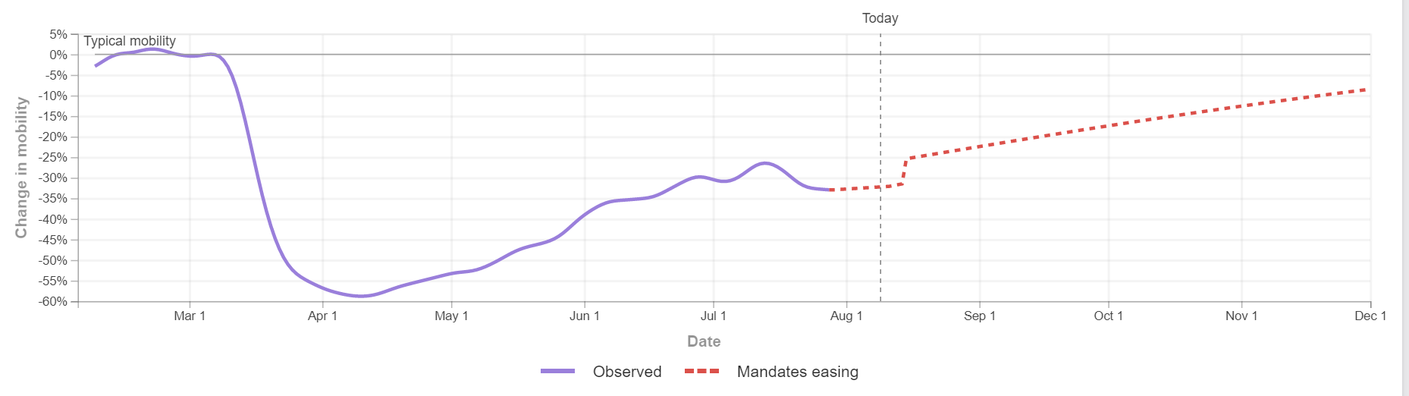
Social Distancing

Slide 12
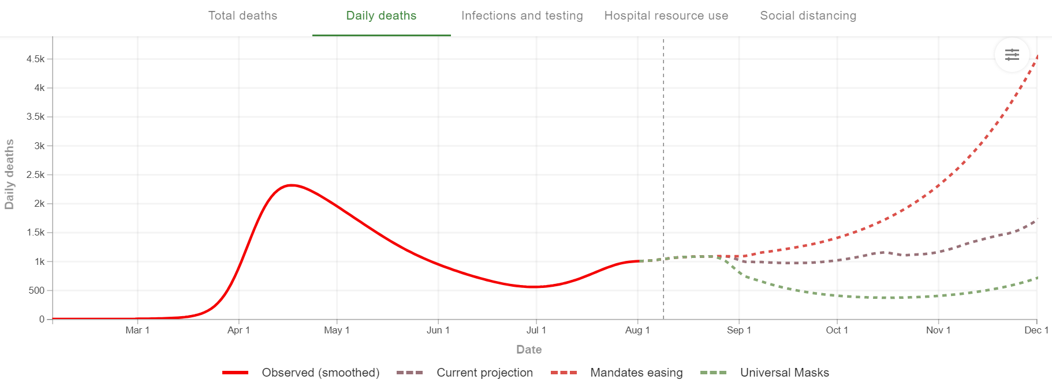
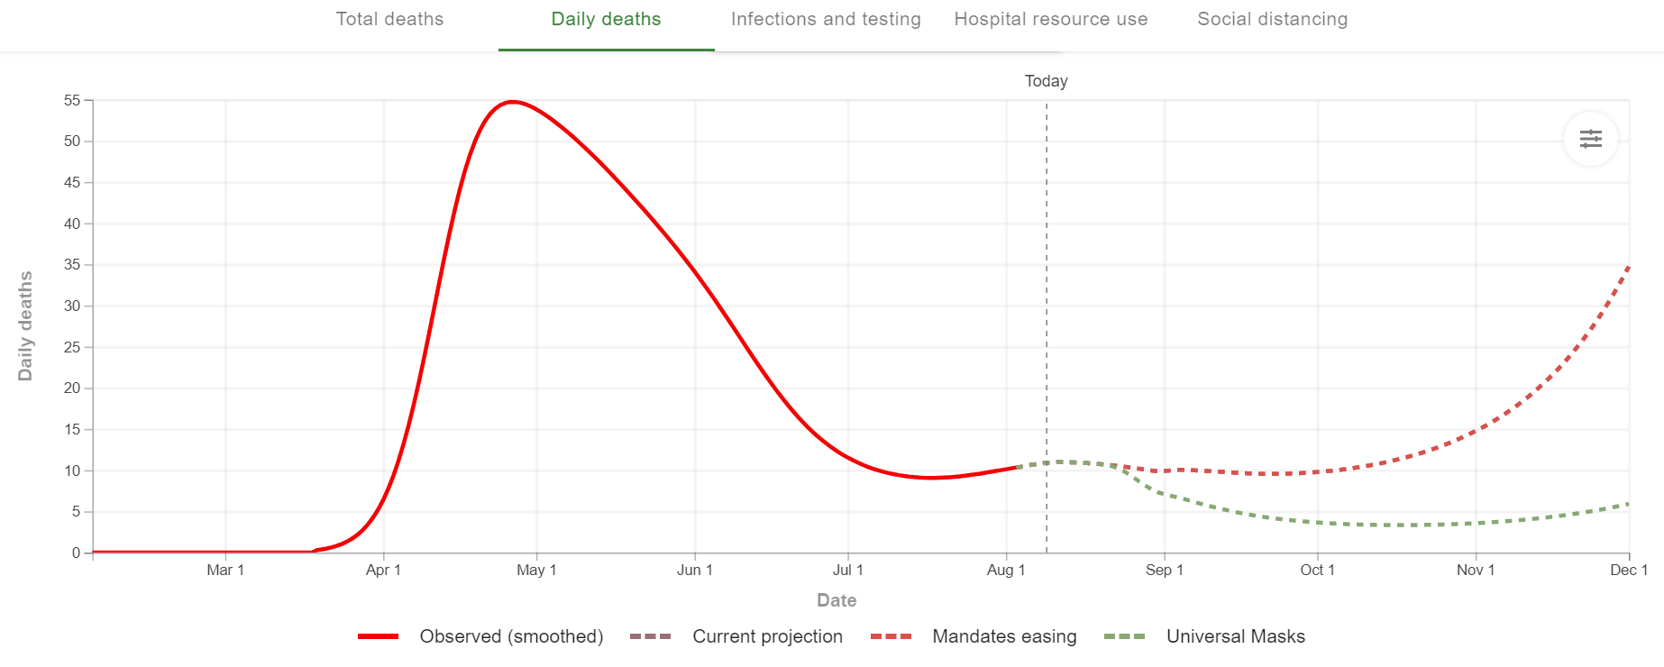
Daily Deaths

Slide 13
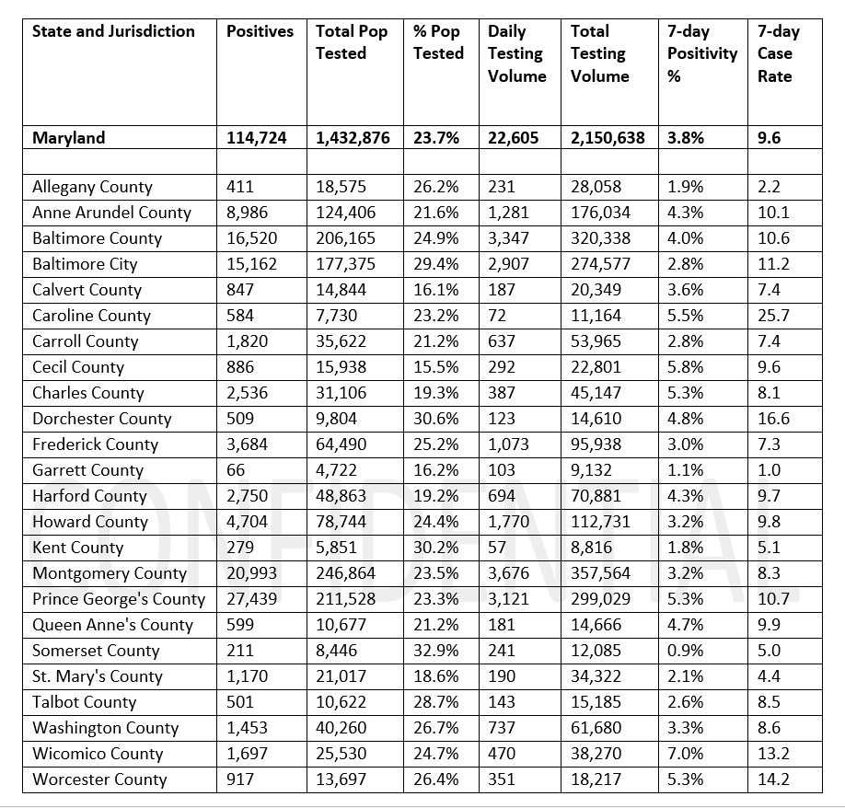
Maryland Testing and Positivity by County
7 day Positivity
6.9%
USA
Source: MDH; Johns Hopkins
Updated 8/25

Slide 14
Draft Covid Immunization plan
States Informed to have a plan for late October, early November
Vaccine type A store at -20C, two doses, Moderna, mRNA
Vaccine type B store at -70C, two doses. Pfizer, mRNA
Have broad infrastructure
Prioritize to highest risk- tbd
Source: https://www.cnbc.com/2020/08/28/cdc-director-says-there-will-likely-be-a-limited-supply-of-coronavirus-vaccines.html; Axios/KFF column
Notes:
next week - talk through what herd immunity is

Slide 15
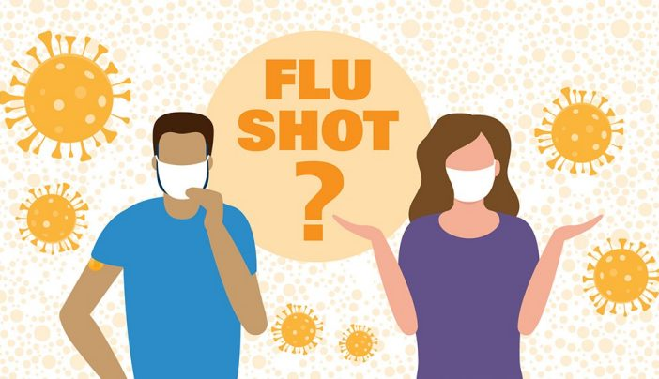
Flu Vaccine
As flu season approaches, flu vaccines will be especially important this year:
  Keeps people out of the hospital, ED, and ICU
  Respiratory illness like the flu can be mistaken for COVID-19, can strain testing capacity
CDC guidance on flu vaccines during COVID
  Flu vaccine recommended for all >6 months old without contraindications, emphasis on high risk groups
  Timing: Aim for September – October
  Patient FAQ Link
The good news: COVID-19 precautions (distancing, hand hygiene, masks) also prevent spread of the flu
Flu vaccines are more critical this year. Encourage your patients to get a flu vaccine.
Source: https://www.cdc.gov/flu/professionals/acip/summary/summary-recommendations.htm; https://www.baltimoresun.com/coronavirus/bs-hs-flu-coronavirus-20200825-hba46ik7xragzm2zajmmkljoam-story.html; https://www.cdc.gov/flu/season/faq-flu-season-2020-2021.htm
Notes:
next week - talk through what herd immunity is

Slide 16
Weekly Summary of New COVID+ (Positive) & COVID Deaths

Slide 17
Weekly Summary of Negative Tests

Slide 18
County Weekly COVID Positivity Percentage(average)

Slide 19
CRMC COVID+ Patients per week (average)

Slide 20
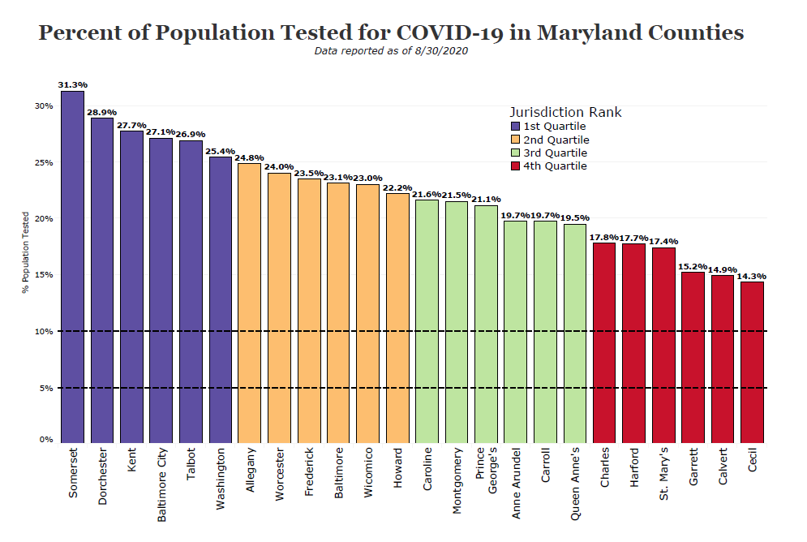

Slide 21
Why Test?
To know who are the asymptomatic carriers
  So that they will not unknowingly infect others
To know who are the pre-symptomatic carriers
  So that they will not infect others
To know if you are not infected after travel
To know if you are not infected after exposure
To know if your employees are infected
For peace of mind
This is the only way we can stop the spread of this virus

Slide 22
Testing is Easy, Painless and Free
Self administered nasal swabs
  Easy
  Painless
  Free to you
Drive through at VEIP
  With or without provider orders
Drive through at pharmacy
Go to your doctor’s office
https://coronavirus.maryland.gov/pages/symptoms-testing

Slide 23
Contact Tracing to Limit the Spread of Virus
If positive test expect a call
Provide as much information as possible
Self isolate with household members
Support as needed- contact Health Department

Slide 24
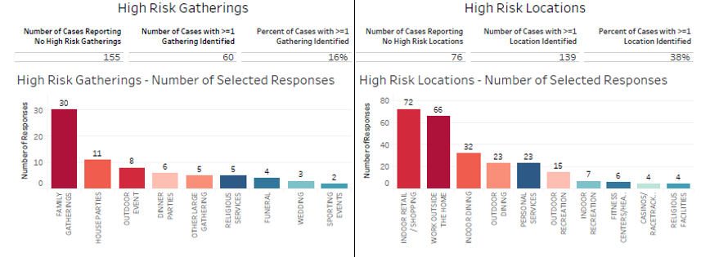
High Risk Gatherings and Locations

Slide 25
CDC Update: Isolation Guidelines
Need to self-quarantine > everyone who has been in close contact with someone who has COVID-19
(Includes people who’ve had COVID-19 and those who’ve taken an antibody test and have antibodies to the virus)
Close contact means:
  Being within 6 ft for at least 15 mins of someone who has COVID-19
  You cared for someone sick with COVID-19
  You touched, hugged or kissed the infected person
  You shared eating or drinking utensils
  They sneezed, coughed or somehow got respiratory droplets on you
Do:
  Stay home for 14 days after your last contact with a COVID-19-infected person
  Watch for fever, cough, shortness of breath, or other symptoms of COVID-19
  If possible, stay away from others, especially people at higher risk of getting sick from COVID-19
Additional CDC information: Duration of Isolation and Precautions for Adults with COVID-19

Slide 26
Release from Isolation
Duration of isolation and precautions
  For most persons with COVID-19 illness, isolation and precautions can generally be discontinued 10 days after symptom onset¹ and resolution of fever for at least 24 hours, without the use of fever-reducing medications, and with improvement of other symptoms.
  For persons who never develop symptoms, isolation and other precautions can be discontinued 10 days after the date of their first positive RT-PCR test for SARS-CoV-2 RNA.
Role of PCR testing² to discontinue isolation or precautions
  Is no longer recommended except to discontinue isolation or precautions earlier than would occur under the strategy outlined in Part 1, above.
Role of serologic testing
  Serologic testing should not be used to establish the presence or absence of SARS-CoV-2 infection or reinfection.

Slide 27

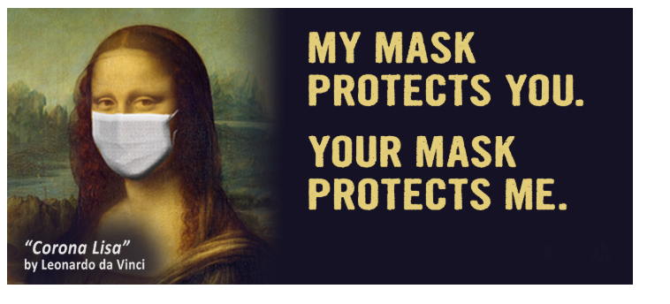

Slide 28
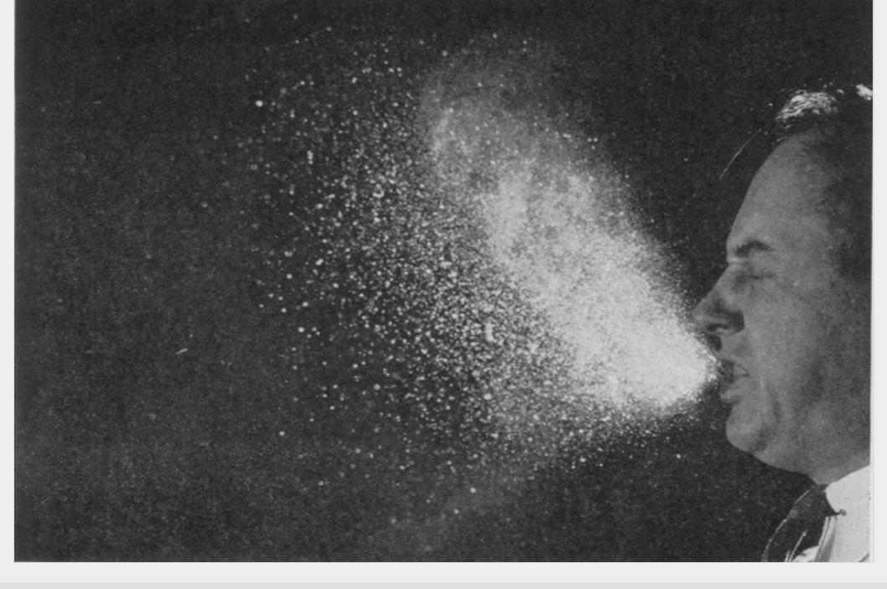
Facemasks- Required and Essential
Retail Establishments
Public Transportation
Food Service Facilities
Alcohol Manufacturer/Sales - Outdoor Dining
Personal Services (Salons, Tanning, Tattoos, Massage Parlors)
Indoor & Outdoor Sport Activities (when feasible)
Youth Camps (when feasible)
Swimming Pools (when possible)
New updates from CDC- on Face Shields
https://www.cdc.gov/coronavirus/2019-ncov/prevent-getting-sick/cloth-face-cover-guidance.html

Slide 29
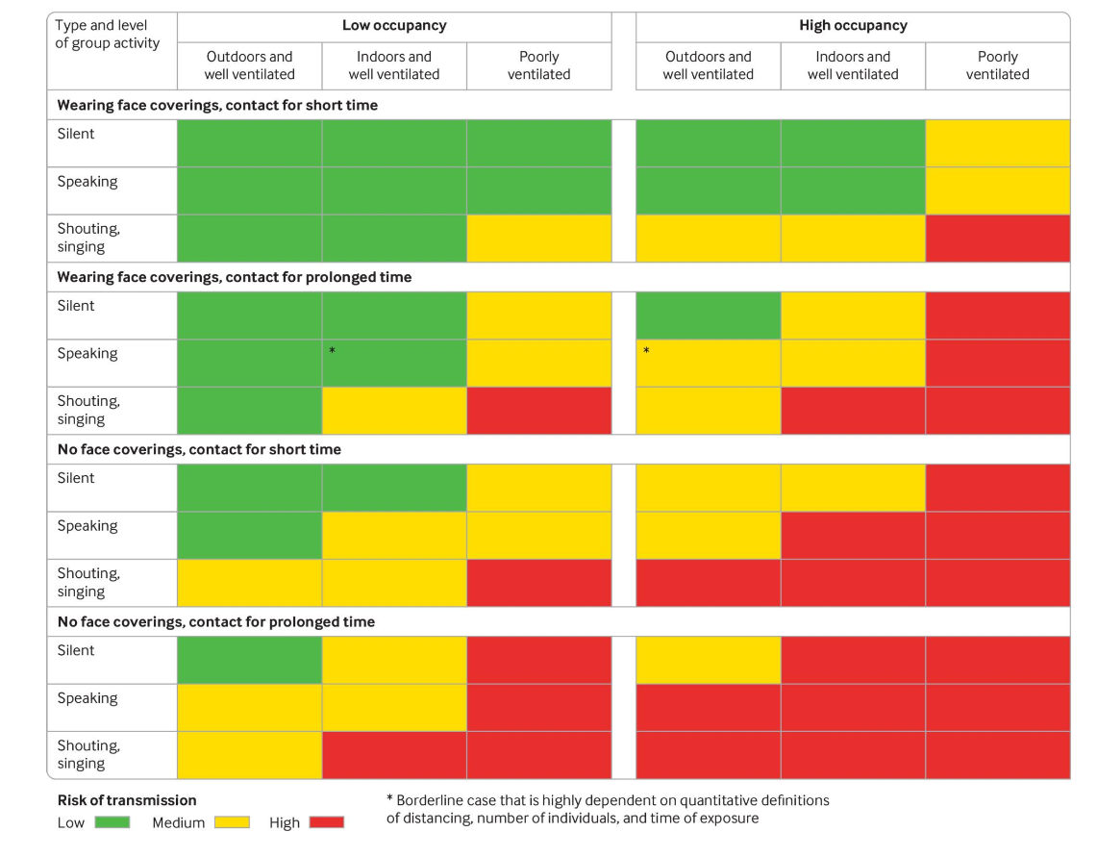

Slide 30

Gating Benchmark Metrics
“Stop Signs”
An unexpected increase in hospitalizations or a sustained increase in cases requiring intensive care; and sustained increase in cases over a period of five or more days
Increase in number of daily COVID deaths
Indications that Marylanders are disregarding physical
distancing guidelines
Significant outbreaks of community transmission where contact tracing cannot establish the route of the spread
13

Slide 31
Compliance is a Complaint Driven Process
Complaints from customers
Complaints from employees
Complaints from other sources
Leads to Health Department on site education
Health department order of immediate compliance
Health department order for closure
Enforcement by local and state police
Contact 301-609-6733 or 301-609-6751 for complaints
Covid Tip Line- 1-833-979-2266
prevent.covid@maryland.gov

Slide 32
What’s Important Now
(WIN)
Best Practices for businesses
Best Practices for employees
Testing for Covid-19
Social Distancing
Facial Covering
Hand hygiene and surface cleaning
Patience
We can get through by supporting one another

Slide 33
Helpful Links
Social Gathering FAQs
Face Covering Exemptions & FAQs
Best Practice Documents for Several Businesses
MDH Secretary Orders
Governor's Executive Orders

Slide 34
Questions and Resources
Resources in following slides
  PPE sources
  Religious organization guidance
  Return to work guidance
  Links to CDC and Maryland business specific guidance
  Environmental cleaning
Write questions in chat box
https://www.charlescountymd.gov/government/other-agencies/charles-county-department-of-health-covid-19-updates
**The next webinar will be held on Monday, September 14 , 2020

Slide 35
Resources and References
Maryland Coronavirus (https://coronavirus.maryland.gov/)
CDC Coronavirus Website (https://www.cdc.gov/coronavirus/2019-nCoV/index.html)
CDC Guidance:
  Interim Guidance for Businesses and Employers Responding to Coronavirus Disease 2019 (COVID-19), May 2020 (https://www.cdc.gov/coronavirus/2019-ncov/community/guidance-business-response.html)
  Prepare your Small Business and Employees for the Effects of COVID-19 (https://www.cdc.gov/coronavirus/2019-ncov/community/guidance-small-business.html)

Slide 36
Resources and References
COVID-19 Response
Back to Business in Maryland- Safety Best Practices
  General Business Best Practices (https://commerce.maryland.gov/Documents/BusinessResource/General-Business-COVID-19-Best-Practices.pdf)
  Manufacturing (https://commerce.maryland.gov/Documents/BusinessResource/Manufacturing-COVID-19-Best-Practices.pdf)
  Personal Services (https://commerce.maryland.gov/Documents/BusinessResource/Personal-Services-COVID-19-Best-Practices.pdf)
  Visit (https://open.maryland.gov/backtobusiness/) for additional guidance for retail, golf and marinas
FDA Best Practices for Re-opening Retail Food Establishment (https://bit.ly/3dUYWrI )
Maryland Higher Education https://mhec.maryland.gov
OSHA
  Additional resources (https://www.osha.gov/SLTC/covid-19/additional_resources.html)

Slide 37
Resources and References
Faith Based Community recommendations: https://goci.maryland.gov/wp-content/uploads/sites/2/2020/05/Faith-Based-Recommendations.pdf
State & Charles County Emergency Vendors Link: https://tinyurl.com/y83zpv83

Slide 38
Personal Protective Equipment (PPE) Sources and Requests
Routed through Local Health Departments
Priority as previously stated - may change over time
Maryland PPE Manufacturers List
National and International PPE Supplier List
PPE request forms and local contacts

Slide 39
State Launches Maryland PPE Network Supplier Portal
Increasing Maryland’s supply of PPE – one of the 4 building blocks on the Road to Recovery
Maryland has launched the Maryland Manufacturing Network Supplier Portal, an online platform that helps connect Maryland suppliers with buyers in need of critical resources
Large daily deliveries come into the state’s warehouses
For additional business resources during COVID-19, visit businessexpress.maryland.gov/coronavirus

Slide 40
Maryland Companies Producing Personal Protective Equipment in Response to COVID-19
Grant Recipient | County | Typical Production | COVID-19 Production
Awesome Ninja Labs | Baltimore City | Medical devices | Face shields
CoastTec | Carroll | Battery back-ups for computers | Battery packs for Vyaire ventilators
CR Daniels | Howard | Textile, plastics, and metal manufacturing | Face masks and gowns
DiPole Materials | Baltimore City | Custom nanofiber manufacturing | Filters for medical masks and respirators
DVF Corporation | Washington | Metal and plastic fabrications | Plastic components of respirators
Fashions Unlimited | Baltimore City | Apparel manufacturing | Surgical masks and protective gowns
Fabrication Events | Howard | Special event decor | Face masks, head coverings, and other PPE
Harbor Designs | Baltimore City | Manufacturing design and engineering | Ventilators
Hardwire, LLC | Worcester | Bulletproof body armor and equipment for law enforcement and the military | Face shields
K&W Finishing | Baltimore City | Traditional die cutting, coating, and other bindery services | Face shields
Grant Recipient | County | Typical Production | COVID-19 Production
Key Technologies | Baltimore City | Medical devices | Blower units for positive air pressure respirators
LAI International | Carroll | Components for aerospace and defense, medical devices and infrastructure systems | Face shields
Manta BioFuels | Baltimore County | Energy technology | Face shields
Marty’s Bag Works | Anne Arundel | Canvas boating products, cushions, laser printing, and bags | Surgical masks, face shields, and lightweight gowns
Nations Photo Lab | Baltimore County | Full-service photo printing | Face shields
NRL & Associates | Queen Anne’s | Ultra-precision machining, fabrication, and assembly | Ventilators
Potomac Photonics | Baltimore County | Biotech and medical devices | PPE visors
Rankin Upholstery | Montgomery | Auto, marine, aircraft and custom upholstery | Masks, gowns, and other PPE
Strouse | Carroll | Adhesive solutions | N-95 masks
X-Laser | Howard | Laser light show systems | Face shields

Slide 41
Employer and Health Care Provider Guidance on Return to Work

Slide 42
Employee Return to Work – Confirmed or Suspected COVID-19
COVID-19 Employer and Provider Guidance
1. Employee has suspected COVID-19 (suspected means the employee has symptoms* but has not been tested), or has symptoms and has tested positive. *Symptoms include cough, shortness of breath or difficulty breathing, fever (subjective, or measured temperature of 100.4º F. or more), chills, muscle pain, sore throat, new loss of taste or smell, or gastrointestinal symptoms like nausea, vomiting, or diarrhea | Return to Work Based on Symptoms The employee may return to work when: At least 3 days (72 hours) have passed fever-free without the use of fever-reducing medications; AND Improvement in respiratory symptoms (e.g., cough, shortness of breath); AND, At least 10 days have passed since symptoms first appeared.
2. Employee has confirmed COVID-19 (has had a positive laboratory test), but has had no symptoms. | At least 10 days have passed since the date of the first positive COVID-19 diagnostic test, and the employee has not subsequently developed symptoms since their positive test. If symptoms develop, use Return to Work guidance in Category 1, above. Note, because symptoms cannot be used to gauge where these individuals are in the course of their illness, it is possible that the duration of viral shedding (infectiousness) could be longer or shorter than 10 days after their first positive test.

Slide 43
Employee Return to Work – Exposed Employee
COVID-19 Employer and Provider Guidance
3. Employee has no symptoms, but: has a household member; OR has an intimate partner; OR is providing care in a non-healthcare setting without using precautions to an individual… who has suspected or confirmed COVID-19. | Send employee home for a period of 14 days. If the employee develops no symptoms, the employee may return to work. If the employee develops symptoms, the employee may return to work after these three things have happened: There has been no fever for at least 72 hours (that is three full days of no fever without the use of medicine that reduces fevers); AND Other symptoms have improved (for example, when cough or shortness of breath have improved); AND At least 10 days have passed since symptoms first appeared.
4. Employee has been within 6 feet for longer than 15 minutes with someone who has suspected or confirmed COVID-19. | Send employee home for a period of 14 days. If the employee develops no symptoms, the employee may return to work (note: if employee is essential worker in a critical infrastructure sector business, employee may return to work as specified in Category 6). If the employee develops symptoms or is tested and confirmed to be COVID-19 positive, the employee may return to work under the conditions in as specified in Category 1 (if symptomatic), or Category 2 (if tested and found positive but has not developed symptoms).

Slide 44
Employee Return to Work – Unexposed, Critical Infrastructure Workers
COVID-19 Employer and Provider Guidance
5. Employee has been in the same indoor environment (e.g., a classroom, a hospital waiting room) as a person with suspected or confirmed COVID-19 for longer than 15 minutes but does not meet the definition of close contact (within 6 feet). | No work restrictions. Employee should self-monitor for symptoms, fever. If symptoms develop, self-isolate and return to work as specified above, depending on whether employee has symptoms or is tested (see Category 1).
6. Employee has had close contact (6 feet or less for longer than 15 minutes) with someone who has suspected or confirmed COVID-19, AND is a Critical Infrastructure Employee | If possible, employee should be off for 14 days. If not possible, employee may return to work with the following conditions: Employer should measure the employee’s temperature and assess symptoms prior to them starting work. Ideally, temperature checks should happen before the individual enters the facility. As long as the employee doesn’t have a temperature or symptoms, they should self-monitor under the supervision of their employer’s occupational health program. The employee should wear a face mask at all times. Employee should maintain social distancing practices at all times. Regular cleaning and disinfection of work areas, especially “high-touch” areas.

Slide 45
Environmental Cleaning
EPA list of disinfectants registered for use against COVID-19 (SARS-CoV-2) available at: https://www.epa.gov/pesticide-registration/list-n-disinfectants-use-against-sars-cov-2
CDC interim guidance for cleaning in homes with suspected or confirmed COVID-19 https://www.cdc.gov/coronavirus/2019-ncov/community/home/cleaning-disinfection.html;
CDC interim guidance for cleaning community facilities with suspected or confirmed COVID-19 https://www.cdc.gov/coronavirus/2019-ncov/community/organizations/cleaning-disinfection.html

Slide 46
Maryland Strong: Roadmap to Recovery
Home page of Maryland Strong: Roadmap to Recovery: (https://governor.maryland.gov/recovery/)
Downloadable version of the Roadmap
Executive Order 20-05-13-01, Amending and Restating the Order Of May 6, 2020, Allowing Reopening of Certain Businesses and Facilities, Subject to Local Regulation: https://governor.maryland.gov/wp-content/uploads/2020/05/Gatherings-SIXTH-AMENDED-5.13.20.pdf

