Slide 1

Viral Syndrome Pandemic Triage Protocol
2020 MIEMSS Emergency Protocol
Just-In-Time Training
Matthew J. Levy, DO, MSc
Region III Medical Director, MIEMSS
Notes:
This brief just-in-time training is designed to familiarize you with emergency protocol for the triage of viral syndrome patients during the COVID-19 Pandemic.

Slide 2
Objectives
Be familiar with the COVID-19 Pandemic
Recognize the signs and symptoms of COVID-19
Review the MIEMSS Pandemic Triage Protocol
Be familiar with the documentation requirements
Notes:
Upon completion of this training you will:
Be familiar with the COVID-19 Pandemic,
Recognize the signs and symptoms of COVID-19,
Review the MIEMMS Pandemic Triage Protocol, and
Be familiar with the documentation requirements
Before we proceed, it’s highly encouraged for you to print out the protocol and patient instructions sheet to follow along with during this very brief training.

Slide 3
COVID-19 Overview
Viral illness
Originated in Wuhan, Hubei Province, China
Has become a global pandemic
Much more serious than the Flu
Easily spread through respiratory droplets
First documented case in Maryland 3/5/2020
Continued rise in cases locally and worldwide
States of Emergency have been declared at the local, state and federal levels
Need for more medical resources
Concern about the number of people who might require hospital and ICU resources.
Notes:
Covid-19 is a viral illness that originated in Wuhan City of the Hubei Province in China in December of 2019 and has since become a global pandemic.
Its much more serious than the flu and has a higher mortality rate.
The virus is easily spread from person-to-person through respiratory droplets that are produced when the infected person coughs or sneezes.
More cases are reported every day around the world and here in Maryland.
Unfortunately, we have seen a significant rise in cases since the original case March 5, 2020.
States of Emergency have been declared in our county, state and nation.
We anticipate the need for significantly higher EMS and healthcare resources as the number of patient’s with symptoms increases.
There is serious clinical concern regarding the number of people who might require hospitalization and ICU resources.

Slide 4
COVID-19 Signs and Symptoms
Fever, cough, congestion and shortness of breath, new body aches and in some cases diarrhea.
The most common symptoms are fever and cough.
These symptoms can begin anywhere between 2-14 days after exposure.
Around 80% will have mild to moderate illness.
In some cases COVID-19 causes pneumonia or life-threatening Acute Respiratory Distress Syndrome or ARDS.
mmhealth.org
Esicm.org
Notes:
Symptoms can include fever, cough, congestion and shortness of breath, new body aches and in some cases diarrhea.
The most common symptoms are fever and cough.
These symptoms can begin anywhere between 2-14 days after exposure.
Around 80% of those infected will have mild to moderate illness.
However in the remaining 20% they can have a complex clinical course of illness. In some cases COVID-19 can cause damage to the lungs and cause pneumonia or a life-threatening condition called Acute Respiratory Distress Syndrome or ARDS.

Slide 5
Identifying a COVID-19 Person Under Investigation (PUI)
Any patient with:
Fever,
- OR-
Shortness of Breath,
- OR-
Flu-like Symptoms
(Sore throat, or congestion, or cough, or new body aches, or diarrhea).
www.npr.org
Notes:
Any patient with
Fever,
- OR-
Shortness of Breath,
- OR-
Flu-like Symptoms
( including sore throat, or congestion, or cough, or new body aches, or diarrhea).
Should be considered a Person Under Investigation for COVID-19
Remember, the patient now only needs to have 1 of these symptoms to be considered a PUI. This is important, as the definition of a PUI is broader than the definition of who is eligible to for the non-transport option of the protocol which you will see in the coming slides.

Slide 6
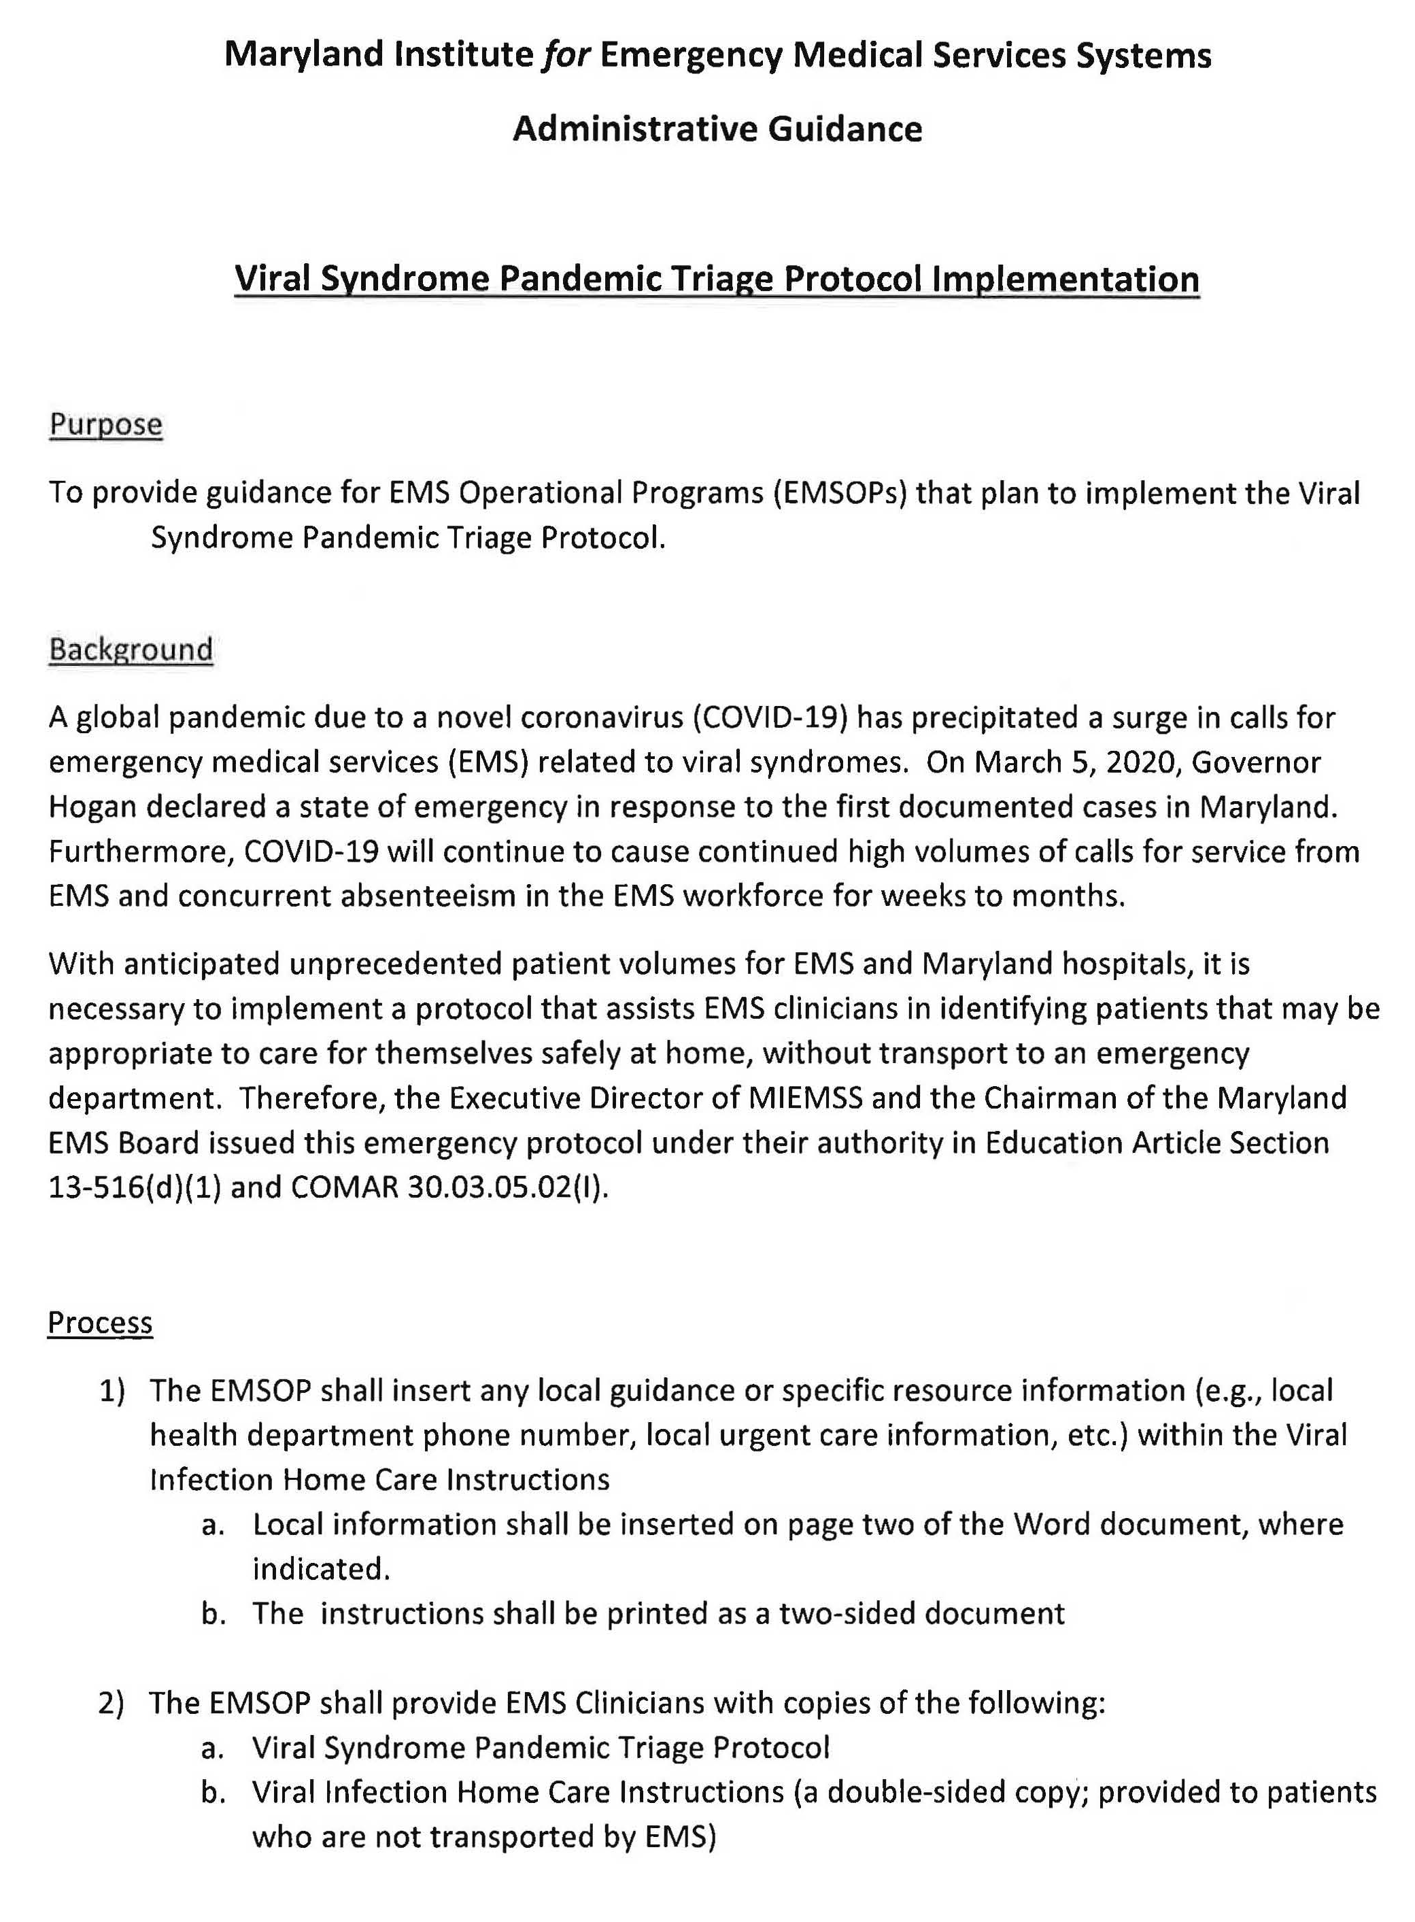
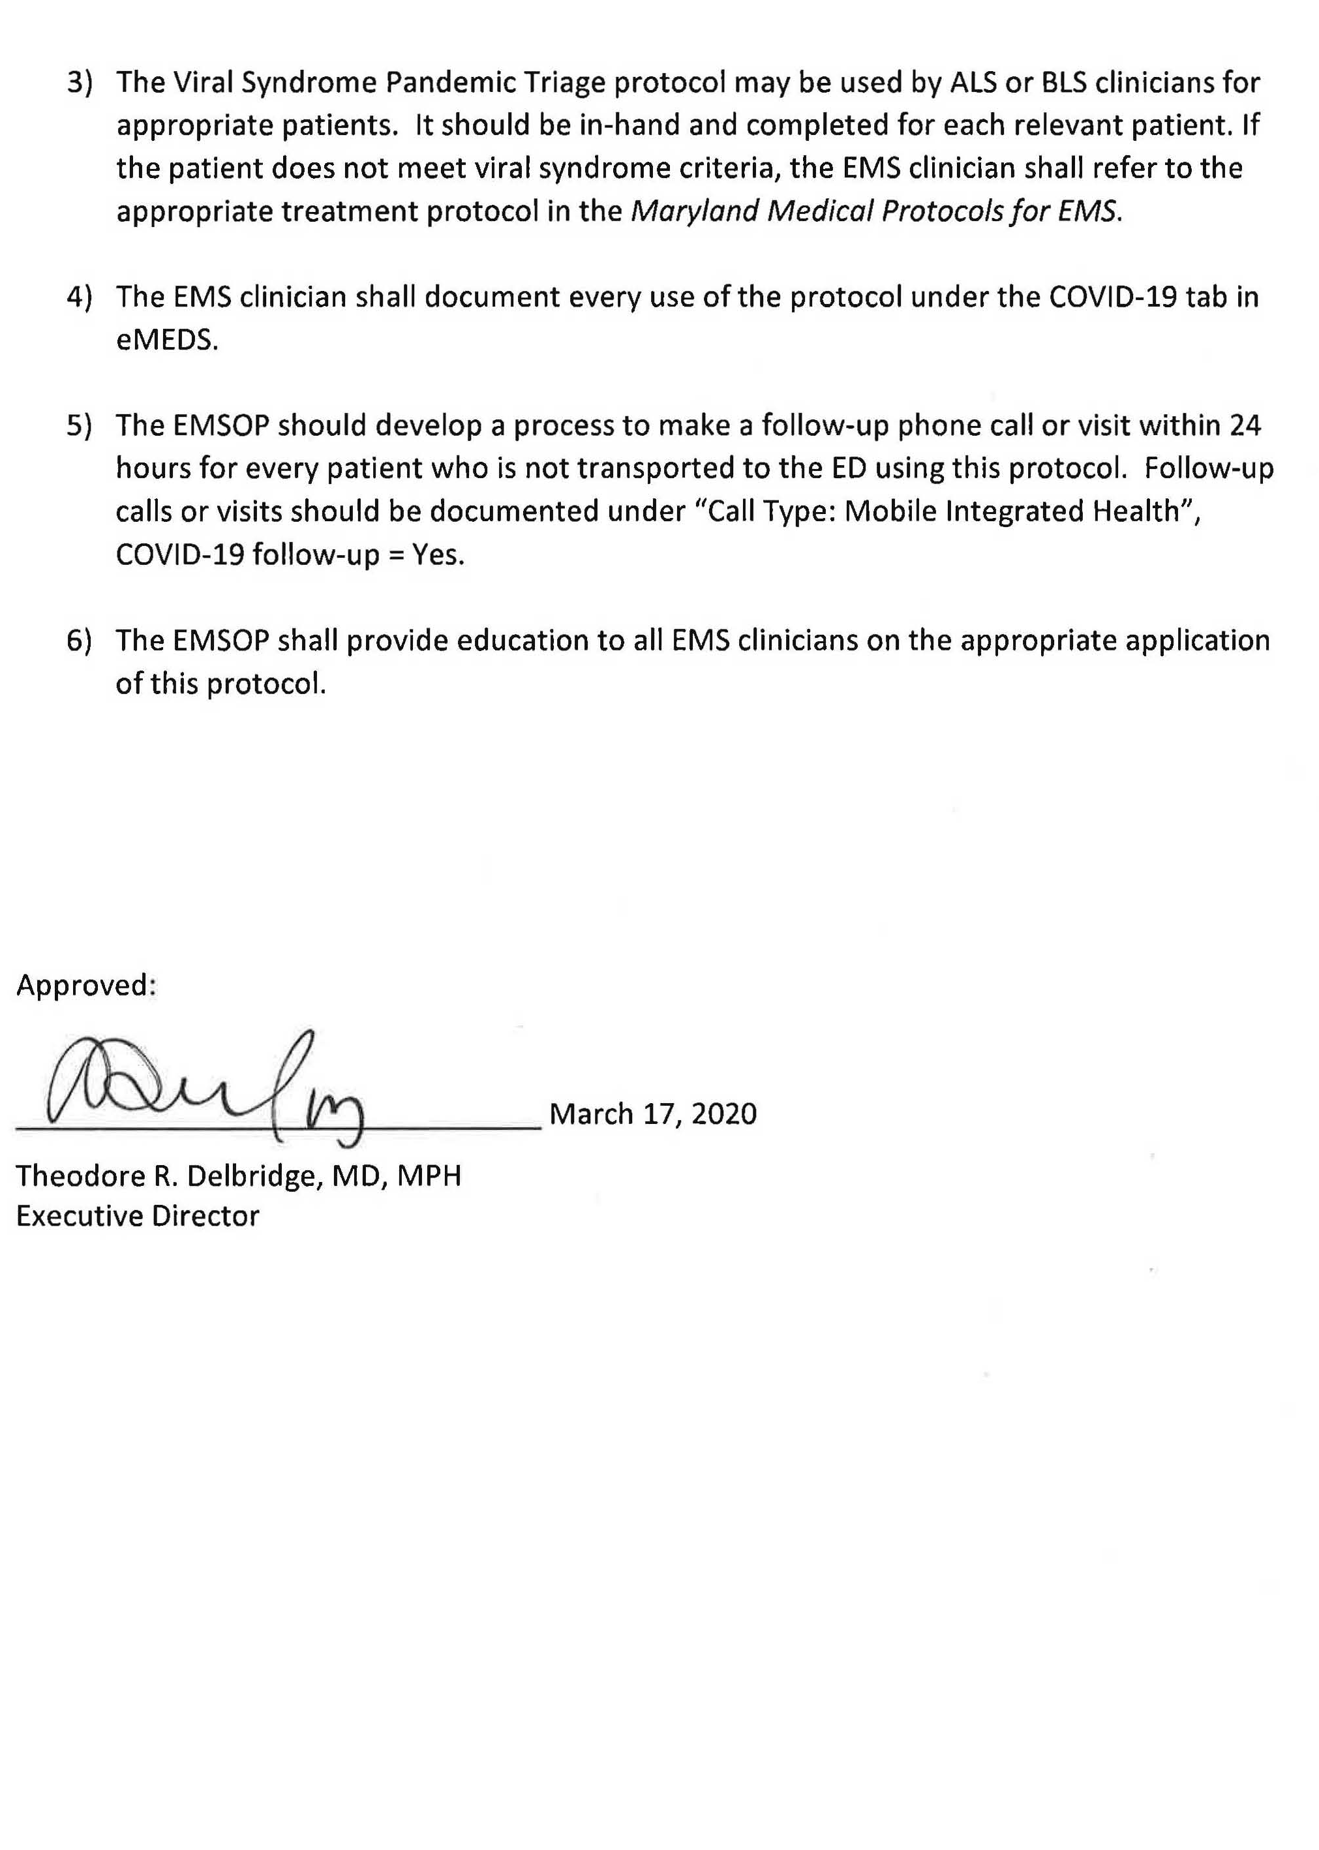
Pandemic Triage Protocol Implementation
Notes:
In light of this pandemic and the potential for unprecedented patient volumes for EMS and Maryland hospitals, the leadership of the Maryland Institute for Emergency Medical Services Systems (MIEMSS) has instituted an emergency protocol entitled Viral Syndrome Pandemic Triage Protocol on March 17, 2020.
This protocol seeks to identify those patients who are safe to be managed by supportive care at home. It also serves to help the EMS clinician promptly recognize a patient who should be taken to the hospital because of certain high-risk criteria

Slide 7
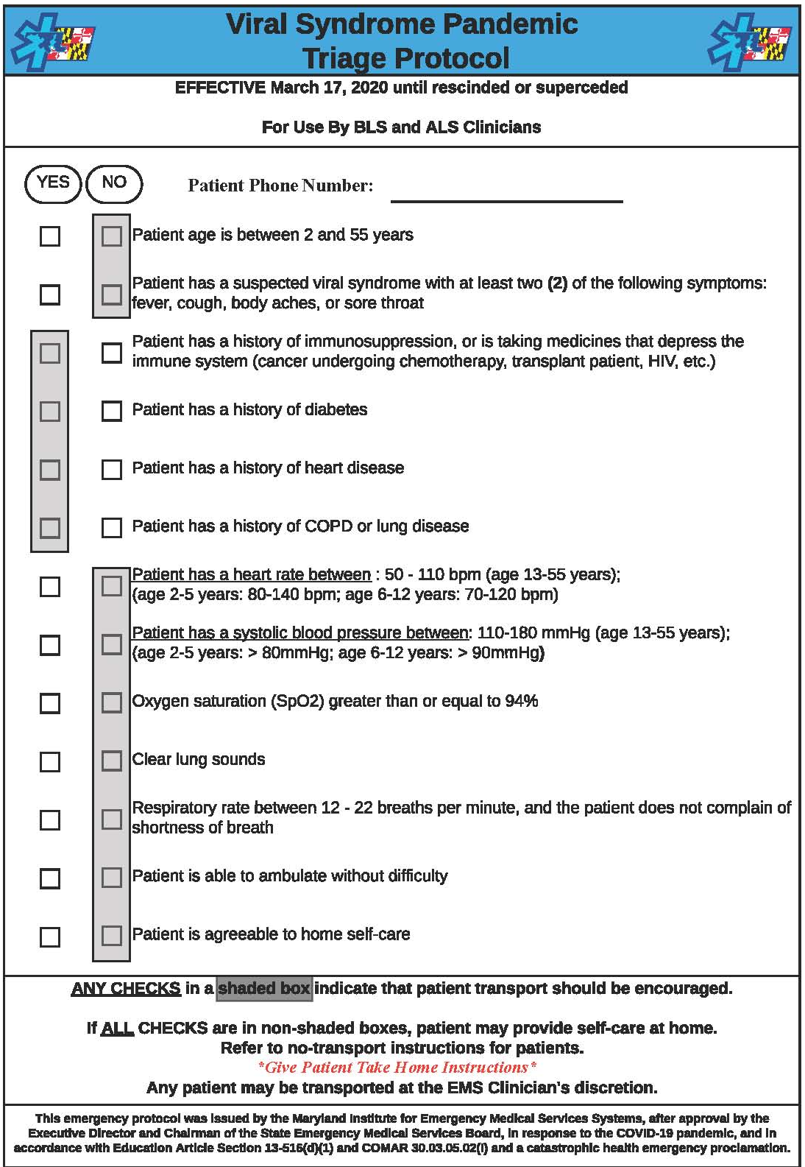
Pandemic Triage Protocol
For use by both ALS and BLS clinicians
Goal:
To identify patients who can safely stay home, and
Help the EMS clinician recognize high-risk criteria
Checklist format
Any grey boxes checked = encourage transport
No grey boxes checked = eligible for no-transport
EMS Clinician has discretion to transport even if no grey boxes are checked
Notes:
This protocol can be used by both ALS and BLS clinicians.
It’s intended to help differentiate between those patients who can safely self manage their care at home from those patients who have high risk criteria and should be transported.
The protocol consists of a checklist that guides the EMS clinician through a series of questions that cover inclusion criteria, high risk conditions, concerning exam findings
If any of the grey boxes are checked, EMS clinicians shall encourage the patient to be transported to the hospital. If a patient has grey boxes checked and does not wish to be transported to the hospital, the EMS clinician shall follow the Maryland Refusal Protocol
In order to be eligible for the non-transport option within this protocol, all checks need to be in the non-shaded boxes. If a patient meets these criteria, a refusal is not necessary.
Also, we’d like to remind you that you, as the EMS clinician, has discretion to transport the patient even if no grey boxes are checked.

Slide 8
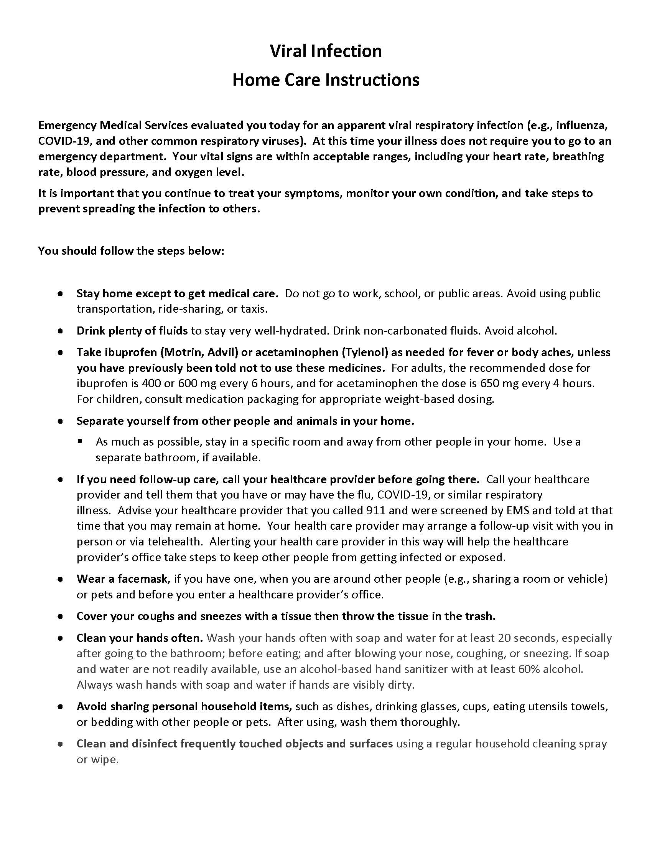
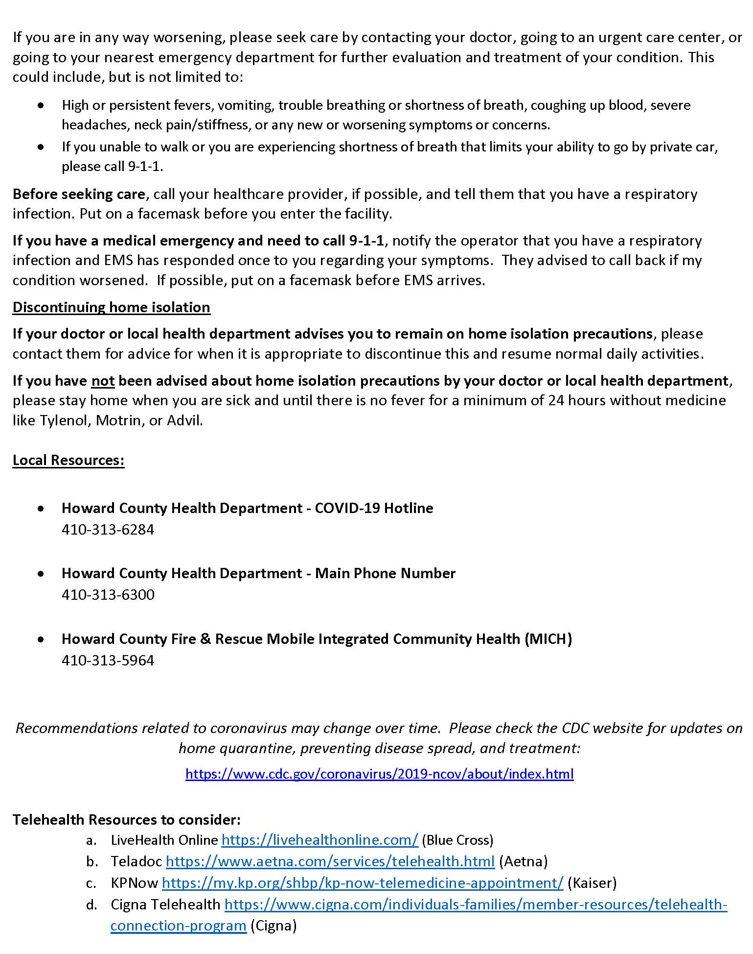
Patient Instructions
Notes:
If all checks are in the non-shaded boxes, the patient meets eligibility to provide self care at home.
A two-page patient instruction sheet has been created by MIEMSS. These instructions shall be provided to patients who are not transported by EMS.
This instruction sheet includes local phone numbers for the patient to use should they have further questions.

Slide 9
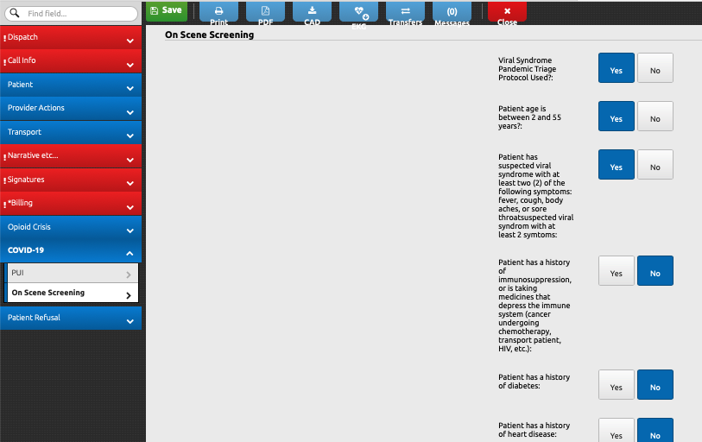
Documentation
New tab in Elite
Document check list and phone number
Patient signature is not required per MIEMSS, to help minimize contamination
“Not Signed - Patient Contamination Concern”
The rest of the EMEDs chart shall be completed per normal procedures
Notes:
In accordance with MIEMSS guidelines, the EMS Clinician shall document every use of the protocol under the newly created COVID-19 tab within eMEDS Elite.
The elite questions directly match those questions within the protocol checklist.
Also, note that a signature option of “Not Signed - Patient Contamination Concern” has been added. Has been added to help minimize contamination of equipment
EMS Clinicians shall complete the rest of the chart per normal procedures.

Slide 10
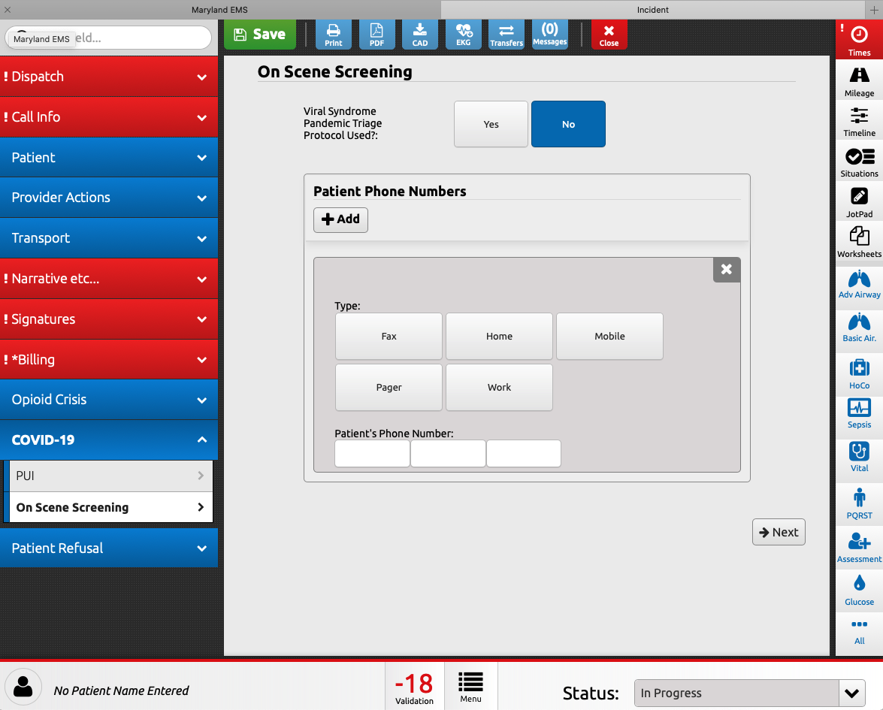
Follow up Phone Call
Call patients within 24 hours
A good phone number is needed
Check up on patients
Phone call will be documented in Elite
Follow up visit as appropriate
Notes:
In accordance with MIEMSS guidelines we are required to follow up with patients who are not transported under this protocol within 24 hours.
As previously mentioned, it is essential that we obtain a good patient phone number for follow up.
That phone number shall be documented in this area within the COVID-19
Documentation of that phone call will also occur in Elite
There will be an option of a follow up home visit as needed for the patients.
The follow up phone call and follow up visit will not impact field operations and will be performed through a separate headquarters function.

Slide 11
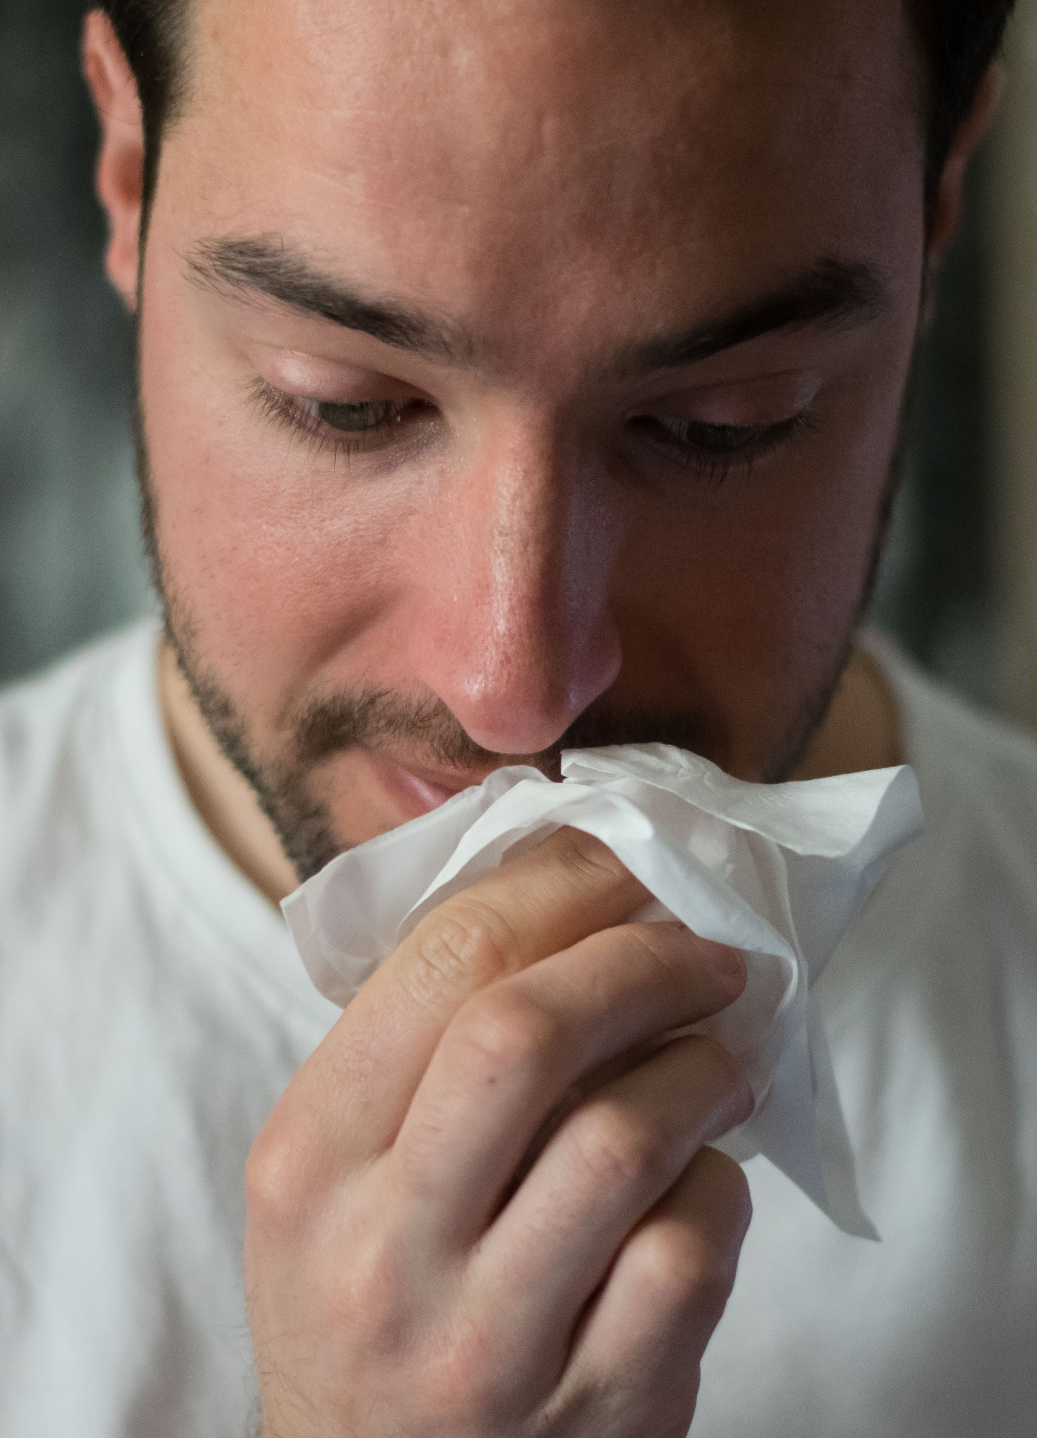
Practice Case 1:
35-year-old male with 3 days of fevers, now with bad cough, body aches.
History of diabetes, seasonal allergies, gastric reflux
HR 104
BP 132/64
SPO2 96
Lungs clear
RR 20
Ambulatory without difficulty
Notes:
Let’s try a practice case.
35 year old male with 3 days of fevers, now with bad cough, body aches.
History includes diabetes, seasonal allergies, gastric reflux
HR 104
BP 132/64
SPO2 96
Lungs clear
RR 20
Ambulatory without difficulty
Is this patient eligible for the non-transport, self-care option?

Slide 12

Practice Case 1:
35-year-old male with 3 days of fevers, now with bad cough, body aches.
History of diabetes, seasonal allergies, gastric reflux
HR 104
BP 132/64
SPO2 96
Lungs clear
RR 20
Ambulatory without difficulty
Notes:
If you said NO, you would be correct. Since this patient has diabetes, he is considered to have higher risk of a bad outcome from COVOD-19 and should be recommended that he be transported to the hospital.

Slide 13
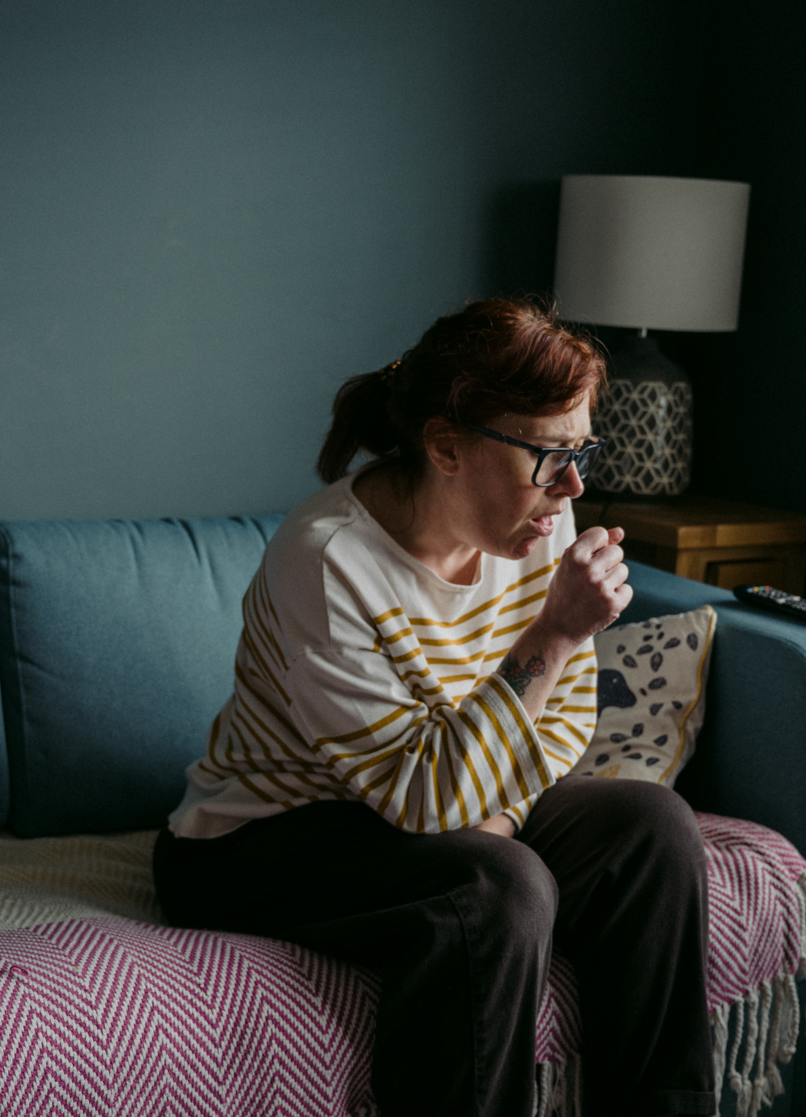
Practice Case 2:
42-year-old female with 2 days of body aches, cough and general weakness.
History includes high cholesterol
HR 110
BP 118/58
SPO2 95
Lungs clear
RR 20
Ambulatory without difficulty
Agreeable to stay home and feels safe
Notes:
Let’s try another practice case.
42-year-old female with 2 days of body aches, cough and general weakness.
History includes high cholesterol
HR 110
BP 118/58
SPO2 95
Lungs clear
RR 20
Ambulatory without difficulty
Agreeable to stay home and feels safe
Is this patient eligible for the non-transport, self-care option?

Slide 14
Practice Case 2:
42-year-old female with 2 days of body aches, cough and general weakness.
History includes high cholesterol
HR 110
BP 118/58
SPO2 95
Lungs clear
RR 20
Ambulatory without difficulty
Agreeable to stay home
Notes:
If you said YES, you would be correct. Since this patient does not have any high-risk features as identified by the viral syndrome pandemic triage protocol. In other words, no grey boxes are checked, and this patient is eligible for the non-transport option
As a reminder, as the EMS clinician on scene, it’s ultimately up to you to decide, if even though no grey boxes are checked on the protocol, you think transport should be recommended.

Slide 15
Questions
Contact your local EMS Operations Leadership, or
The Office of the State EMS Medical Director (410-706-0880)
Notes:
Thank you for watching this just-in-time training.
If there are any questions, please reach out to any of the EMS operations or the Office of the Medical Director
Please stay safe, take care of yourself and each other.

