Slide 1


Charles County
Climate Action Plan
WELCOME
In-Person Public Meeting

Slide 2

Purpose of Today’s Meeting
Let’s Talk About It
Climate Action Planning in Charles County
AGENDA
6:10 – 6:30 PM Presentation
6:30 – 7:15 PM Poster Session
7:15 – 7:30 PM Closing Remarks & Next Steps
During today's meeting we will:
Meet the Climate Action Plan (CAP) Team
Meet Attendees
Discuss Climate Change and the Climate Action Plan
Share County Analyses of Greenhouse Gas Emissions and Vulnerability
Gather Your Feedback on Climate Action Plan Strategies

Slide 3







Meet the Team
Let’s Talk About It
Climate Action Planning in Charles County
Climate Action Plan Project Manager
Contracting
Authority
Project Team
Lead
Greenhouse Gas Analyses
Resilience
Analyses
Financial Analyses
Community Engagement
Notes:
Beth discusses cog and introduces colleen, colleen introduces the rest of the consultant team

Slide 4
Introductions
Let’s Talk About It
Climate Action Planning in Charles County
Your Name
General area where you live and / or work
What are you most interested in learning or sharing today?
HELLO
my name is…
Notes:
If the crowd is small (maybe less than 10 people)
Invite attendees to introduce themselves and use these 3 questions as a guide for their introduction.

Slide 5














What is Climate Change?
Let’s Talk About It
Climate Action Planning in Charles County
Human activities, including burning fossil fuels for transportation, electricity, industry, and various land use practices, release greenhouse gases (GHGs) into the atmosphere.
Commercial and Residential Energy Use, Landfills, Transportation, Agriculture, Land Use, Water, Wastewater
Heat Trapping Greenhouse Gases
These heat-trapping gases, such as carbon dioxide, methane, nitrous oxide, fluorinated gases, and ozone—contribute to Climate Change.
Extreme Heat
Extreme Cold
Flooding
Severe Storms
Drought
Warming of Oceans

Slide 6

What is Climate Action Planning?
Let’s Talk About It
Climate Action Planning in Charles County
The Climate Action Plan (CAP) serves as a comprehensive roadmap to guide Charles County through a process of reducing its Greenhouse Gas (GHG) emissions, mitigate and respond to climate change, improve the environment, and protect communities.
Charles County recognizes the need to take action to sustain the vitality of our community for years to come. The Office of Climate Resilience and Sustainability works with government and community partners to reduce our greenhouse gas emissions, protect our natural environment, and safeguard our community against the effects of climate change.

Slide 7


CAP Approach – 1 Plan in 2 Parts
Let’s Talk About It
Climate Action Planning in Charles County
Community-Wide Resilience and GHG Mitigation Action Plan
Residential and Commercial buildings, Industrial facilities, all Vehicles in Community, etc.
Government Operations Resilience and GHG Mitigation Action Plan
Facilities the County or other units of government manage to provide essential public services e.g., buildings, fleet vehicles, wastewater treatment
Other non-governmental critical services facilities (medical, power, etc.)

Slide 8
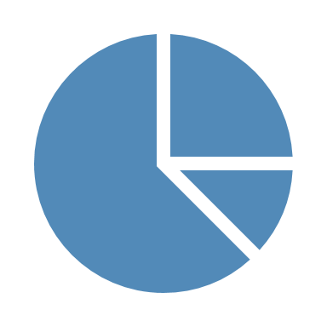






CAP Process
Let’s Talk About It
Climate Action Planning in Charles County
1
Develop Inventories Analyze Existing Conditions
5
Establish Metrics
To Track Progress
Develop Business As Usual (BAU) Forecasts
Future Conditions Based on What we “Know” Today
2
6
Develop CAP Document
To Define an Actionable Approach
3
Stakeholder & Public Outreach
To Develop CAP Goals & Strategies
An On-Going Effort
Regular Progress Updates through our Communications Platforms
7
4
Establish Implementable,
Time-Oriented Strategies
Analyze Goals and Strategies
Notes:
Under step one, we analyze Existing Conditions by developing inventories assessments. This tells us where we are starting from – a 2018 GHG emissions inventory and a current vulnerability assessment for our resilience work.
Under step two, we forecast future conditions based on existing actions as we understand them today. We call this developing a “Business As Usual or BAU” and it helps us understand where we would be heading in the future if things remain essentially the same with some incorporation of things such as population and other demographic projections as well as our understanding of Plans, Programs, and Policies that are in Place now – like federal vehicle standards.
Stakeholder and Public Outreach will help Us Develop and Define CAP Goals and Strategies. To date, we have conducted 4 interactive webinars, and those materials and recordings are available online. We are also in the midst of conducting 6 in-person meetings over the next few weeks. We will also be reaching out to stakeholders and conducting stakeholder meetings to ensure that we are connecting with local business, advocacy groups, other governmental organizations, utility companies, and others.
Under step 4, we will utilize what we have heard through our outreach efforts as well as research and expert feedback from the project team to develop and analyze the goals and strategies that will be added to the plan.
Tracking Metrics will be developed under step 5 to ensure that we evaluating our progress and realigning when and where it makes sense.
Develop CAP Document - think of this as a foundation that establishes the intention to address climate change by setting forth goals and actions that will be incorporated into other efforts, plans, policies, and projects over time. This will be re-evaluated and tracked as part of a continuing effort (see #7)
Continuing Effort – Frequent Updates on Progress Through our Communications Platforms
For Context on #3:
Maryland State Goal is to reduce GHG by 60% from 2006 emissions by 2031 and to achieve Net-Zero Emission by 2045.
MWCOG Goal is to Reduce GHG by 50% from 2005 emissions by 2030 and by 80% by 2050. As a region we are making progress! COG documenting exceeding the 2020 reduction goal of 20% below 2005 levels.

Slide 9
CAP Timeline
Let’s Talk About It
Climate Action Planning in Charles County
Spring 2025
Summer 2025
Fall 2025
We are Here:
Present draft Plan to the Resilience Authority and Board of Charles County Commissioners
Interactive Webinars
In-person public meetings
Stakeholder Meetings
Draft Climate Action Plan development
Public Review of draft Plan
Final Charles County Climate Action Plan
Notes:
Summer 2025 draft for public review
Incorporate comments and RA / BOCCC meetings / approval – final plan

Slide 10
Where do GHG Emissions Come From?
Let’s Talk About It
Climate Action Planning in Charles County
86% from Transportation and Energy Use
AFOLU = Agriculture, Forestry, and Other Land Use
Process & Fugitive Emissions = Industrial process and manufacturing emissions as well as leaks from equipment or pipelines
* Charles County Emissions Inventory based on 2018 Data Available from MWCOG

Slide 11
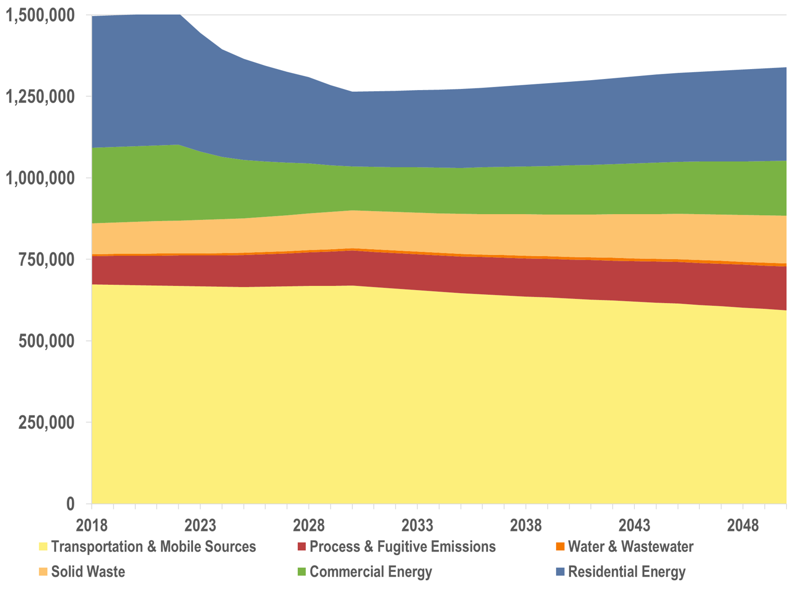
What is Business-As-Usual?
Let’s Talk About It
Climate Action Planning in Charles County
10% reduction from 2018
  MWCOG cooperative forecast for Charles County.
National Renewable Energy Laboratory (NREL) Cambium projections for electricity emissions factors through 2030. Electricity emissions factor is constant from 2030 onwards.
Federal vehicle efficiency standards through 2050.
* Charles County Emissions Inventory based on 2018 Data Available from MWCOG
Notes:
A Business as Usual Forecast or “BAU” forecast estimates future emissions based on current trends and policies. It provides a baseline and helps us understand how implementing climate action strategies will impact emissions.
Our forecast starts with the 2018 inventory (the pie chart in the previous slide) and forecasts emissions to 2050.
The current trends and policies incorporated into the BAU include:
Demographic and socio-economic data, like population and employment, that are developed and regularly updated by MWCOG. The latest version was developed in the summer of 2023 and extends the growth trends through 2050 for the first time. This information helps us better forecast consumption and usage across sectors.
We’ve also included a conservative estimate of electricity emissions factors projections from NREL Cambium through 2030 and have held them constant from 2030 onwards.
Finally, we included the federal vehicle efficiency standards that reflect the latest updates for light, medium, and heavy-duty vehicles though 2050.

Slide 12
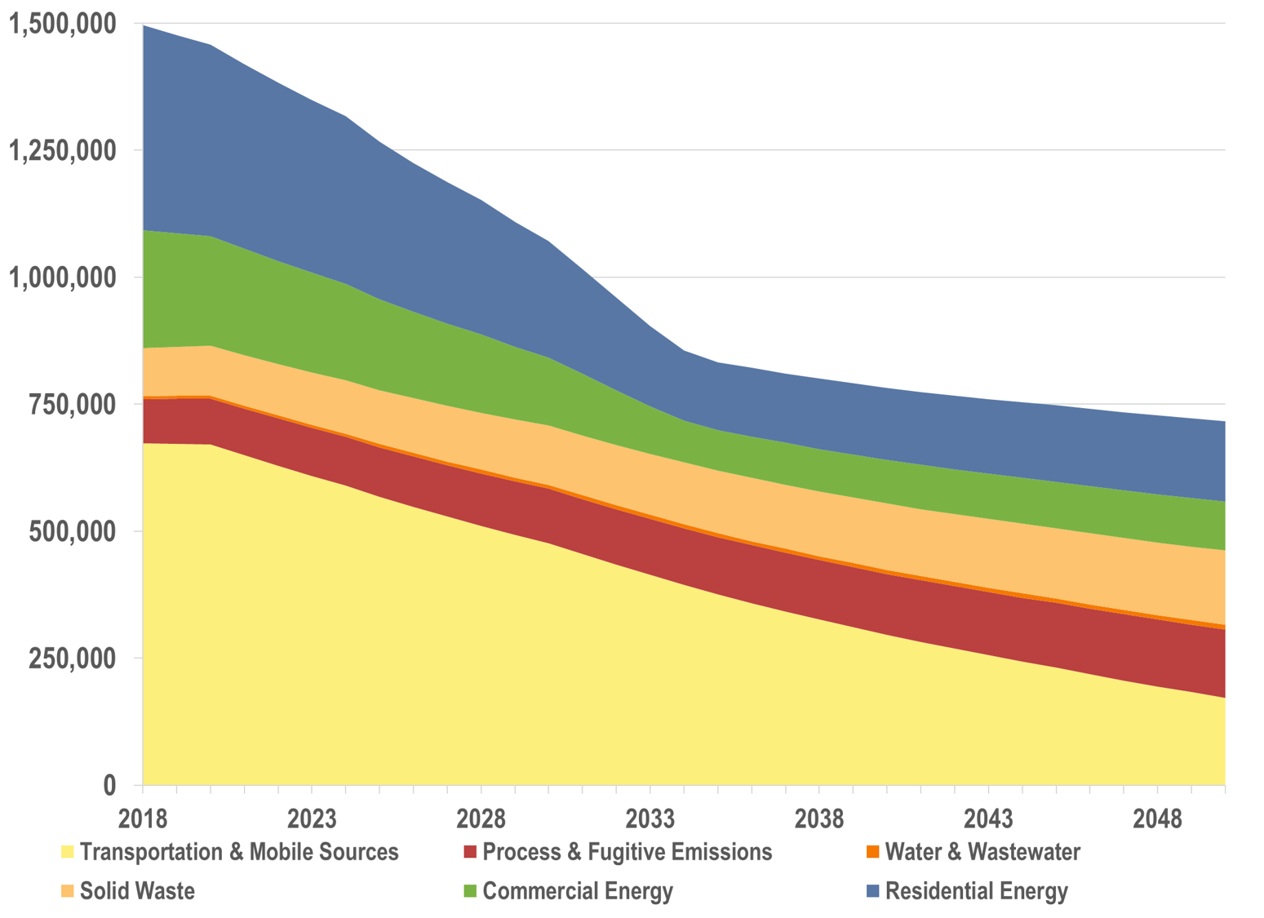
State of Maryland Policies
Let’s Talk About It
Climate Action Planning in Charles County
52% reduction from 2018
Clean Power Plan - 100% clean electricity by 2035.
Advanced Clean Cars II - 100% of new light-duty vehicles are electric from 2035 onwards.
Advanced Clean Trucks - 40% of new heavy-duty trucks are electric from 2032 onwards.
* Charles County Emissions Inventory based on 2018 Data Available from MWCOG

Slide 13
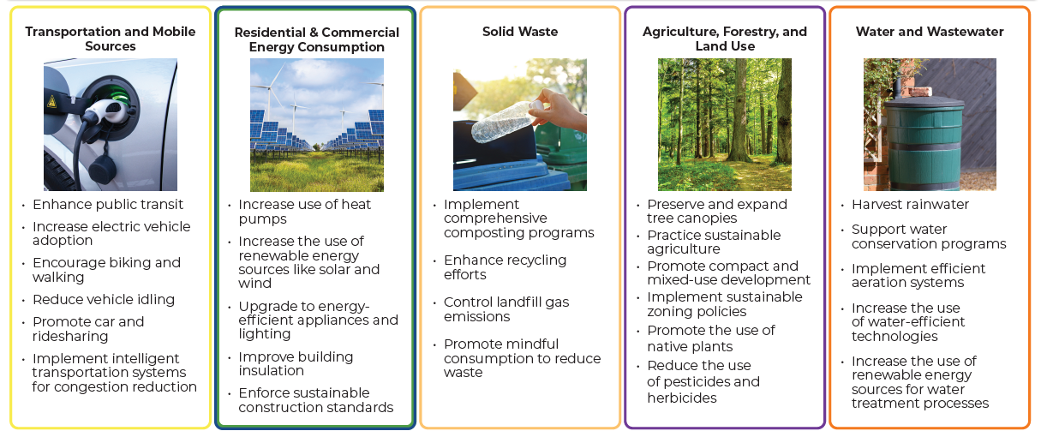
Sample GHG Reduction Strategies & Actions
Let’s Talk About It
Climate Action Planning in Charles County

Slide 14
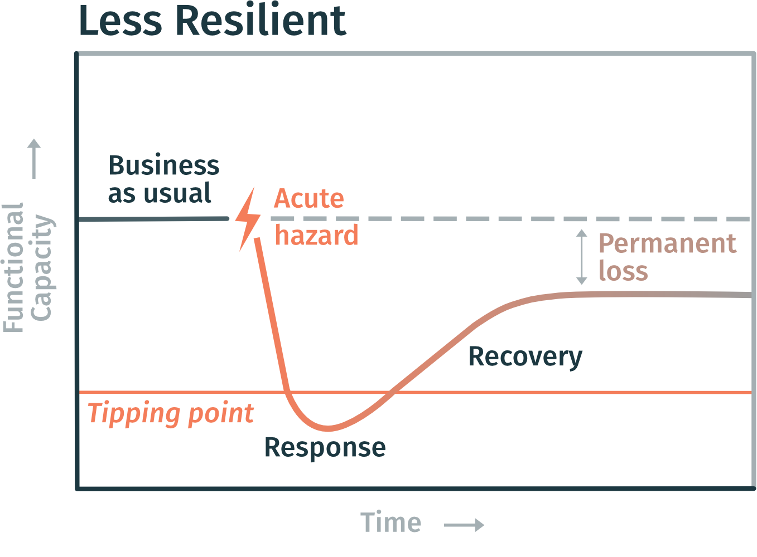
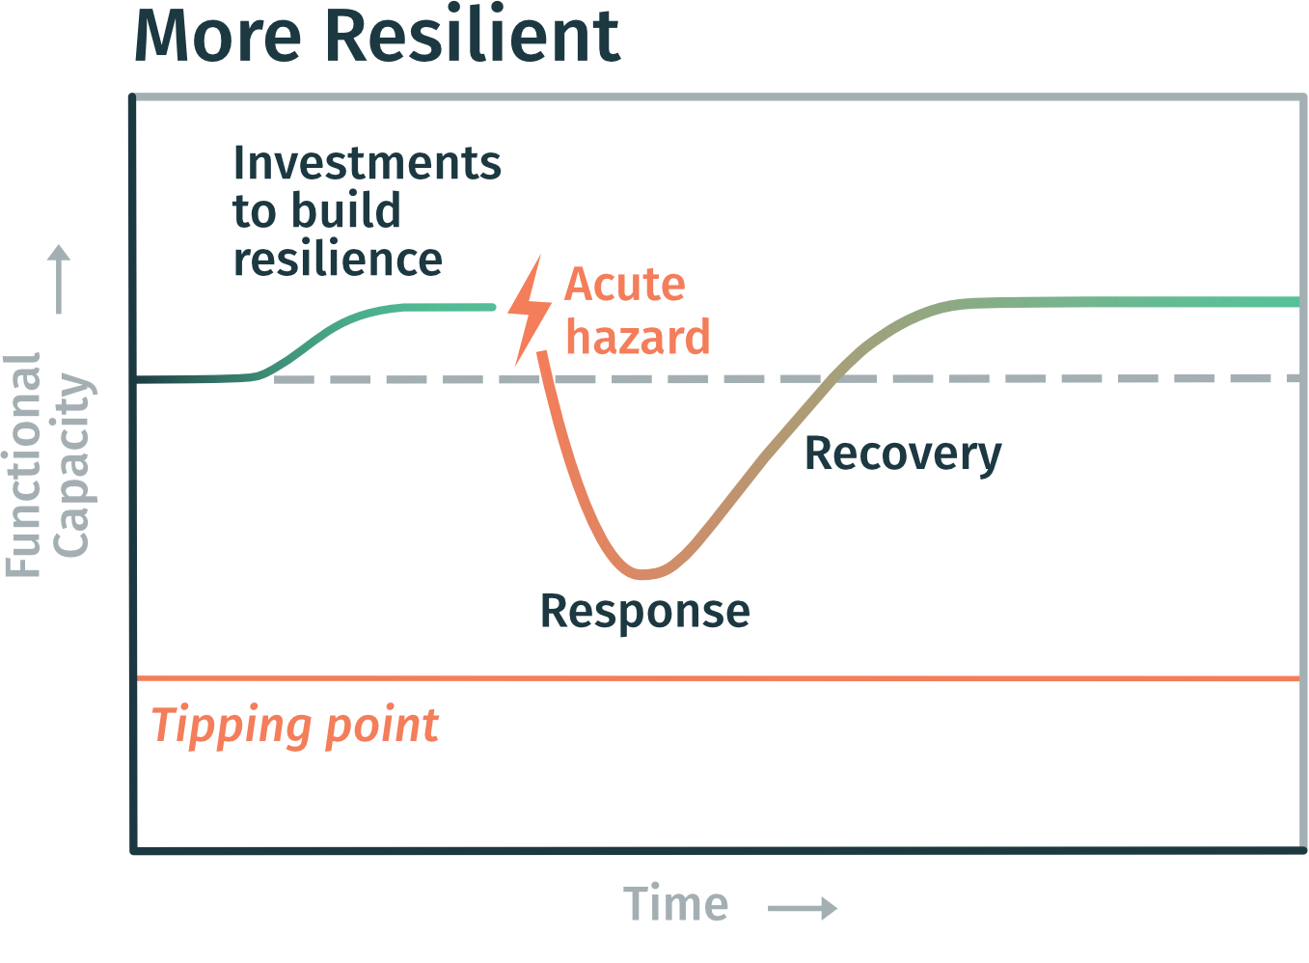
Understanding Resilience
Let’s Talk About It
Climate Action Planning in Charles County
"The capacity of a community, business, or natural environment to prevent, withstand, respond to, and recover from a disruption."
From U.S. Climate Resilience Toolkit, adapted from M.E. Hynes, B. Ross and CARRI (2008); White et al. (2015)

Slide 15
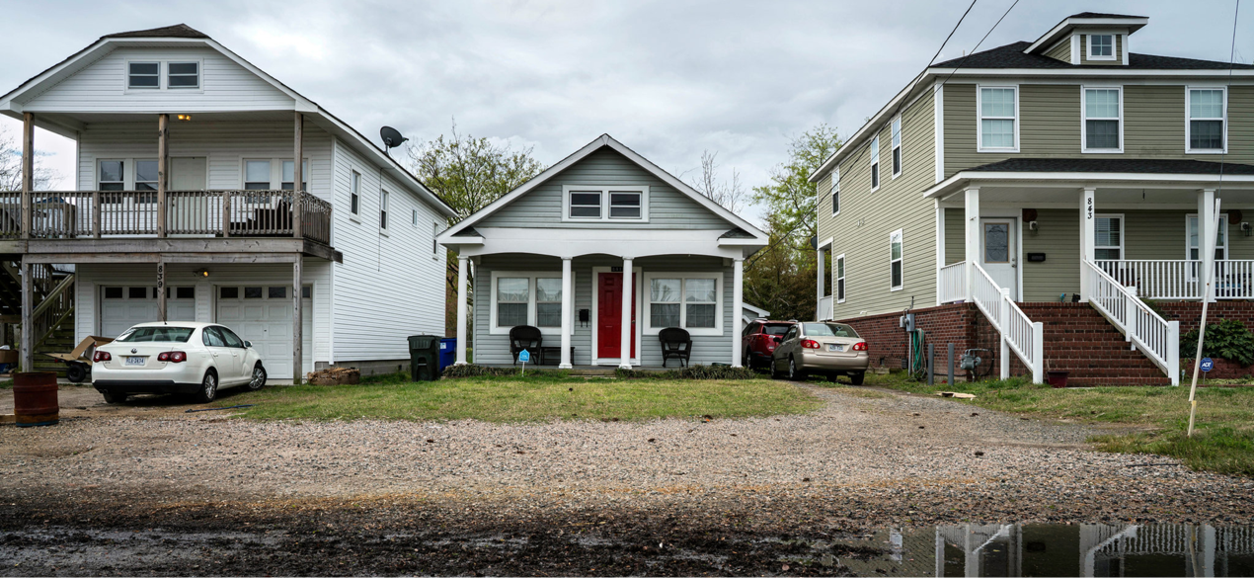
Understanding Vulnerability
Let’s Talk About It
Climate Action Planning in Charles County
All three homes are exposed to flooding, but their level of vulnerability varies.

Slide 16
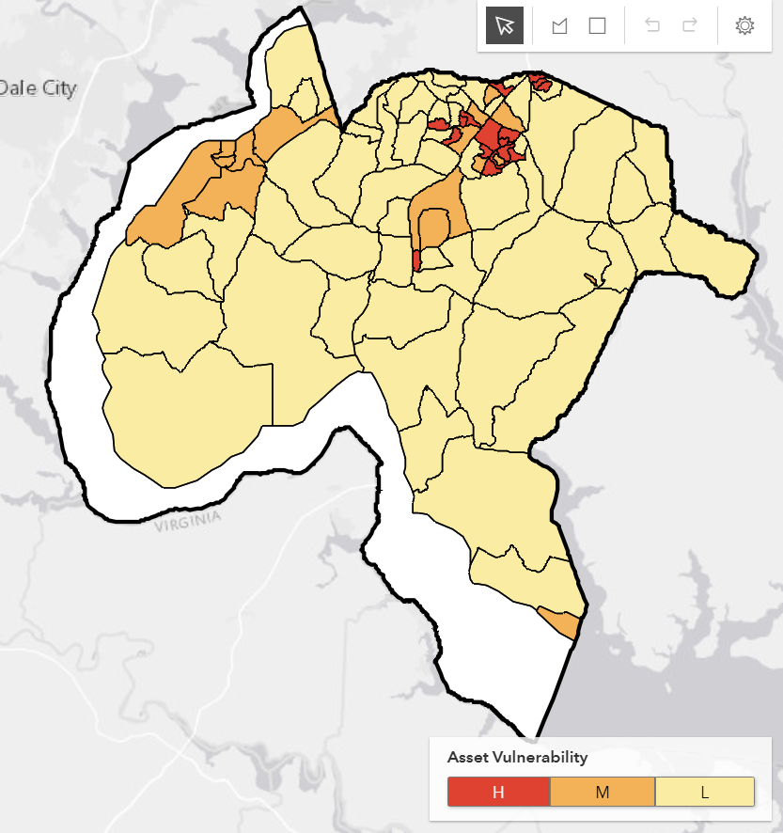
Resilience Assessment – Hazards & Assets
Let’s Talk About It
Climate Action Planning in Charles County
Resilience assessment identifies communities and community assets that have, high, medium, and low vulnerability associated with climate hazards.
Extreme Heat Vulnerability
Hazards
Tidal Flooding
Floodplain Inundation
Storm Surge
Extreme Heat
Asset Categories
Government Operations Assets: Government owned properties, critical infrastructure
Community Wide Assets: residential and commercial property, cultural and community resources
Transportation: Roads and parcels potentially isolated from Emergency Services due to flooding
The vulnerability output for the extreme heat assessment in the County, where darkest red census block groups have the highest vulnerability to extreme heat events and yellow have the lowest vulnerability.

Slide 17
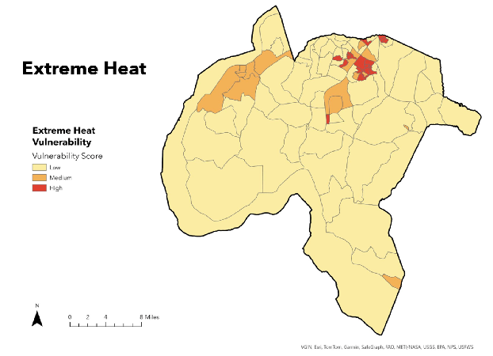
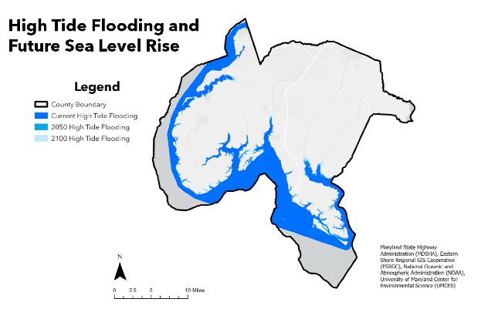
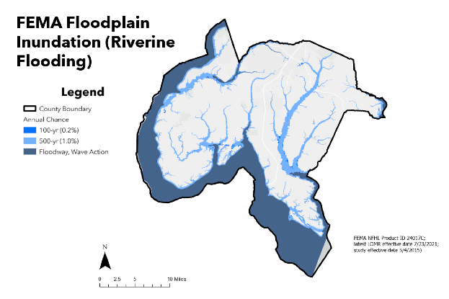
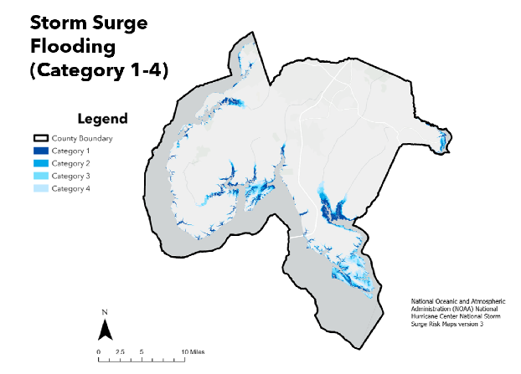
Sample Resilience Strategies and Actions
Let’s Talk About It
Climate Action Planning in Charles County
Building Resilience to Extreme Heat
Building Resilience to Flooding
Plant more native trees, shrubs, and plants to create more green spaces.
Expand cooling centers.
Expand use of cool roofing and pavement materials.
Expand weatherization of homes and businesses.
Check in on neighbors.
Protect natural areas like wetlands and forests Improve stormwater infrastructure.
Raise or flood-proof buildings and equipment in risk-prone areas.
Share flood warnings and safety information early.

Slide 18






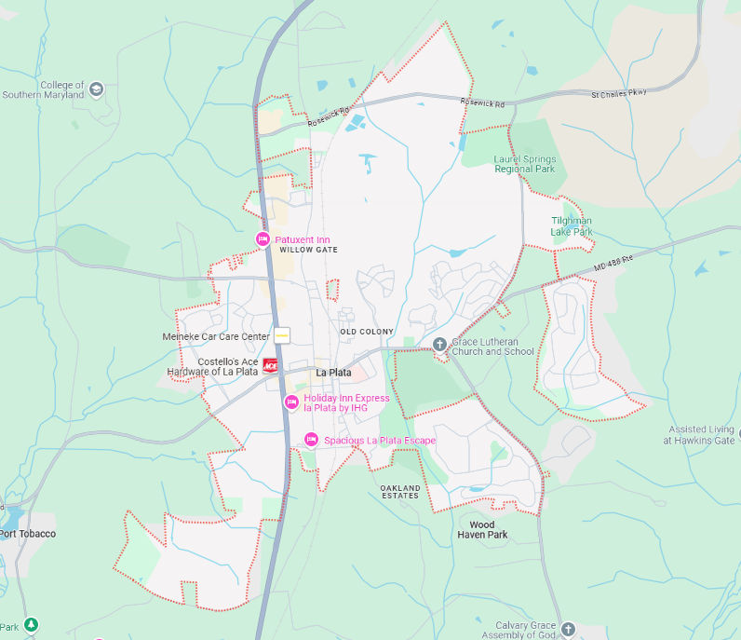
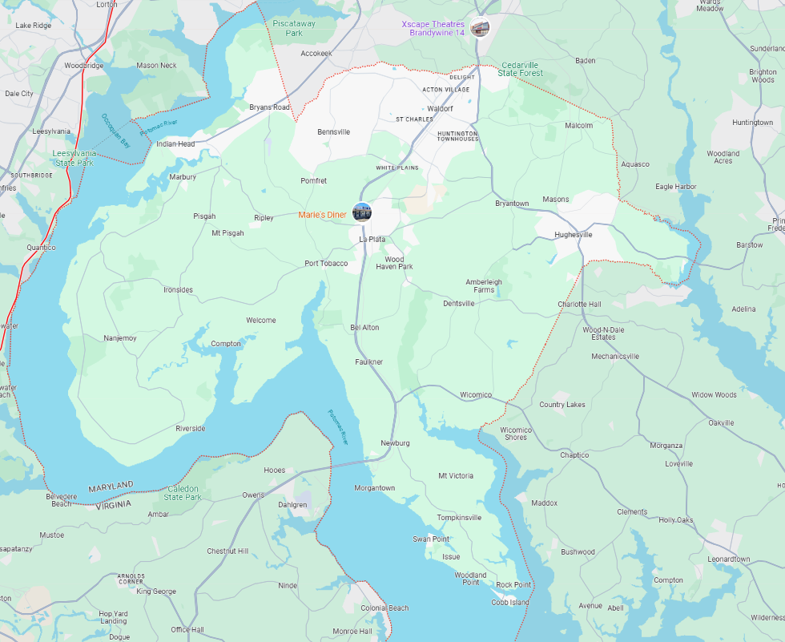



How to Move Around the Room
Let’s Talk About It
Climate Action Planning in Charles County
Mapping Station – For Location-Specific Feedback
Place a numbered dot on the map where you have a suggestion for a GHG reduction, resilience, or communication strategy or concern.
Tell us more about your suggestion by adding the number of your dot and writing more details on the provided boards.
Use the zoomed-in map for local input
Use the full County map for input outside of the local area
Let us know if you have any questions, need help writing, or would like to discuss a strategy.
Add a cooling center in
downtown La Plata
Increase transit service
to Nanjemoy

Slide 19

How to Move Around the Room
Let’s Talk About It
Climate Action Planning in Charles County
General Strategies Stations
Share ideas and strategies that are more general, not location-based, or if you do not know the location. EXAMPLE: Install more EV charging throughout the County.
Learn more about our analyses and ask any technical questions.
Resilience
GHG
Engagement
Land Use
Natural Infrastructure
Built Infrastructure
Transportation & Mobile Sources
Energy Use Solid Waste
Water / Wastewater
Agriculture, Forestry, Land Use
What barriers prevent you from participating in climate action initiatives?
What types of communication do you find most effective for understanding climate action plans?
What motivates you to engage in climate action activities?
What suggestions do you have for improving communication about climate action in our community?
What climate impacts are most concerning to you?
What would help you and your community address these impacts?
Are there any barriers to building resilience in your community?
Have any strategies made a difference in your community?
What emissions sources are most concerning to you?
What would help you and your community reduce emissions?
Are there any barriers to reducing emissions in your community?
Have any strategies made a difference in your community?

Slide 20

How to Move Around the Room
Let’s Talk About It
Climate Action Planning in Charles County
The Trivia Wheel
Visit the trivia wheel to play climate change trivia, learn a little more about climate change, and win prizes!
Exit Survey
Please remember to take a quick exit survey before you leave tonight.
Your participation will help us improve the CAP engagement process.
Other Helpful Tips. Remember you can:
Ask someone from the project team questions, we are here to help.
Talk amongst yourselves.
Use the QR codes provided on the handout and posters.
?

Slide 21
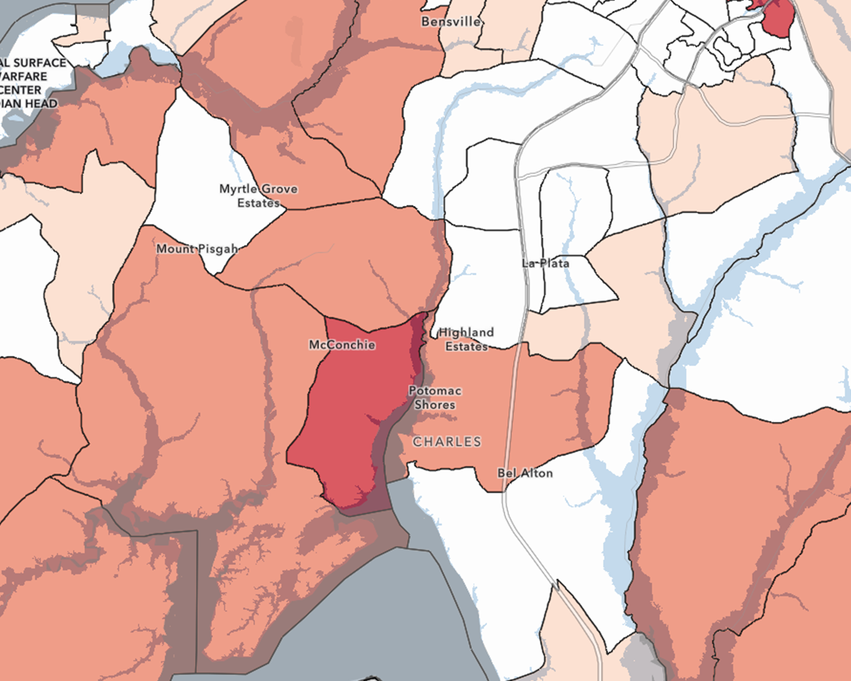

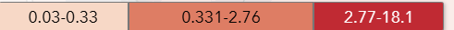
La Plata – Residential Vulnerability to Riverine Flooding
Vulnerability to riverine flooding is high in the La Plata area. In this area 64 residential properties and 33 community and cultural resource properties are highly vulnerable to flooding.
Storm surge flooding also puts coastal areas of La Plata at high risk. A significant number of residential, commercial, and community resources are highly vulnerable.
Percent of Residential Properties Highly Vulnerable
Notes:
Chose riverine flooding (FEMA Floodplain Inundation) for the La Plata area because there are two major offshoots of the river that heavily impact this area. There are a relatively high number of residential and community and cultural resource properties in this area that are highly vulnerable.

Slide 22
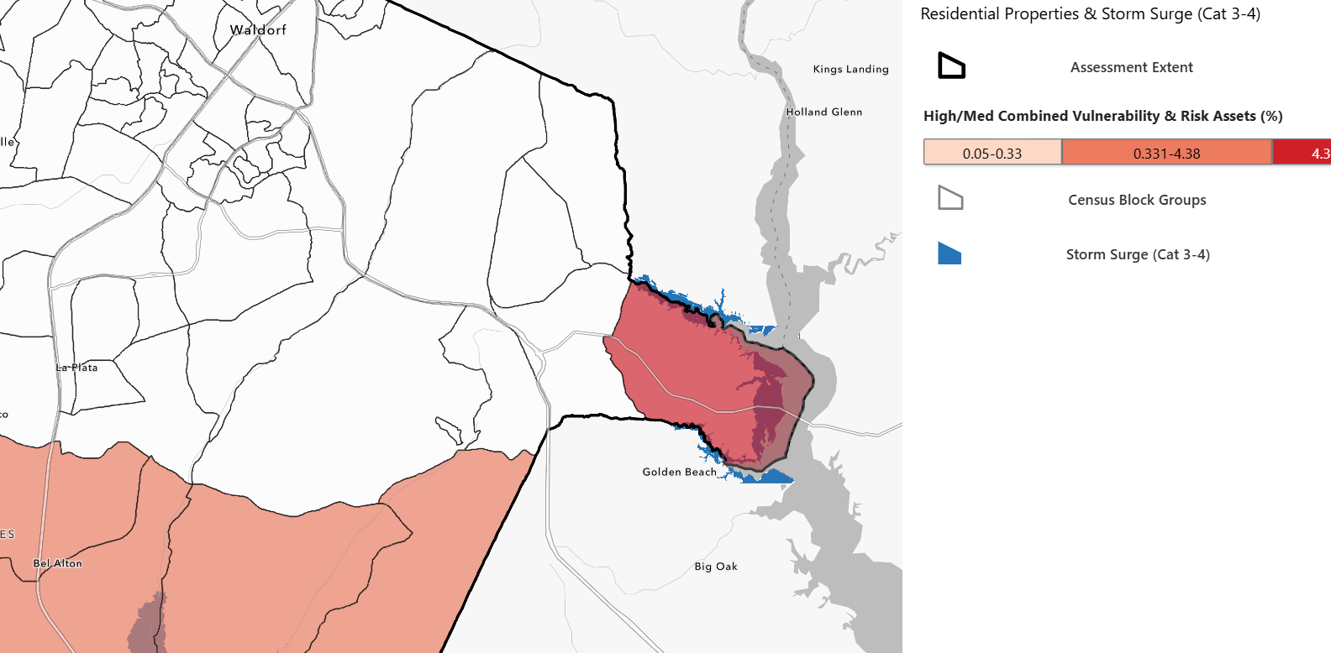
Hughesville / Benedict – Residential Vulnerability to Storm Surge Flooding
Vulnerability to storm surge flooding is relatively high in the coastal Benedict areas. Over 100 residential properties and over 100 community and cultural resources are highly vulnerable to storm surge flooding in this area.
Percent of Residential Properties Highly Vulnerable
Notes:
Storm surge flooding was chosen for this area due to the very high vulnerability of the Benedict area to storm surge flooding. It is one of the most storm-surge vulnerable areas in the County.

Slide 23
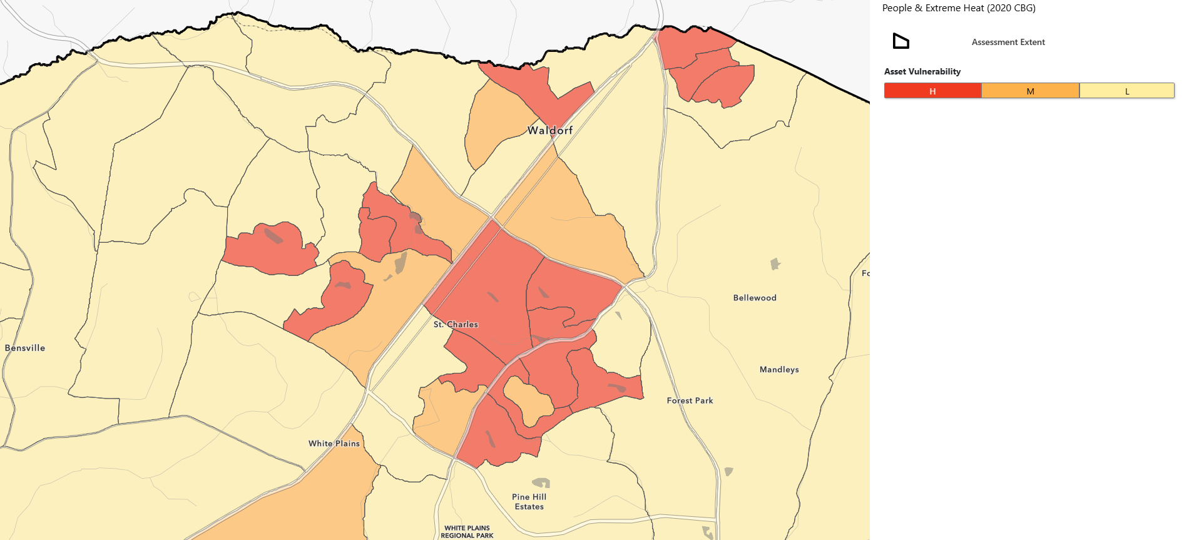
Waldorf – Extreme Heat
Vulnerability to extreme heat is high in the Waldorf area. Many census block groups are classified as high heat vulnerability, meaning they have higher impervious surface cover and lower tree canopy cover than other areas of the county.
Notes:
Storm surge flooding was chosen for this area due to the very high vulnerability of the Benedict area to storm surge flooding. It is one of the most storm-surge vulnerable areas in the County.

Slide 24
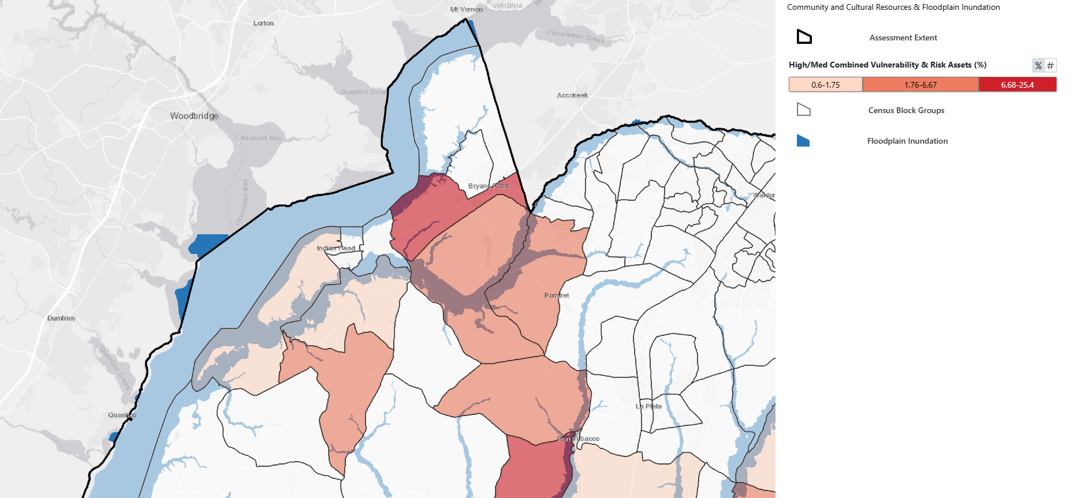
Indian Head / Bryan’s Road – Riverine Flooding Impacts to Community and Cultural Resources
Vulnerability to riverine flooding from floodplain inundation is relatively high in Indian Head / Bryan’s Road. A total of 41 community and cultural resources assets and 100 residential properties are highly vulnerable.
Percent of Community and Cultural Assets Highly Vulnerable
Notes:
Storm surge flooding was chosen for this area due to the very high vulnerability of the Benedict area to storm surge flooding. It is one of the most storm-surge vulnerable areas in the County.

Slide 25
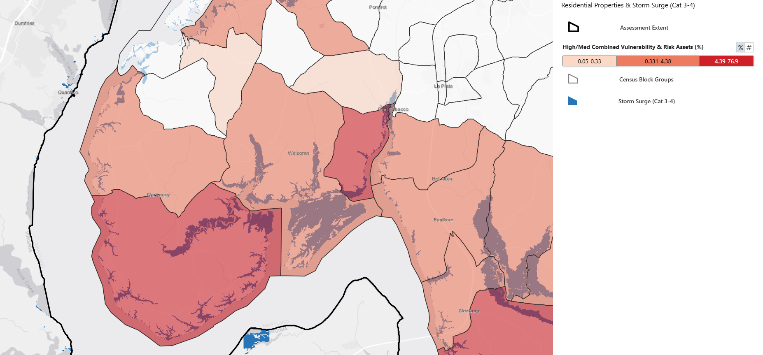
Riverside / Nanjemoy – Residential Property Vulnerability to Storm Surge Flooding
The Riverside/Nanjemoy area faces significant risk from storm surge flooding. In stronger storms (Category 3–4), 165 homes, 7 critical facilities, and 59 community and cultural resources are highly vulnerable to flooding. Even in weaker storms (Category 1–2), the area still faces risk, with 85 homes, 3 critical facilities, and 40 community and cultural resources vulnerable.
Percent of Residential Properties Highly Vulnerable
Notes:
Storm surge flooding was chosen for this area due to the very high vulnerability of the Benedict area to storm surge flooding. It is one of the most storm-surge vulnerable areas in the County.

Slide 26
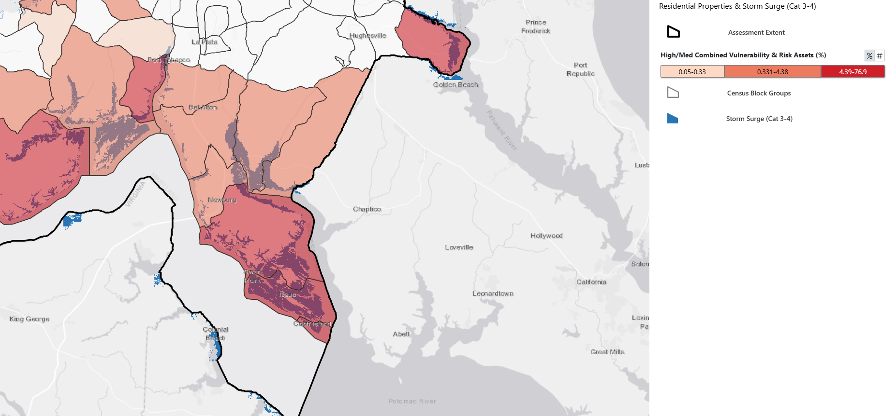
Newburg / Cobb Island – Residential Property Vulnerability to Storm Surge Flooding
Newburg / Cobb Island faces very high vulnerability to storm surge related flooding. In weaker (Category 1-2) and stronger storms (Category 3–4), virtually the entire area is highly vulnerable. In category 3-4 storms, 1,408 residential properties, 70 community and cultural resources, and 16 commercial properties are highly vulnerable.
Percent of Residential Properties Highly Vulnerable
Notes:
Storm surge flooding was chosen for this area due to the very high vulnerability of the Benedict area to storm surge flooding. It is one of the most storm-surge vulnerable areas in the County.

Slide 27

Questions Before We Begin?
Let’s Talk About It
Climate Action Planning in Charles County
Notes:
I would frame this as questions about how to move about the room and / or participate.

Slide 28
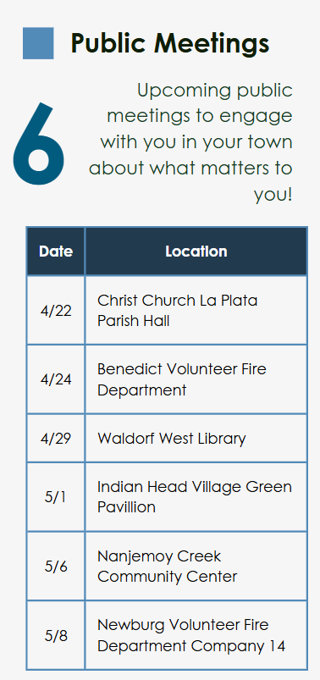
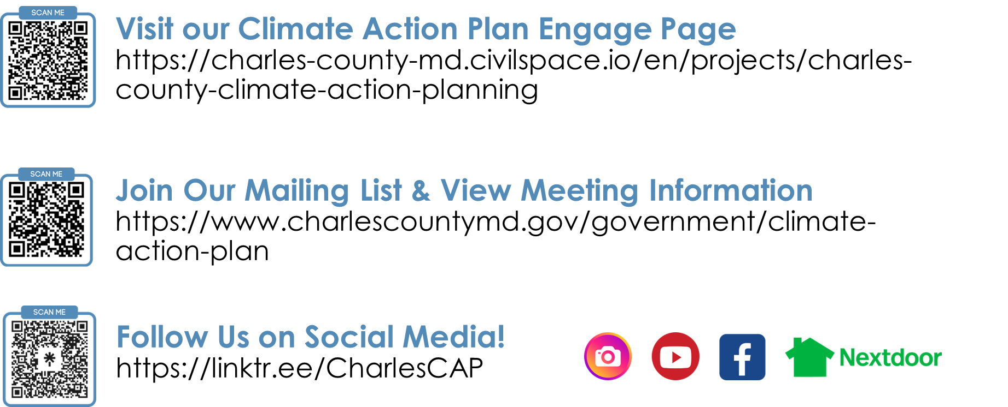
Let’s Talk About It
Thank You! Please Stay Engaged & Share
Climate Action Planning in Charles County
Stay Engaged & Involved
Share
Information about our CAP Development Process within your communities. Encourage people to attend our remaining meetings and to sign-up for our mailing list.
Please Remember to Take the Short Exit Survey

Slide 29
Thank You For Your Participation!
Beth Groth
Noelani Brockett
Climate Resilience and Sustainability Officer
Planner
301-645-0692
ClimateAction@CharlesCountyMD.gov

