Slide 1
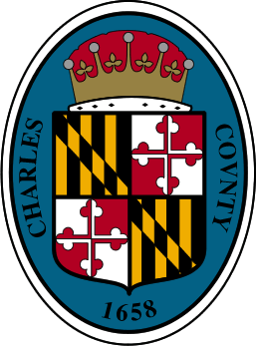
Rural Broadband Task Force May 7, 2024
Jenifer M. Ellin, Acting Deputy County Administrator
Evelyn Jacobson, Chief Information Officer
Matt Jacobson, Network Specialist II
Dee Anna Sobczak, ThinkBig CEO
Mark Wagner, ThinkBig Chief of Partnerships
Karen James, ThinkBig Account Relationship Manager
Michelle Arbaugh, Director of Sales

Slide 2
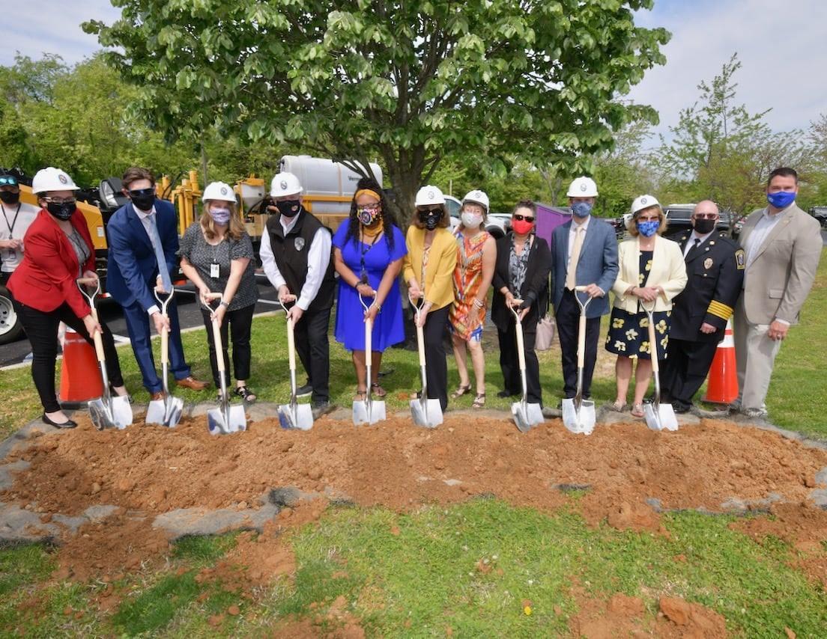
Rural Broadband Task Force Members
Jenifer Ellin & Erica Rizor, County Administration
Evelyn Jacobson, Matt Jacobson & Gina Markovich, Information Technology Division
Renesha Miles, Chief Equity Officer
Jeffrey Clements, Department of Emergency Services
Michelle DeSoto, Economic Development
Steve Andritz, Charles County Board of Education
Thomas Dennison, SMECO
Kevin Warring, District 1 Resident
Katie Stickle, District 2 Resident

Slide 3
Rural Broadband Task Force Agenda
Categories & Definitions
Nanjemoy/Cobb Neck (NCN) Broadband Buildout – Completed!
In Progress
North Nanjemoy Broadband Buildout
MD FY22 Infrastructure Grant – Comcast (Newburg/Dentsville/Charlotte Hall)
MD FY23 Infrastructure Grant – Comcast
MD FY23 Infrastructure Grant - Verizon
In Progress (con’t)
Long Driveway Grant (LD-Cat3)
Connect America Fund (CAF) II
Upcoming Projects
Difficult to Serve Properties Grant
FCC Mapping Project
Future Opportunities
BEAD
Questions & Comments

Slide 4
Categories of Unserved Definitions
Category 1: Contiguous areas where no infrastructure exists capable of delivering broadband
Category 2: Isolated pockets and roads that don’t have broadband infrastructure that are located within otherwise-served areas
Category 3: Locations at the end of long setbacks/driveways requiring customers to contribute to the cost of installation of the “service drop”

Slide 5
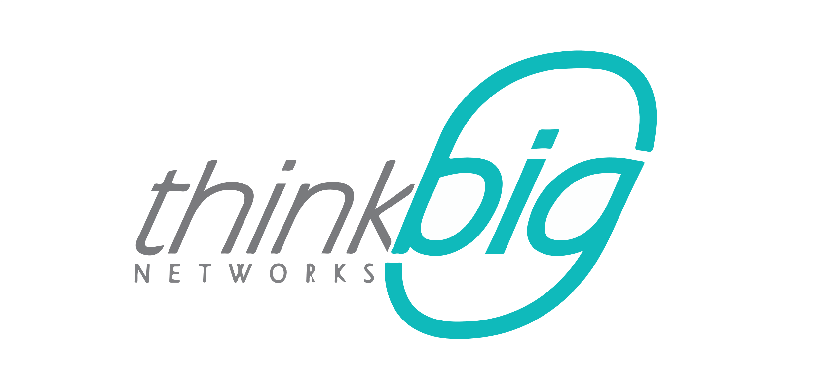
ThinkBig Networks is a leading Maryland-based internet service provider offering Gigabit Internet services over a pure fiber optic network.

Slide 6
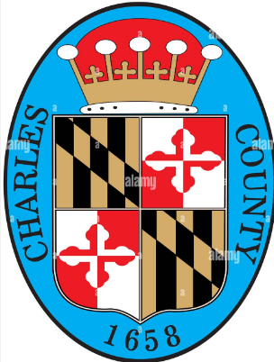
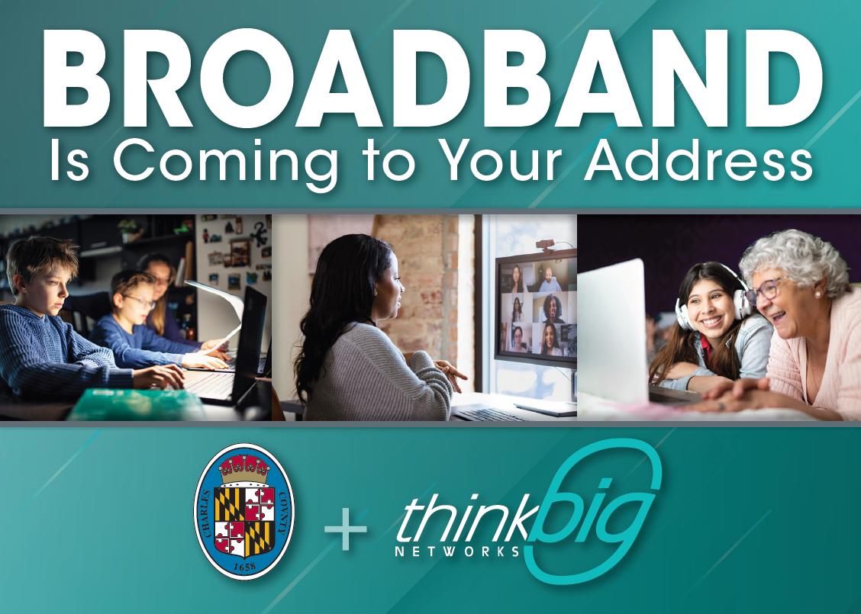

Slide 7
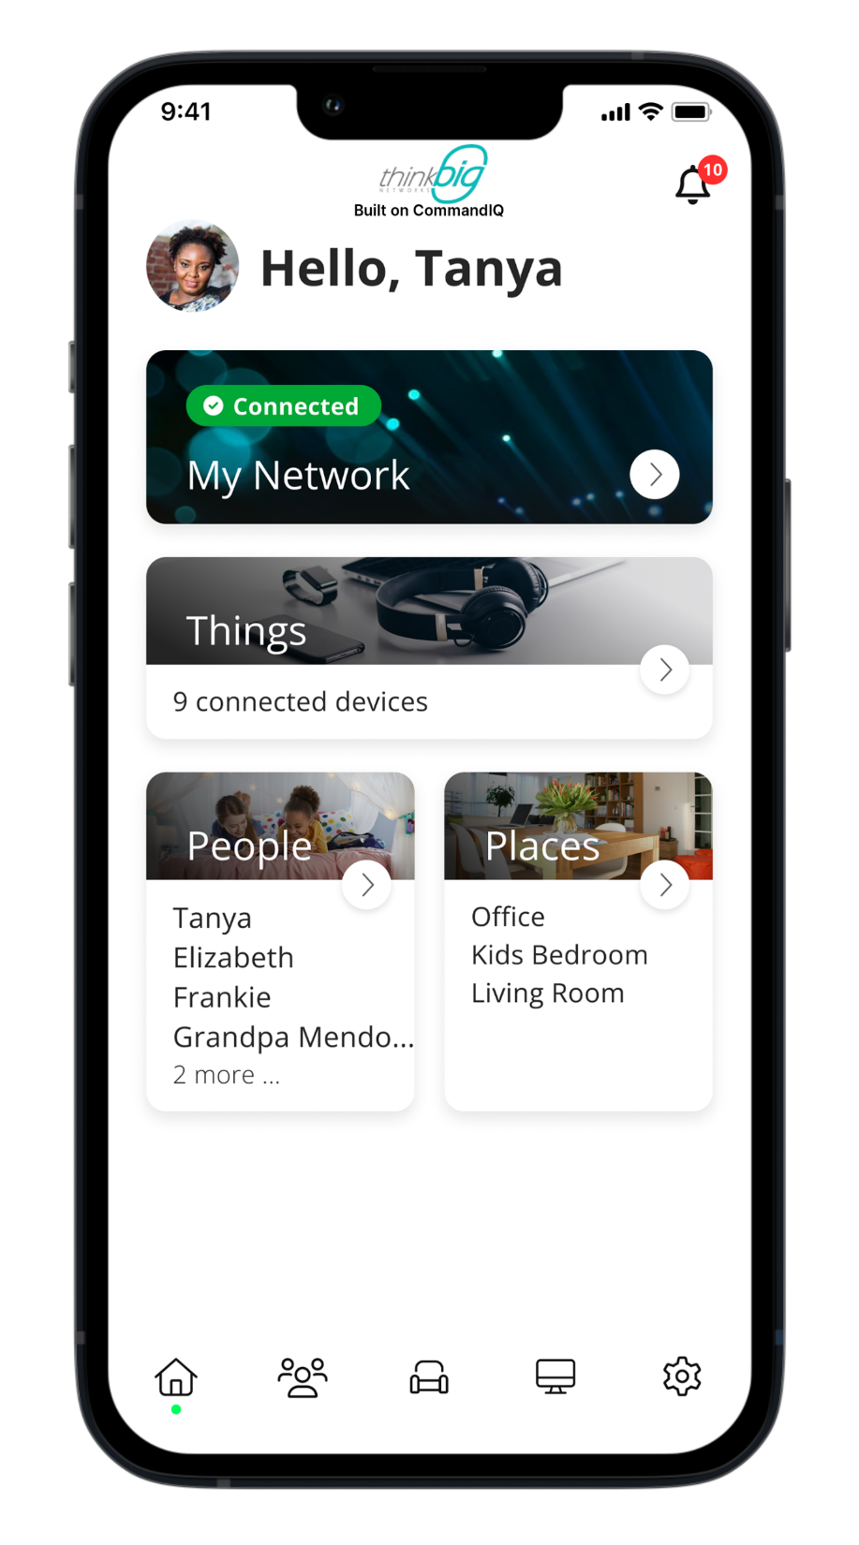

From nothing to Best in Class Broadband Service
Up to 1Gig of connectivity
State of the Art Wireless Connectivity
Fully integrated customer control over all devices
Future Proof total connectivity

Slide 8
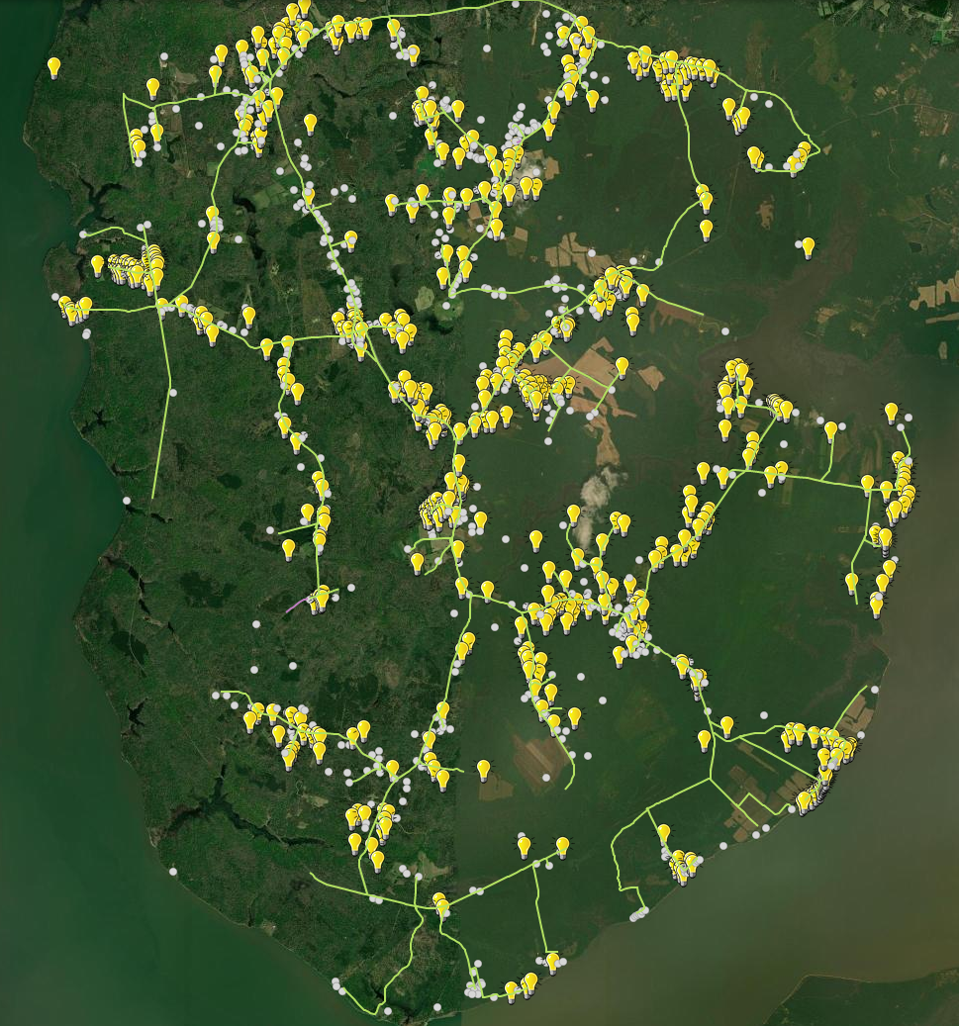
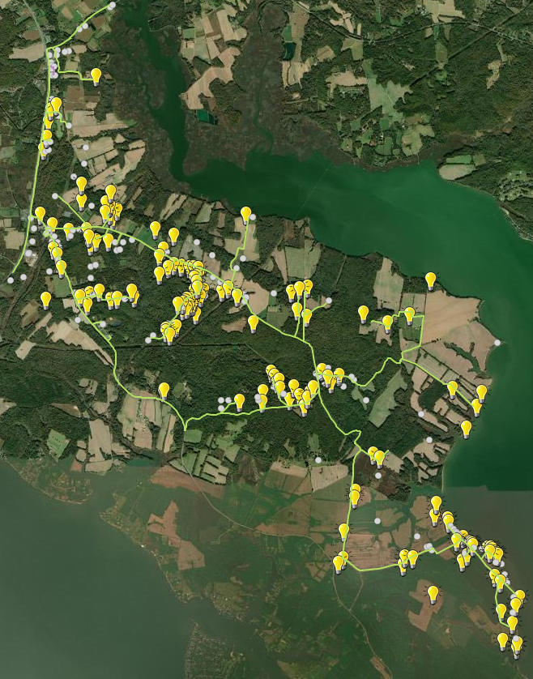
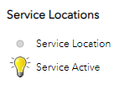
NCN Broadband Buildout
Only 10% over budget despite beginning pre Covid.
Over 300 private right of way easements obtained
1500 residents passed with a brand new state of the art fiber optic network
682 customers brought online already
105 in the que to be installed shortly
True Partnership with Charles County allowed for this successful and impactful project
Link to the County’s
Interactive Map

Slide 9
NCN Broadband Buildout Completed!
In early 2020, ThinkBig Networks, LLC received grants from MD State and Charles County to bring high-speed internet to two large Category 1 areas – Nanjemoy and parts of Cobb Neck.
We named this project the NCN Broadband Buildout.
The NCN Broadband network would be 100% FTTP (Fiber to the Premise)
The NCN Broadband Buildout project was planned to pass 1,408 locations - residences and businesses.
Passing a location means that the owner has the ability to sign up for broadband service
The project was completed in February 2024!

Slide 10
NCN Broadband Buildout Completed!
The budget for this project was:
County $2,598,802
MD State $2,924,083
ThinkBig $215,361
Actual costs for the project were:
County $2,598,802
MD State $2,924,083
ThinkBig $861,824

Slide 11
NCN Broadband Buildout Completed!
Project Challenges
COVID-19
Impacted purchasing required network components in the areas of cost and availability
Easement Issues
In the end, ThinkBig collected over 300 easements from private parties
ThinkBig hired an additional employee dedicated to obtaining easements
SMECO Utility Poles
Over the next few years, SMECO plans to replace some Nanjemoy poles; this caused ThinkBig to redesign some areas
The cost of going on poles was more than initially budgeted

Slide 12
NCN Broadband Buildout Completed!
The End Result
ThinkBig passed 1,500 premises
To date, 683 locations have received high-speed internet with several installations still to be completed
This number changes on a daily basis as ThinkBig connects more customers
Several County locations were also connected via the NCN Project
Friendship Landing Park, Nanjemoy Community Center, Nanjemoy Volunteer Fire Department, Mt Hope/Nanjemoy Elementary, Piccowaxen Middle School, Higdon Elementary School and Mallows Bay Park
We have a great partner in ThinkBig, which is excellent because they are also working on our North Nanjemoy build.

Slide 13
In Progress Nanjemoy North Broadband Buildout – Project Status
This project is adjacent to the Nanjemoy portion of the NCN Broadband Buildout and contains approximately 290 properties.
ThinkBig began construction in July 2023.
The project is scheduled to be completed by August 31, 2025.
This project was phased in a different manner, where Phase 1 contains roads that do not require an easement, and Phase 2 contains roads with properties that do require an easement.
The County encourages residents to grant ThinkBig an easement (where needed), so that ThinkBig may bury the broadband fiber underground.
To date, ThinkBig has connected 30 homes.

Slide 14
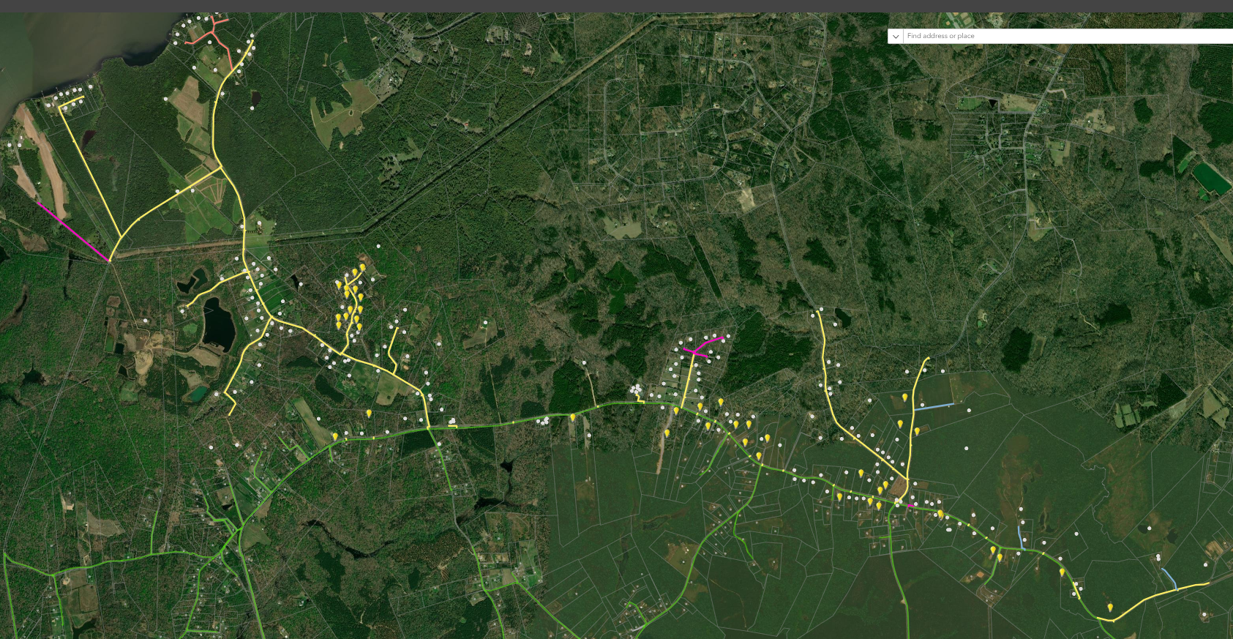
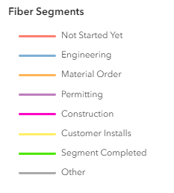
In Progress Nanjemoy North Broadband Buildout – Build Progress
Interactive Map

Slide 15
In Progress FY22 MD Infrastructure Grant Broadband Buildout – Comcast
Newburg/Charlotte Hall/Dentsville
In mid 2022, Comcast received grants from MD State and Charles County to bring broadband to Dentsville/Charlotte Hall (a category 1 area), Newburg (a category 2 and 3 area), as well as some additional homes in Hughesville.
The Comcast Broadband Buildout project is planned to pass 996 locations - residences and businesses.
The project is scheduled to be completed by August 31, 2025.
IT meets with the Comcast Project Manager on a weekly basis.

Slide 16
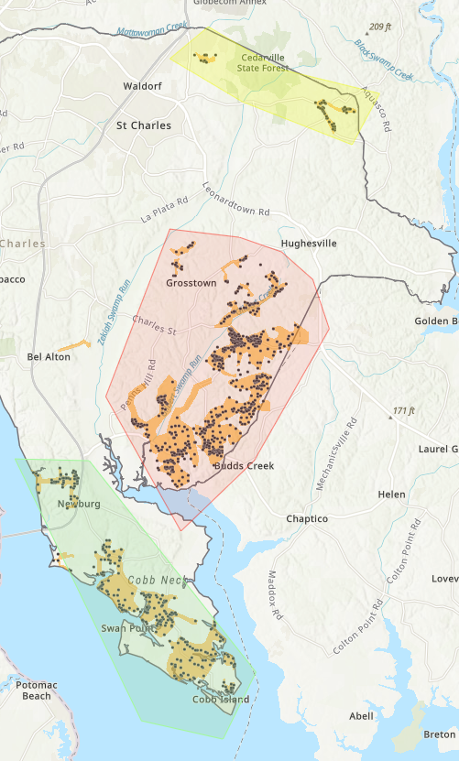
In Progress FY22 MD Infrastructure Grant Broadband Buildout - Comcast
Newburg/Charlotte Hall/Dentsville
Comcast has divided the project into clusters
Cluster 1 – Newburg/Cobb Neck (green)
Make-ready work for pole overlashing in progress
Working on cost estimates for new infrastructure on poles
Underground work is done
Hope to light some customers in Cluster 1 by June 2024
Cluster 2 – Dentsville (pink/purple)
Make-ready work for pole overlashing waiting for inspection
Much new infrastructure needs to be placed on poles
Underground work in progress
Cluster 3 – Hughesville (yellow)
Working on easements in all 3 clusters

Slide 17
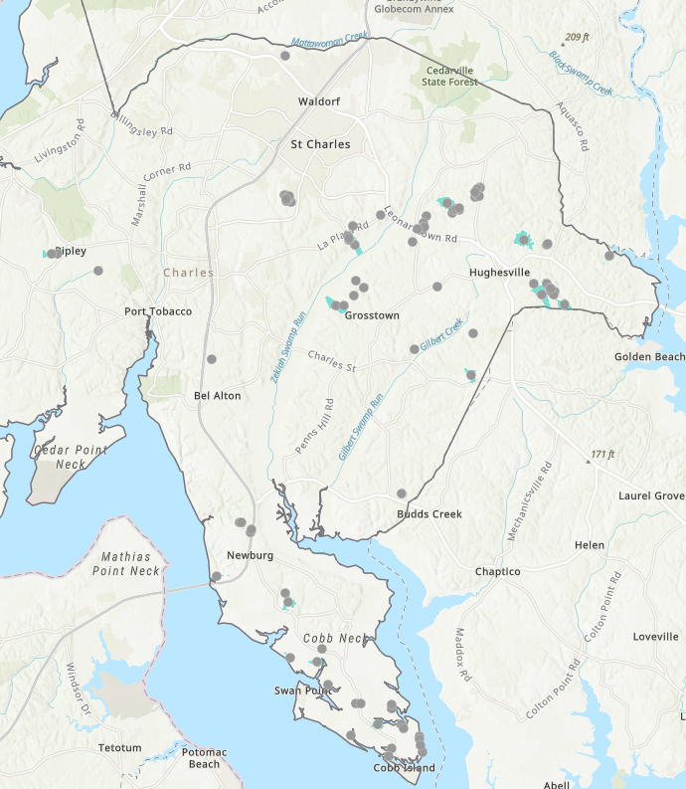
In Progress
FY23 Network Infrastructure Grant - Comcast
In mid 2023, Comcast received grants from MD State and the County to build out to approximately 92 homes.
Many of these homes are located in areas where Comcast already provides service or where Comcast plans to build under their FY22 Infrastructure Grant.
This project must be completed by August 2026.
All MOUs have been completed.
Comcast is currently walking the area; it is their plan to provide service to some of these homes when they build out under their FY22 Infrastructure Grant.

Slide 18
In Progress FY23 Infrastructure Grant Broadband Buildout – Verizon
In mid 2023, Verizon received grants from MD State and Charles County to bring broadband to various unserved areas and homes throughout the County.
The Verizon Broadband Buildout project is designed to pass 107 locations - residences and businesses.
The project is scheduled to be completed by August 31, 2026.
IT meets with the Verizon Project Build Team on a bi-weekly basis.

Slide 19
In Progress FY23 Infrastructure Grant Broadband Buildout – Verizon
Verizon has been focusing its efforts on equipment upgrades to their LaPlata, Hughesville, Indian Head, Bryans Road and Chapel Hill wire centers.
These are the wire centers which will support the build of this project.
They are currently working on the network construction and, as of March 2024, they had laid 12.8 miles of new fiber.

Slide 20
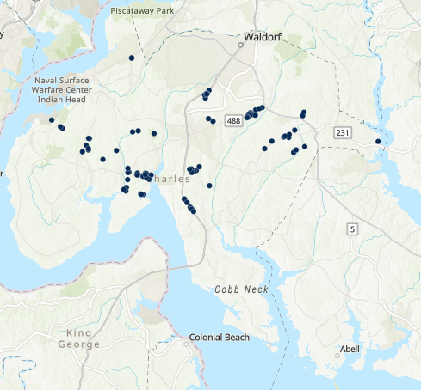
In Progress FY23 Infrastructure Grant Broadband Buildout – Verizon

Slide 21
In Progress LD–Cat3 Grant – Project Overview
County sponsored grant which will assist with funding the construction of service drops to connect homes at the end of long, private driveways to the existing broadband network on the road.
The program will run through December 31, 2024. The ISP shall determine the best construction method and location for the service drop (1 per household) installation.
Funding formula:
First $1000 paid by County
After $1000, County will pay 90% and resident will pay 10%
County will pay up to $15,000 in total
Hardship waiver – eligible residents will have their 10% contribution waived.

Slide 22
In Progress LD–Cat3 Grant - Providers
ThinkBig
Program is well underway
To date, 115 residents have received the County’s LD-Cat3 grant for an approximate total of $67,000
Comcast
Continue to work out details of agreement
ROW extensions
Verizon
Will work with us on an individual extension, if identified

Slide 23
In Progress Connect America Fund Grant (CAF) II Project - Overview
In 2018, the FCC opened up the CAFII Grant, and Verizon was awarded funding to build to a minimum number of properties in certain census blocks in Charles County.
Initial count of properties was 146 but that has been increased as some of the FY23 MD Infrastructure Grant properties (approximately 91) are located in the CAFII areas.
Project must be completed by the end of 2025.

Slide 24
In Progress Locating Broadband Needs
County staff continues work to identify homes which do not have access to high-speed internet.
This is not anywhere near as easy as it used to be!
When we identify a home that does not have service, we reach out to our existing providers to see if it can be included in a grant or can be reached by a long driveway extension.
We encourage residents who do not have access to high-speed internet to complete our Internet Service Questionnaire located at
https://www.charlescountymd.gov/our-county/rural-broadband-in-charles-county/internetaccess-questionnaire

Slide 25
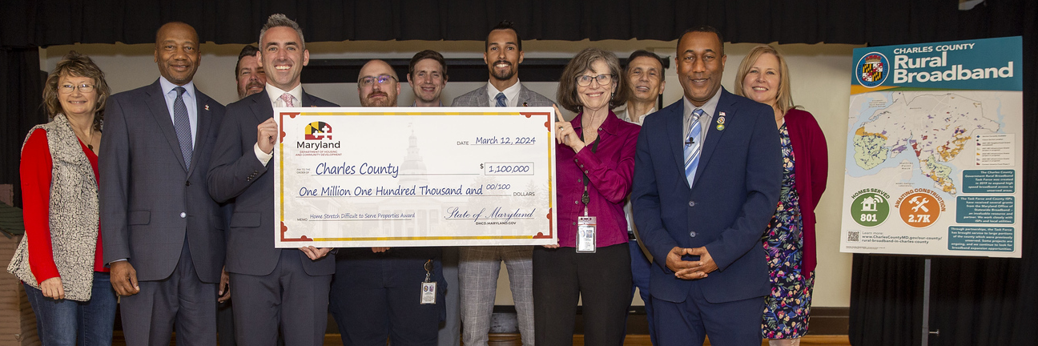
Upcoming Projects MD State FY24 Difficult to Serve Properties Grant
The County was recently awarded funding through the FY24 Difficult to Serve Properties Grant, which will assist with projects focused on bringing broadband to “difficult to serve” properties.
The grant will pay for up to 75% of the installation costs to bring service to an unserved location. The maximum grant amount per location is $8,000.

Slide 26
FCC Mapping Project
The FCC has undergone a multi-year effort to improve the accuracy of their broadband mapping.
The FCC collected address level data from broadband providers to generate an accurate map of service availability.
The new FCC map was released in November 2022 and the underlying data made available to service providers and government entities.
Charles County Government went through the application process to acquire this data.
This data will greatly help the Broadband Task Force’s efforts to identify remaining unserved locations in the County.

Slide 27

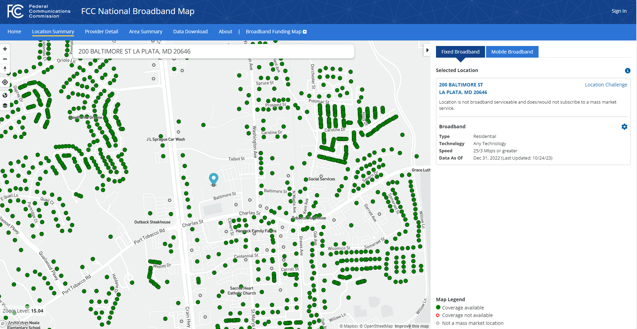

Slide 28
Upcoming Opportunities BEAD
The Broadband Equity, Access, and Deployment (“BEAD”) program provides federal funding​ to expand broadband access. The BEAD program will fund broadband planning, infrastructure deployment, and adoption programs.
Once final, the BEAD Plan will serve as Maryland’s State Plan establishing its commitments and strategy to support broadband projects over the next five years to close the digital divide in Maryland.
Information regarding the BEAD plan can be found at https://dhcd.maryland.gov/Broadband/Pages/StatePlans.aspx

Slide 29
Questions & Comments

Slide 30

Charles County Government
200 Baltimore Street • La Plata, MD • 301-645-0550
Equal Opportunity Employer
www.CharlesCountyMD.gov
About Charles County Government
The mission of Charles County Government is to provide our citizens the highest quality service possible in a timely, efficient and courteous manner. To achieve this goal, our government must be operated in an open and accessible atmosphere, be based on comprehensive long- and short-term planning and have an appropriate managerial organization tempered by fiscal responsibility. We support and encourage efforts to grow a diverse workplace. Charles County is a place where all people thrive and businesses grow and prosper; where the preservation of our heritage and environment is paramount; where government services to its citizens are provided at the highest level of excellence; and where the quality of life is the best in the nation.
It is the policy of Charles County to provide equal employment opportunity to all persons regardless of race, color, sex, age, national origin, religious or political affiliation or opinion, disability, marital status, sexual orientation, genetic information, gender identity or expression, or any other status protected by law.

