Slide 1

Welcome
Please read over all the information provided. Any questions or concerns you may have can be directed to Jessie Settle, Roads Program Administrator, at 301-932-3467 or SettleJ@charlescountymd.gov
Route sheets will be sent to you once completed.
Note: Bobcats, and loaders do not receive routes.

Slide 2

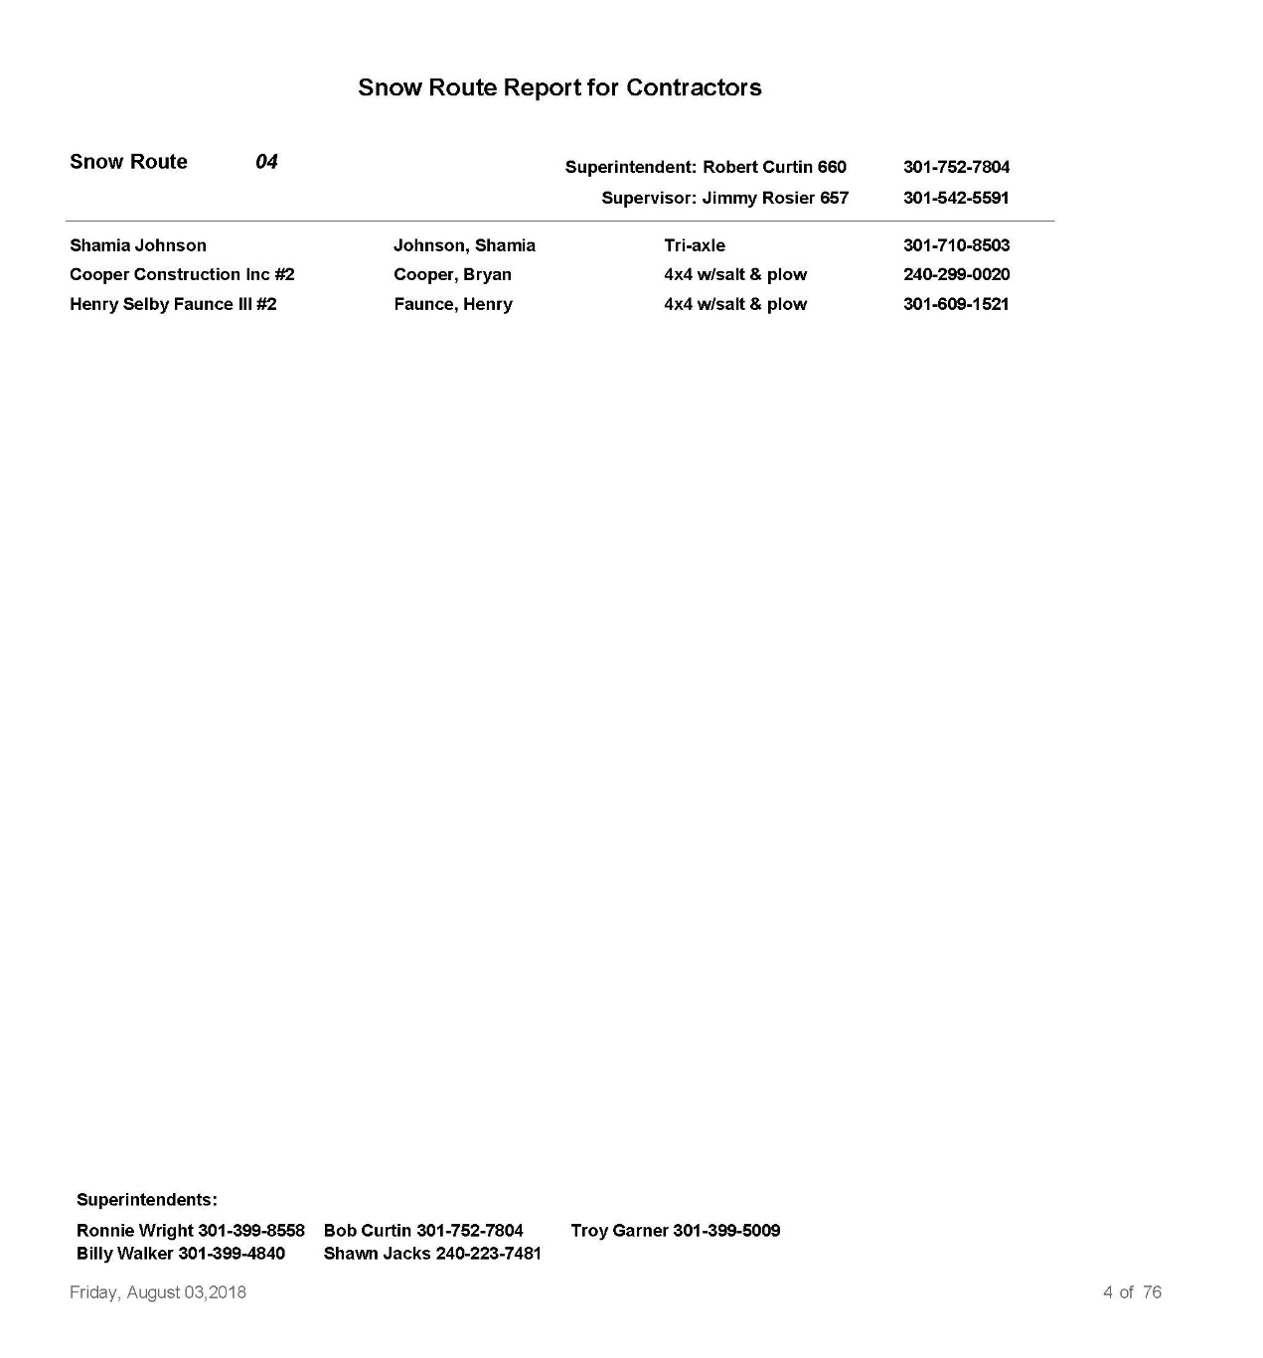
Route Sheets

Slide 3
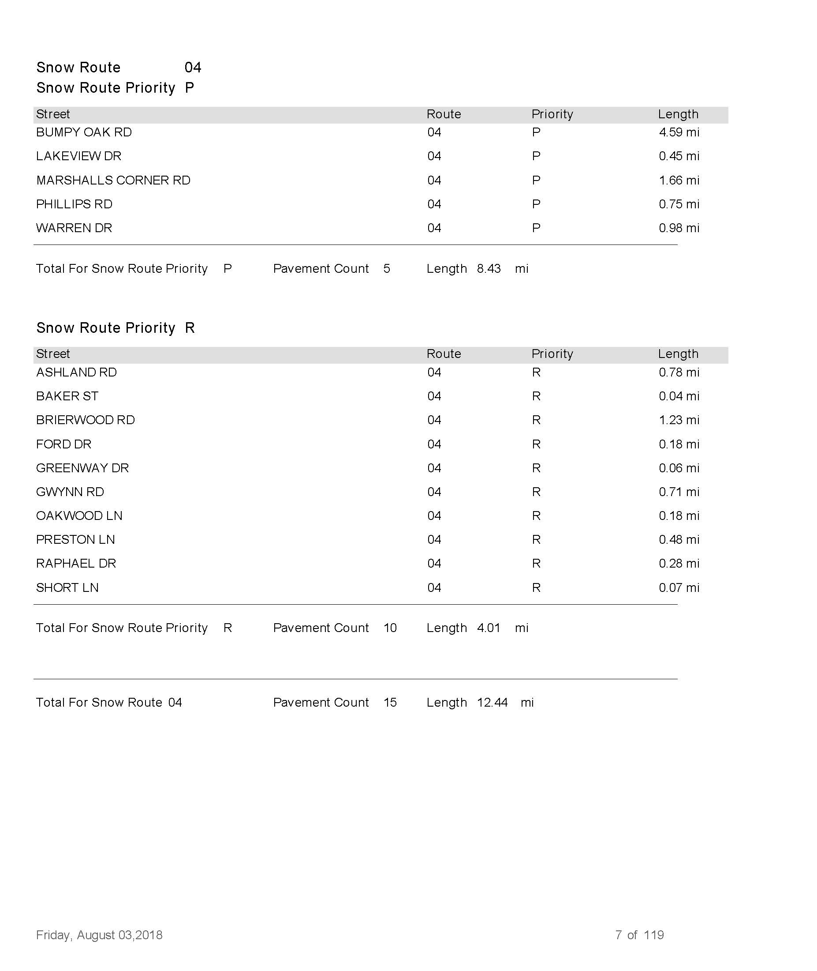

Slide 4
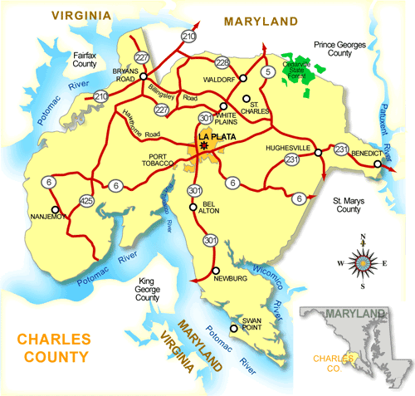
Maps and/or GPS
Check your route before it snows for obstructions (tree limbs, manhole risers, potholes, etc.) If you see an obstruction, please notify Public Works
All snowplow drivers must know their routes before a snow event, or have one of the following:
GPS
Map book

Slide 5
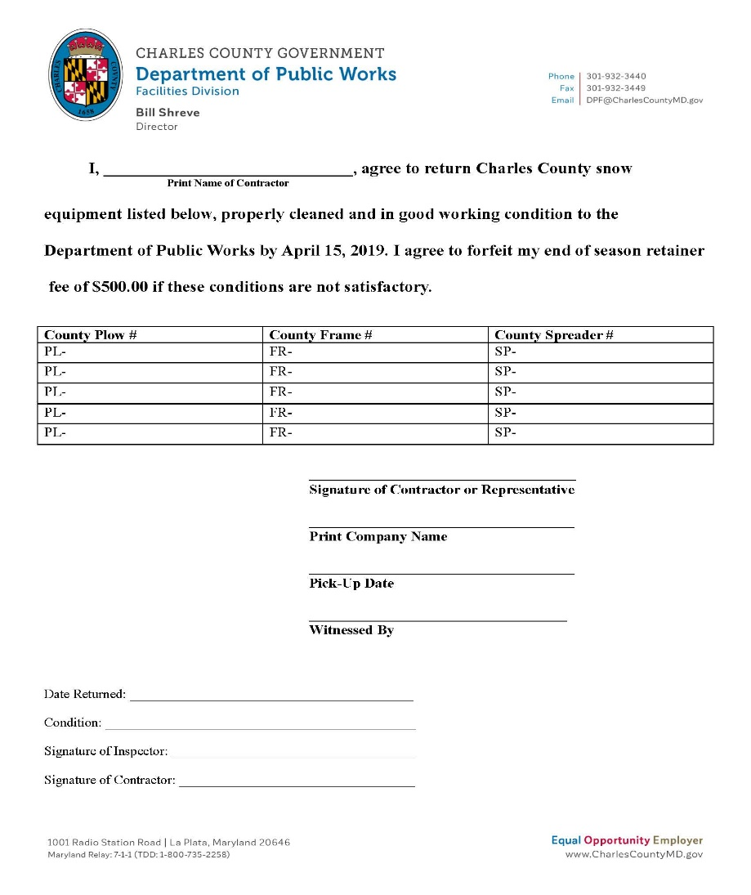
County Equipment Pickup & Returns
All county equipment must be picked up by November 12th
All county equipment must be returned by April 14th unless told otherwise
Please make sure you call or email roads staff for pickups and returns. You will be turned away, if you show up without an appointment. If you can’t get through by phone, please email Jessie Settle at SettleJ@charlescountymd.gov
If the county equipment needs to be repaired, please notify roads staff or the shop before returning the equipment

Slide 6

INSPECTIONS
All new contractors or returning contractors who are adding new equipment are required to pass inspection.
Returning contractors with equipment that previously passed inspection are exempt from re-inspection.
All vehicles & equipment must be in working order and prepared for emergency operations before showing up for a storm.
Make sure all equipment is on the truck for inspection. This includes the beacon light.

Slide 7
Scheduling Inspection and Equipment Pickup
Monday - Friday
Monday – Friday 7:00 am – 2:30 pm (Lunch 12:00 pm – 12:30 pm)
Weekend hours
Saturday November 3rd and Sunday November 4th from 7:00 am – 4:00 pm (Lunch 12:00 pm – 12:30 pm)
Saturday November 10th and Sunday November 11th from 7:00 am – 4:00 pm (Lunch 12:00 pm – 12:30 pm)
Weekday Hours
Monday – Friday 7:00 am – 2:00 pm Appointments Required
Weekend Hours
Saturday, October 28th from 7:00 am – 12:00 pm Appointments Required

Slide 8
Contractor Equipment Basic Guidelines
Single Axle
GVW Min. 26,000
Load capacity Approx. 8 tons/5yd min
Tandem Axle
GVW Min. 55,000
Load capacity approx. 15 tons/10 yd min
Triaxle Axle
GVW Min 70,000
Load capacity approx. 22 tons/15 yd min
4 Wheel Drive Trucks
¾- two ton pick up style trucks/ includes dual wheel “dually”
Tractors
No tractors lower than 50 hp
See section F of the contract for all guidelines.
NO tailgate spreaders
Tractors must have snowplows not buckets

Slide 9
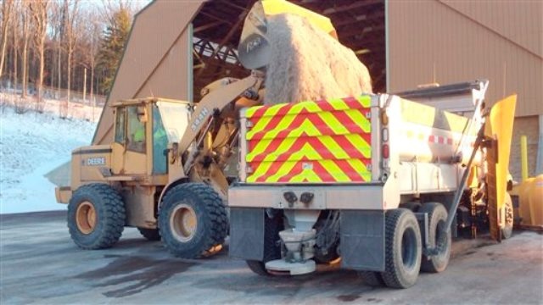
Salt
Only use salt when told to do so by your supervisor
Make sure your salt box is calibrated
Report salt spills immediately
Return all salt to DPW Yard (La Plata Shop)
You will need a sticker in order to receive salt
County trucks will be loaded first
All first-round salt will be loaded at either the La Plata Shop or White Plains (Demarr Rd).
4x4 Trucks - White Plains
Six and ten wheelers - La Plata Shop

Slide 10
Salt Domes
La Plata Shop
1001 Radio Station Road La Plata, Md. 20646
Demarr Rd
10791 Demarr Rd Salt Barn Place La Plata, Md. 20646
Breeze Farms
15950 Cobb Island Rd Cobb Island Md. 20625
Pisgah
Pisgah Park Pl /Landfill Rd

Slide 11
Call Outs
You will receive a phone call and/or text message informing you of the time, date, and location to get loaded.
Reply back to phone call and/or txt
Show up on-time with all equipment in working condition
Get in line for salt(4x4 Demarr Rd, 6 & 10 whlrs La Plata Shop)
Call your supervisor to check in and receive location to meet

Slide 12

A Public Works Staff member will be walking the salt line to sign you in.
Once sign-in contact your Supervisor. (if they don’t answer leave a message)
Supervisor will inform you on where to meet which will be the same location for the year, unless told other wise or truck moved to a different route.
MOST IMPORTANT- Stay in contact with your Supervisor at all times. If they don’t answer leave a message and if you don’t hear back within 15 mins then call the Superintendent (located on route sheet) or the main office.
A Public Works staff member will be walking the salt line to sign you in
Once signed in contact your supervisor (if they don’t answer leave a message)
Supervisor will inform you on where to meet, which will be the same location for the year, unless told otherwise or your truck is moved to a different route
MOST IMPORTANT- Stay in contact with your supervisor at all times. If they don’t answer leave a message, if you don’t hear back within 15 minutes call the superintendent (located on route sheet), or the main office.

Slide 13

Please report mailbox or vehicle damages to your supervisor ASAP
If you break down notify your supervisor
Contractors with multiple vehicles will need to number each one, per the number on the route sheet
Contractors are prohibited from using County equipment for any business that is not County related
Only plow the roads located on your route sheet

Slide 14

Billing
You, as the Contractor, are responsible for submitting an invoice for payment. You may only use a county invoice
Do not call or visit the Government Building for your check
All checks will be mailed unless you sign up for direct deposit
Once invoices are received you will receive payment within three to four weeks
Supervisors will let you know the snowstorm number
Invoices can be mailed, faxed, dropped off, or emailed. Please only submit once
There is a drop off box located outside the main building for after hours

Slide 15
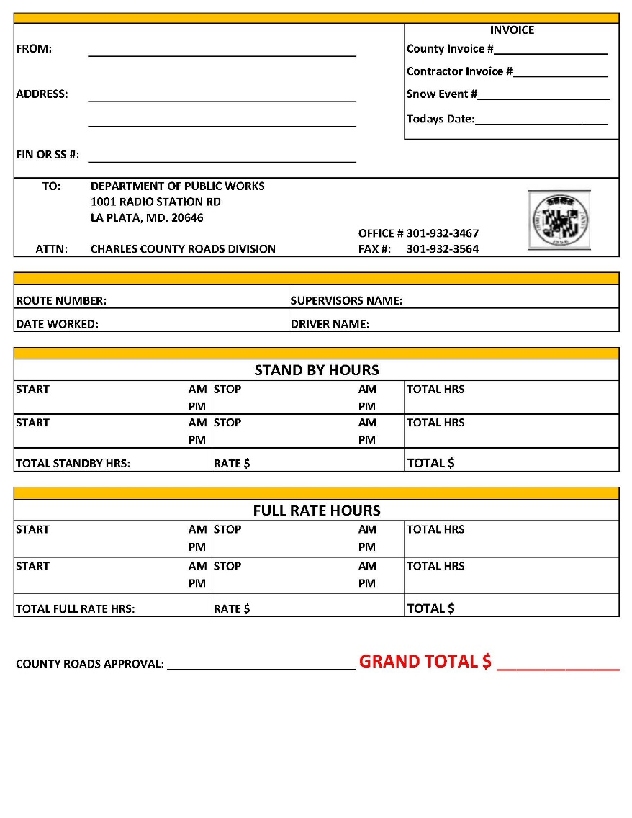
Invoices
Snowstorm Invoices
Please submit a county invoice within 5 working days from the completion of the call out
One invoice per day, per vehicle
Confirm all invoices with your supervisor once the storm has ended
Retainer Fee Invoice
It’s the Contractor’s responsibility
to submit an invoice to Public Works after April 15^{th.}

Slide 16
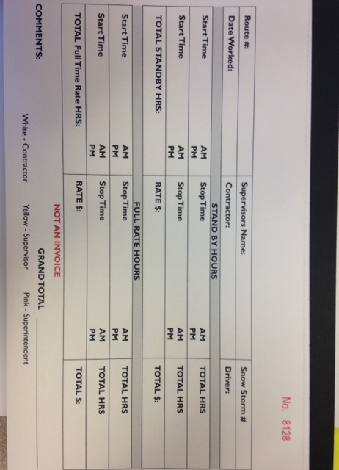

Slide 17
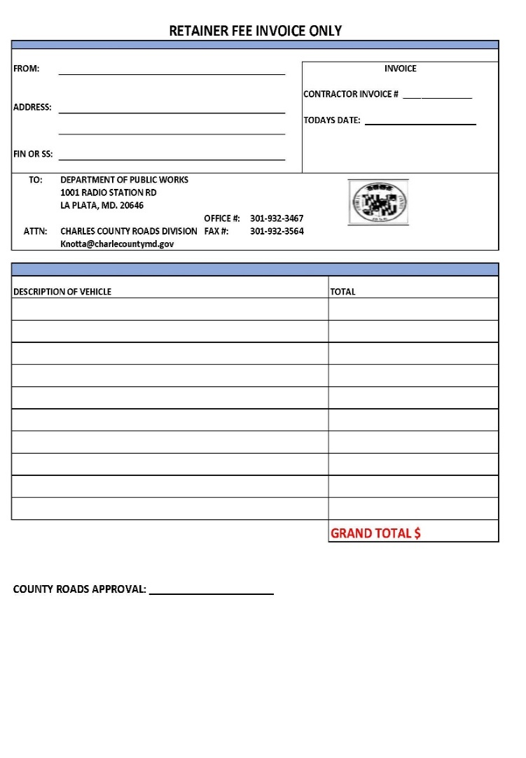
End of Season Retainer Fee
Only single, tandem, tri-axle, and/or tractors can receive the retainer fee
All vehicles must have a snow route or have been called out during the snow season to obtain the retainer fee
All county equipment must be picked up before Nov 12th and returned before April 14th
All county equipment must be returned clean and free of salt/dirt
All plow pins must be returned with plows
Please see Section D of the contract for all performance measures.

Slide 18
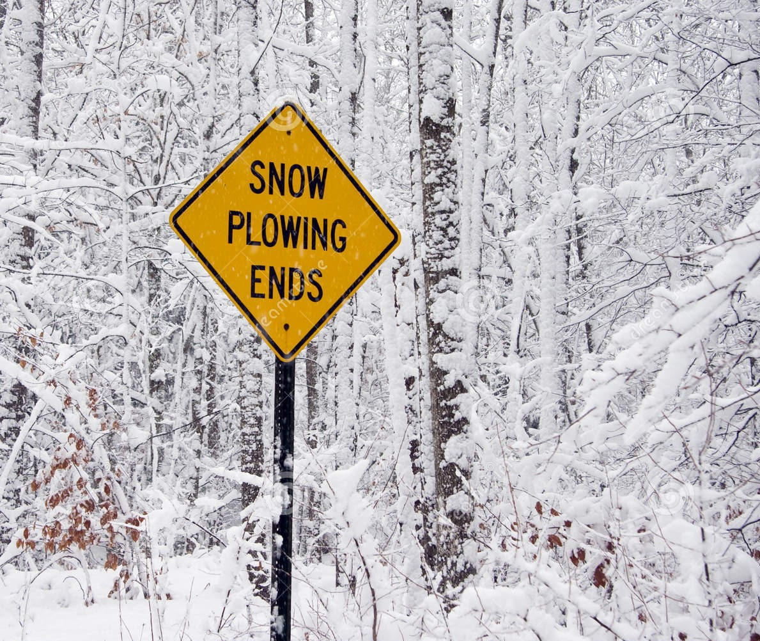

Slide 19
Roads Main # 301-932-3450
Jessie’s Desk # 301-932-3467
Snow Hotline #: 1-888-460- SNOW
Fax #: 301-932-3564
Jessie’s Email: SettleJ@charlescountymd.gov
County Website: www.Charlescountymd.gov

