Slide 1
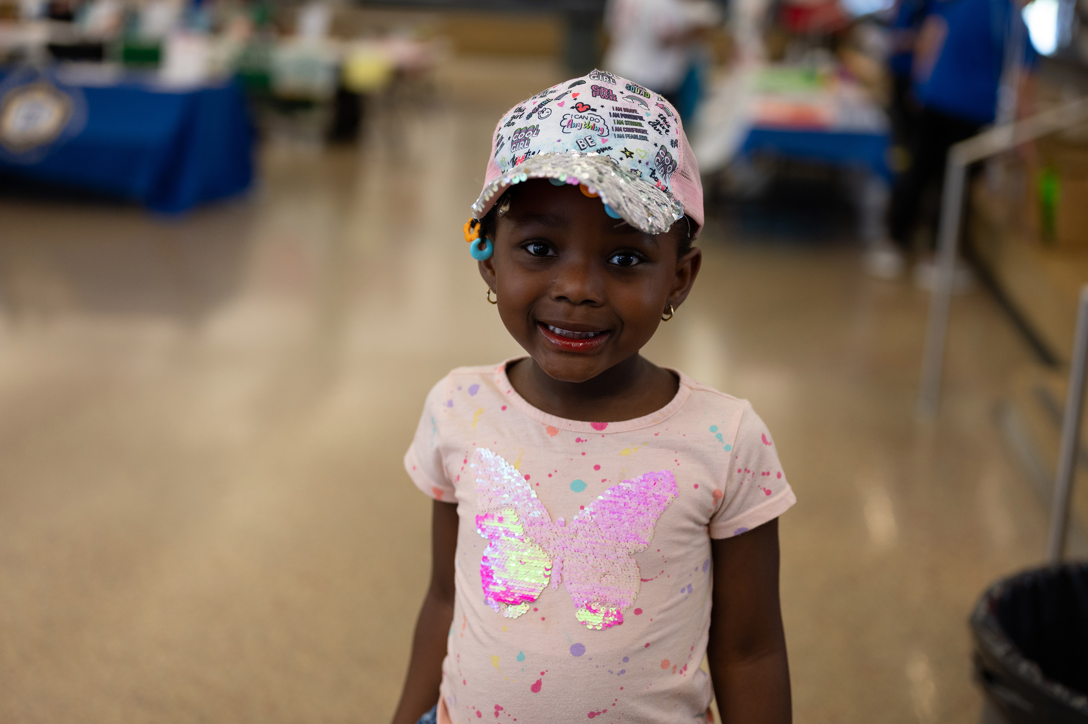

Charles County Maryland
Community Plan for Children, Youth and Families
2023-2026
Prepared by Due East for CCACCYF

Slide 2

A Message from Leadership
Charles County is a wonderful place to raise a family. We also have many children and families who are struggling, living a paycheck away from poverty. Many of our families make too much to qualify for public assistance, but can barely make ends meet after paying rent, groceries, gas and childcare. We know other families face additional barriers when accessing services and are committed to addressing those inequities.
As you will see in the data that follows, economic instability often results in adverse outcomes for children and youth as well as intergenerational poverty for many of our families. We are working with residents, partners, and other child-serving agencies to create a better future where all communities are safe and all families have equitable opportunities to learn, grow and thrive in Charles County.
Over the next three years, our Local Management Board and staff, along with our partners, will focus on three priorities:
Build community connection throughout the County
Increase collaboration, innovation, and accountability among our partners
Improve quality, awareness, and equitable access to resources
For a big picture view of how we will make lasting change happen, see page 11.
By working together, we will improve the well-being of all children, youth, and families in Charles County . We hope you will join us in making Charles County an even better place to live, grow up and raise a family, for today’s residents and generations to come.
Laura Gustafson, LMSW, Local Management Board Coordinator
“Our Charles County Local Management Board is vital in providing resources and support to families in our community, as well as filling gaps in services to provide equitable opportunities for all families. This Community Plan captures a snapshot of their current and future efforts, and I encourage you to take a look to learn more about the impactful work they are doing.”
– Mark Belton, County Administrator

Slide 3
Meet Your Local Management Board
The Local Management Board is made up of child-serving agencies, community partners, and local leaders including:
Chair: Thomas McKeithan II, Consumer Representative/Stakeholder
Vice Chair: Lt. Bill Welch, Charles County Sheriff's Office
Elizabeth Phipps, Charles County Government Representative
Melanie Wegand, Local Behavioral Health Authority
Danielle Grimmett, Charles County Department of Juvenile Services
Kathy Kiessling, Charles County Public Schools
Lolita Gleaton, Charles County Department of Social Services
Corae Young, LifeStyles of Maryland, Inc.
Patty Stine, Pure Play Every Day
Greg Holtz, Tri-County Council for Southern Maryland
Staff
Laura Gustafson, LMSW, LMB Coordinator
Sapreen Khalaifeh, LMB Specialist
Fredina James Local Care Team Convenor
The Charles County Advocacy Council for Children, Youth, and Families is the Local Management Board (LMB) for our community, one of 24 LMBs in Maryland responsible for assessing and addressing the needs of children, youth, and families locally. Our mission is to coordinate and fund responsive, accessible, and supportive resources that improve the quality of life for children, youth, and families.
How we carry out our mission is just as important as what we do. We believe in:
Equitable opportunities for families to thrive
Person-centered approaches that meet people where they are
Collaborating across agencies and sectors
Decision-making that is informed by qualitative and quantitative data

Slide 4
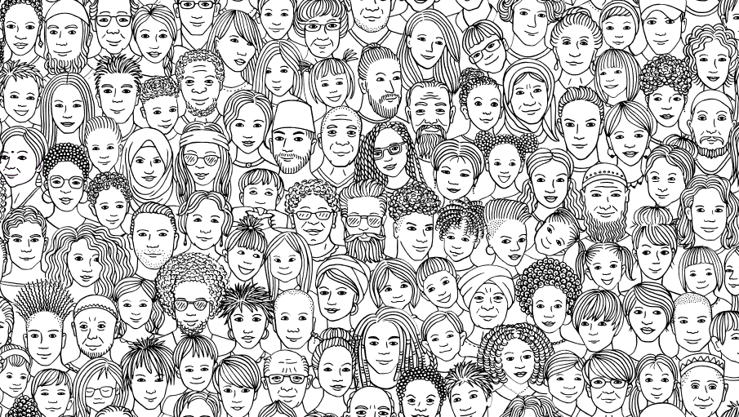
About this Plan
3
Community Planning Sessions with participation from:
Catherine Foundation Pregnancy Resource Center
Center for Children
Charles County Department of Juvenile Services
Charles County Recreation Division
Charles County Department of Social Services
Charles County Family Daycare Association
Charles County Government – Community Engagement Coordinator
Charles County Judy Center
Charles County Public Library
Charles County Public Schools –
Early Intervention Coordinator
Mental Health Coordinator
Specialist in Early Childhood
Charles County Sheriff's Office –Teen Court
LifeStyles of Maryland Inc.
Local Behavioral Health Authority
Local Management Board Consumer Representative
Maryland Coalition of Families
Maryland State Department of Education – Division of Early Childhood
Parents’ Place of Maryland
Pure Play Every Day
Stella’s Girls
The Accessibility Bridge Corporation
The Promise Resource Center
Tri County Council for Southern Maryland
Two Home-Based Child Care Providers
Participant Engagement
This Community Plan for Children, Youth, and Families draws on data from the Charles County Sheriff's Office, Public School System, Department of Juvenile Services, LifeStyles of Maryland, Kindergarten Readiness Data, Maryland State Department of Education, and other county resources and needs assessments to lay out an actionable plan for collective impact that ensures communities are safe and all families have equitable opportunities to learn, grow, and thrive in Charles County. We are grateful to our Board, partners, and community stakeholders who helped to inform and shape this plan through a series of interviews, community planning sessions, focus groups, and surveys.
The complete list of stakeholder and community engagement includes:
5
Interviews
1
Internal Community Survey
2
Focus Groups with 9 parents and caregivers representing families who have various aged children, children with disabilities, and are from different parts of the County
1
External Community Survey
Beyond those listed here, we are grateful to the residents and community leaders who helped shape this plan by attending our information gathering sessions including our annual Resource Fair to identify ways we can better serve and support children, youth, and families.

Slide 5
Charles County By the Numbers
We are a diverse community.
Population of Charles County
BY AGE
Population of Charles County
BY RACE/ETHNICITY
*Less than 1% of residents identified as Native Hawaiian/Pacific Islander
“We need more inclusive representation for people with disabilities and those who do not speak English and greater accessibility of resources available to them.”
– Focus Group Participant

Slide 6
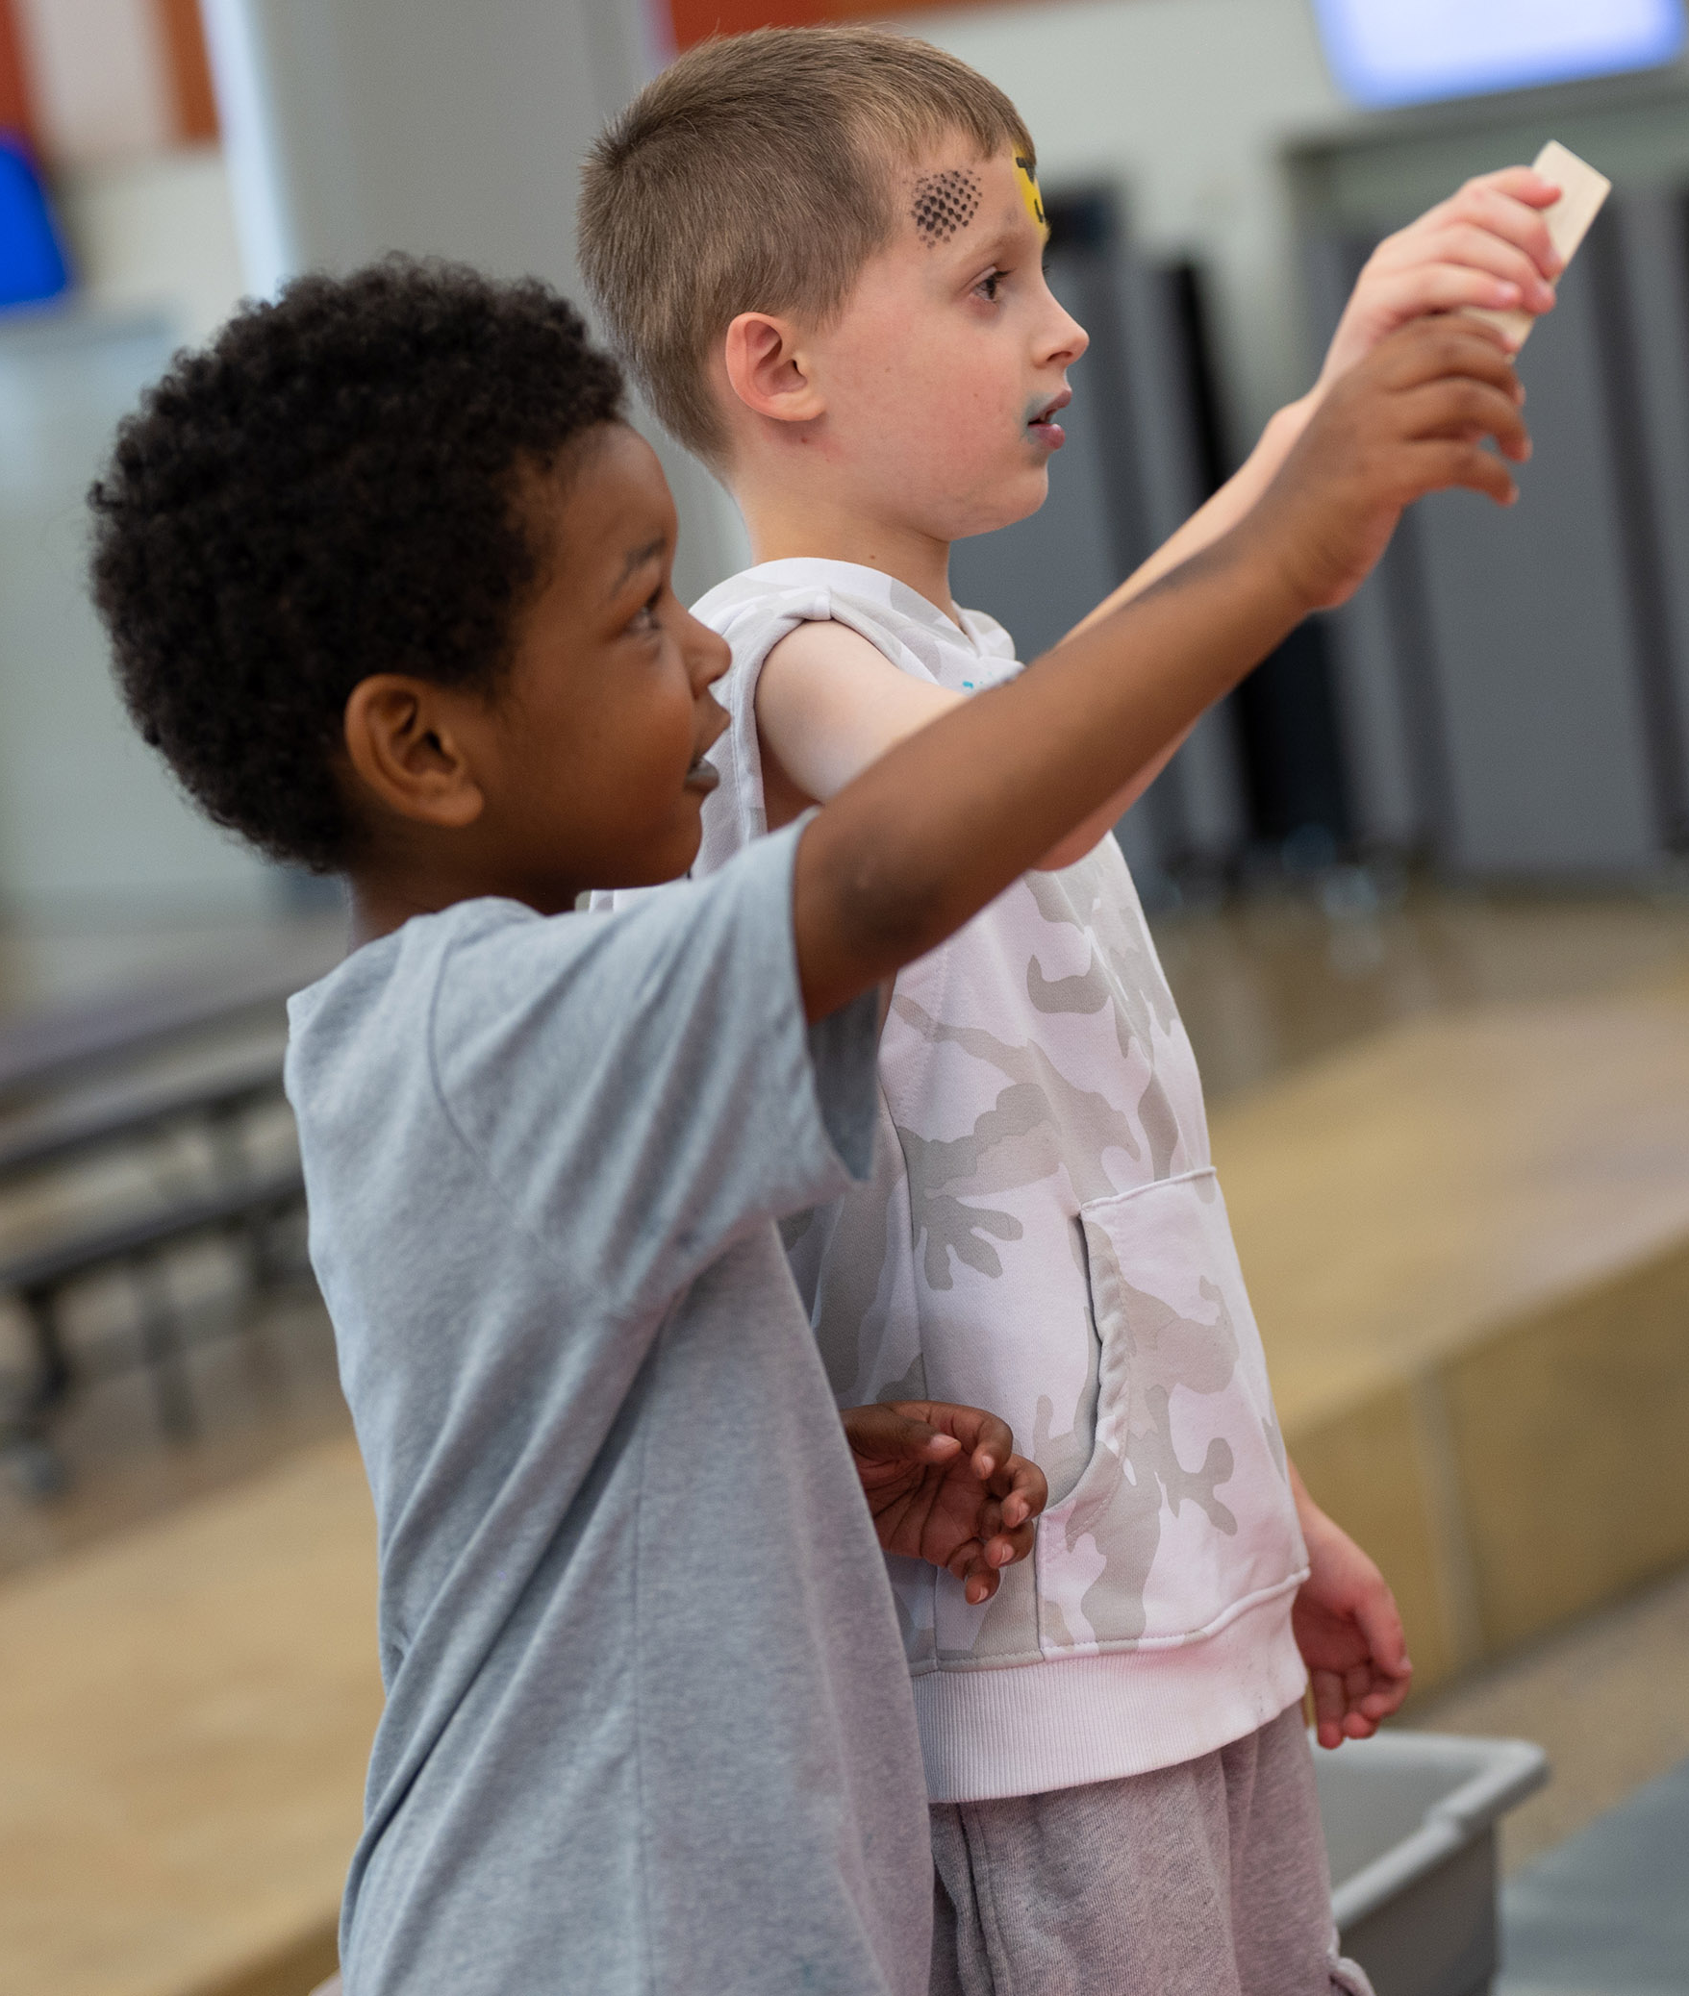
Charles County By the Numbers
All of our children deserve a healthy start.
17%
17%
17%
15%
15%
10%
15%
8%
10%
13%
12%
12%
BY RACE
68%
69%
…and nutritious food and exercise to fuel healthy growth and development.
61%
60%
45%
¹ Maternal and Infant Health Profile 2018; ² Charles County, CHNA 2021; ³ Youth Behavior Risk Survey 2019

Slide 7
Charles County By the Numbers (all data is reflective of Charles County)
42%
37%
38%
37%
38%
All children need reliable access to food, health care, and safe and secure housing to thrive.
Low-income families and many middle-income families struggle to find affordable housing in Charles County, leaving little money left for food, childcare, doctors’ visits, transportation, and other essentials.
10%
10%
9%
9%
7%
759
713
800
164
521
607
649
$90,520
$109,680
106
136
$60,520
$61,920
$70,600
91
93
^{4,5} National Low Income Housing Coalition 2021; ⁶ Maryland State Department of Education Report Card for Charles County 2021; ⁷ Census Bureau, American Community Survey 2020; ⁸ Charles County Public School System 2022

Slide 8
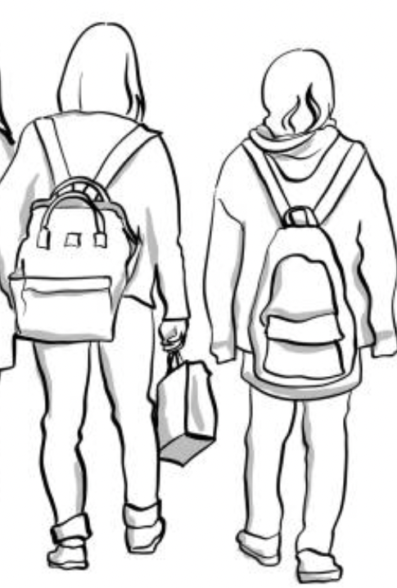
Charles County By the Numbers
The gap widens during elementary and middle school years as children and youth start to miss school, struggle with mental health and get into trouble with the law.
When families struggle to make ends meet, paying for quality childcare is often out of reach.
Too many of our children are not ready for school when they reach kindergarten. Children of color, those with disabilities, and English language learners start the farthest behind.
Chronic Absenteeism in Charles County¹¹
16%
18%
14%
14%
15%
Kindergartners Demonstrating Readiness¹⁰
BY SUBGROUP
44%
42%
42%
46%
39%
50%
48%
53%
52%
Students Who Felt Sad or Hopeless¹² (almost every day for >+2 weeks in a row so that they stopped doing some usual activities)
47%
43%
44%
45%
47%
13%
11%
15%
20%
17%
37%
36%
39%
39%
41%
32%
31%
35%
27%
25%
41%
39%
41%
45%
37%
14%
14%
*
* *
4%
■ 2016-2017 ■ 2017-2018 ■ 2018-2019 ■ 2019-2020 ■ 2021-2022
2014
2016
2018
* School Year 2017-2018 did not have date for Asian children entering Kindergarten
* School Year 2016-2017 & 2017-2018 did not have data for English Language Learners
^{9,10} Kindergarten Readiness Assessment 2017-2022; ¹¹ Maryland State Department of Education Report Card Report 2017-2021; ¹² Youth Behavior Risk Survey 2014-2018

Slide 9
Charles County By the Numbers
Juvenile crime starts in elementary school and peaks during middle school, showing the importance of reaching children and families much earlier.
99
2021 Number of Juvenile Offenses¹³
BY AGE
82
68
22
19
16
12
0
1
7
0-3
4-7
8-11
12-15
16-18
“Kids need more safe places to socialize and connect outside of school.”
– Focus Group Participant
¹³ Charles County Sheriff's Office 2021; ¹⁴ Data represents the locations where arrests were made. For many, it is their city of residence, but it may not be for all.

Slide 10

Charles County By the Numbers
The cycle often carries forward into the next generation, when youth become young parents before they’ve been able to complete high school or college and secure a job that pays a living wage. This cycle of poverty limits the futures of whole communities and multiple generations of families impacted by these inequities.
Research indicates that student engagement impacts attendance and positive outcomes. According to a 2019 Gallup, Inc. study, student engagement resulted in a 26% higher rate of students meeting or exceeding progress in all subjects. In Charles County, four-year graduation rates rose from 93.53% in 2020 to 93.58% for 2021, 5% higher than the statewide average (Maryland State Department of Education Report Card).
95
97
93
95
82
80
85
70
65
15%
15%
15%
14%
■ Black/African American ■ Hispanic/Latino ■ White ■ Students with Disabilities ■ English Learners
“Connecting with existing community networks and groups is critical. They can help bridge the gap.”
– Focus Group Participant
¹⁵ Maryland State Department of Education Report Card 2017-2018 & 2018-2019; ¹⁶ Opportunity Index 2019

Slide 11
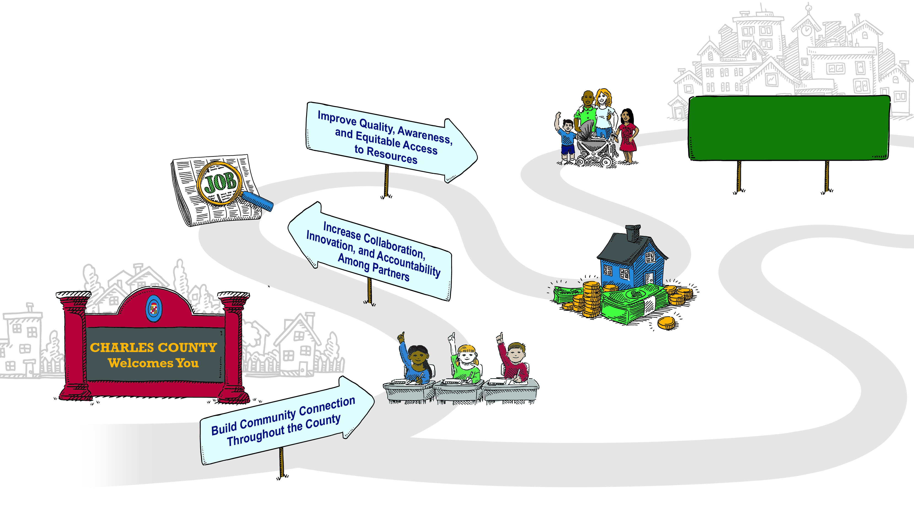
Theory of Change
Communities are safe for children, youth, and families
Communities are safe and all families have equitable opportunities to learn, grow, and thrive in Charles County
Youth have opportunities for employment or career readiness
Households are economically stable
Children enter school ready to learn

Slide 12
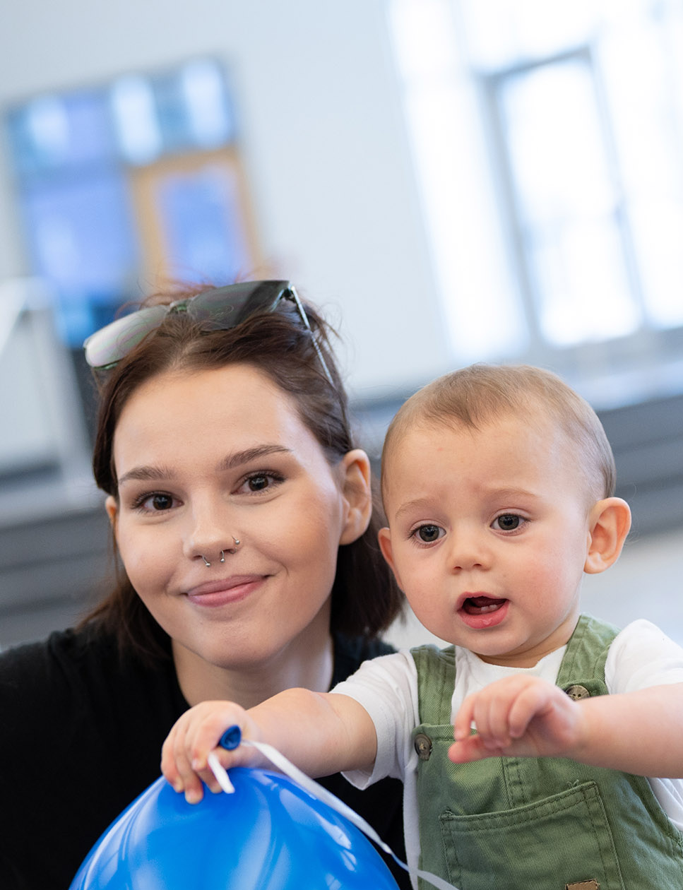
Strategic Roadmap 2023-2026
VISION:
Communities are safe and all families have equitable opportunities to learn, grow, and thrive in Charles County
MISSION:
To coordinate and fund responsive, accessible, and supportive resources that improve the quality of life for children, youth, and families
We Believe in:
Equitable opportunities for families to thrive
Person-centered approaches that meet people where they are
Collaborating across agencies and sectors
Decision making informed by qualitative and quantitative data
PRIORITY ONE
PRIORITY TWO
PRIORITY THREE
Build Community Connection Throughout the County
Strategies
Develop relationships with existing parent/caregiver networks and groups
Promote more positive community and family success stories
Host quarterly meetings and events to engage families in peer learning, community discussions, and recreation
Support opportunities for youth and young adults to build trusted relationships outside of school
Engage youth and parents/caregivers in program design and development to support their goals
Increase Collaboration, Innovation, and Accountability Among Partners
Strategies
Develop communication channels to improve coordination among people and partners who support children, youth, and families
Convene agencies quarterly for information and knowledge sharing
Offer ongoing trainings and cultural reinforcement to providers and public service members (Trauma Informed and Restorative Care, Cultural Competency, supporting children with disabilities, etc)
Target funding to fill gaps and support innovative programs
Continue to grow network and quality of providers and services
Track and publicly share provider impact data
Improve Quality, Awareness, and Equitable Access to Resources
Strategies
Create feedback loops for youth and families to share needs, gaps, and opportunities
Conduct equity audit of current distribution of funding and services to increase representation in service delivery
Support bi-lingual and culturally competent resources and service delivery
Partner with other agencies to provide navigation for services
Invest in mobile resources to meet people in their communities
Use texting and social media to promote services and resources
RESULTS
1
2
3
4
Children enter school ready to learn
% increase in overall readiness as shown by KRA
# of 3-4 year olds enrolled in Infants and Toddlers
Youth have opportunities for employment or career readiness
% of youth not in school and not working (age 16-24)
Four year cohort graduation rate
Households are economically stable
% of total CCPS enrollment eligible for free and reduced meals
% increase in ALICE families in Charles County
% of families paying more than 30% of income towards housing
Communities are safe for children, youth, and families
Violent crimes per 100,000
% of juvenile offense reports created compared to 5-18 year old census

